Slide 1
Transforming streets with TU
Case studies from Chennai, Pune and Ranchi in India
Your Own ITDP PowerPoint Template

Slide 2
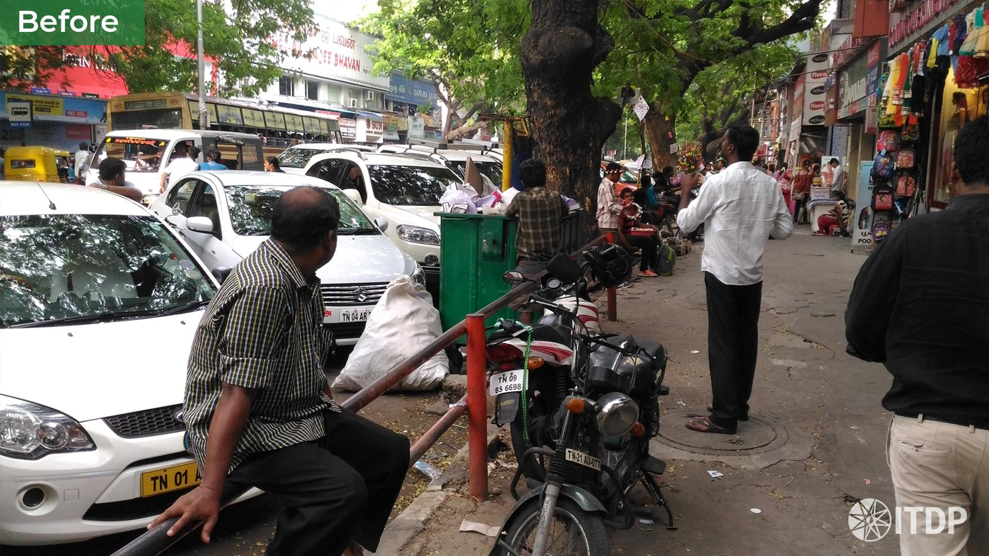

Slide 3
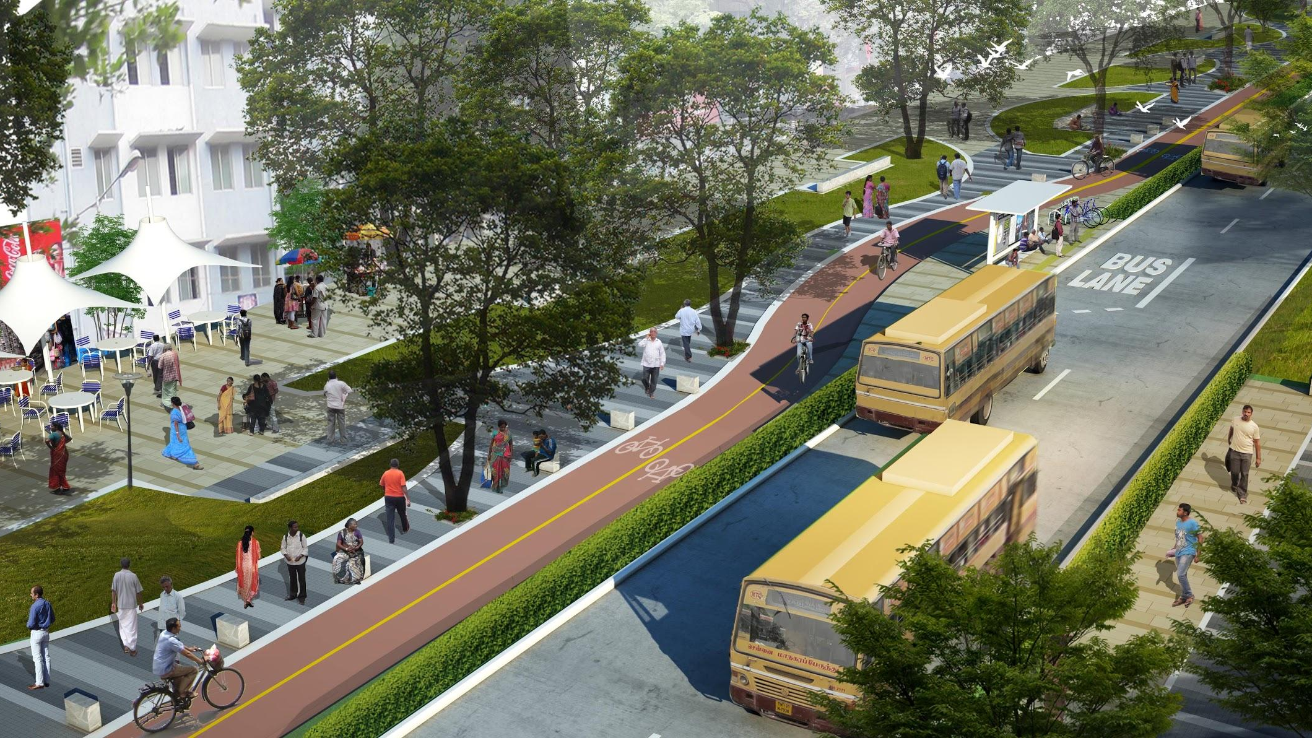

Slide 4
Transforming streets with TU
Is this design even feasible?
Where will the traffic flow?
What about parking?
What activities will take place here?

Slide 5
Transforming streets with TU
Tactical urbanism interventions are quick, temporary, and low-cost projects characterised by a community focus to build support for long term change.

Slide 6
Transforming streets with TU
1. Building citizen support
for street transformation

Slide 7
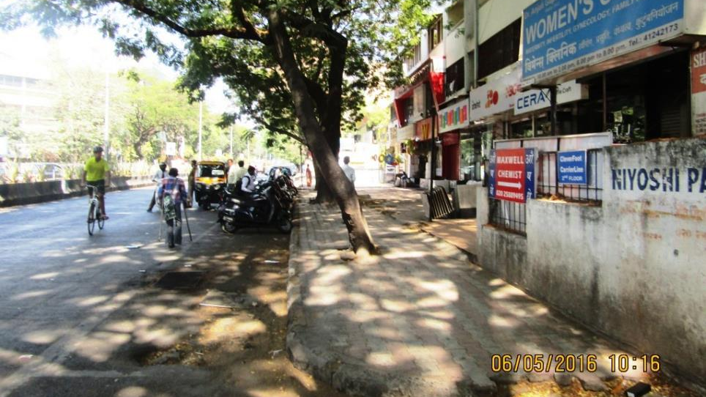
Before I DP Road, Pune

Slide 8
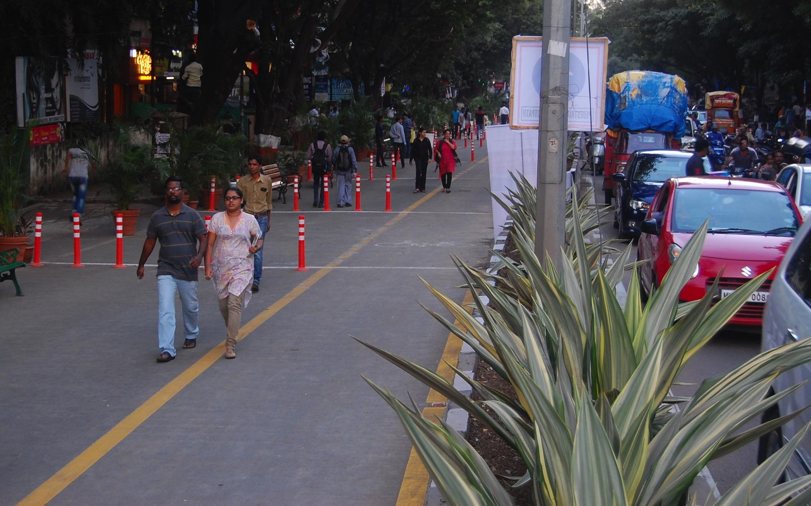

Slide 9
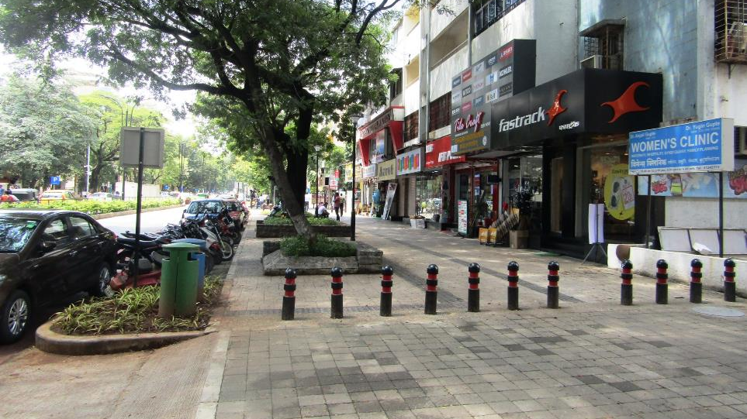
TN MEGA STREETS PROGRAMME
After | DP Road, Pune

Slide 10
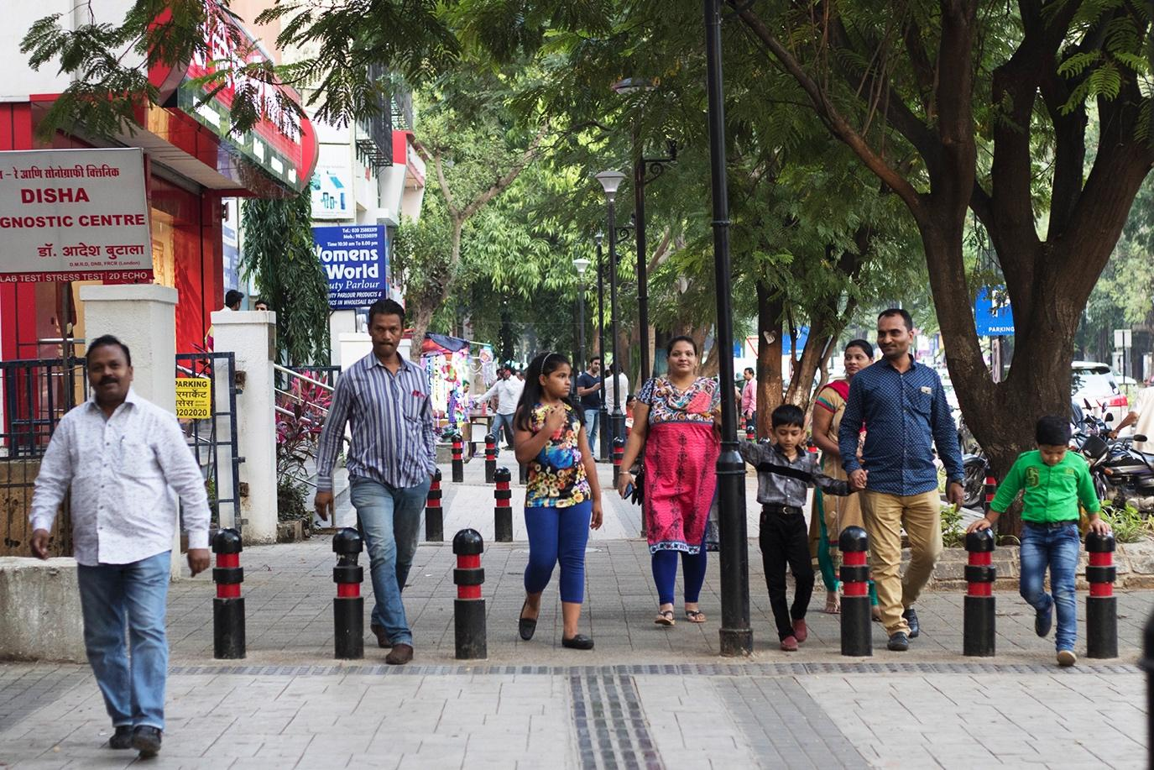

Slide 11
Transforming streets with TU
2. Building support from
Traffic Police

Slide 14
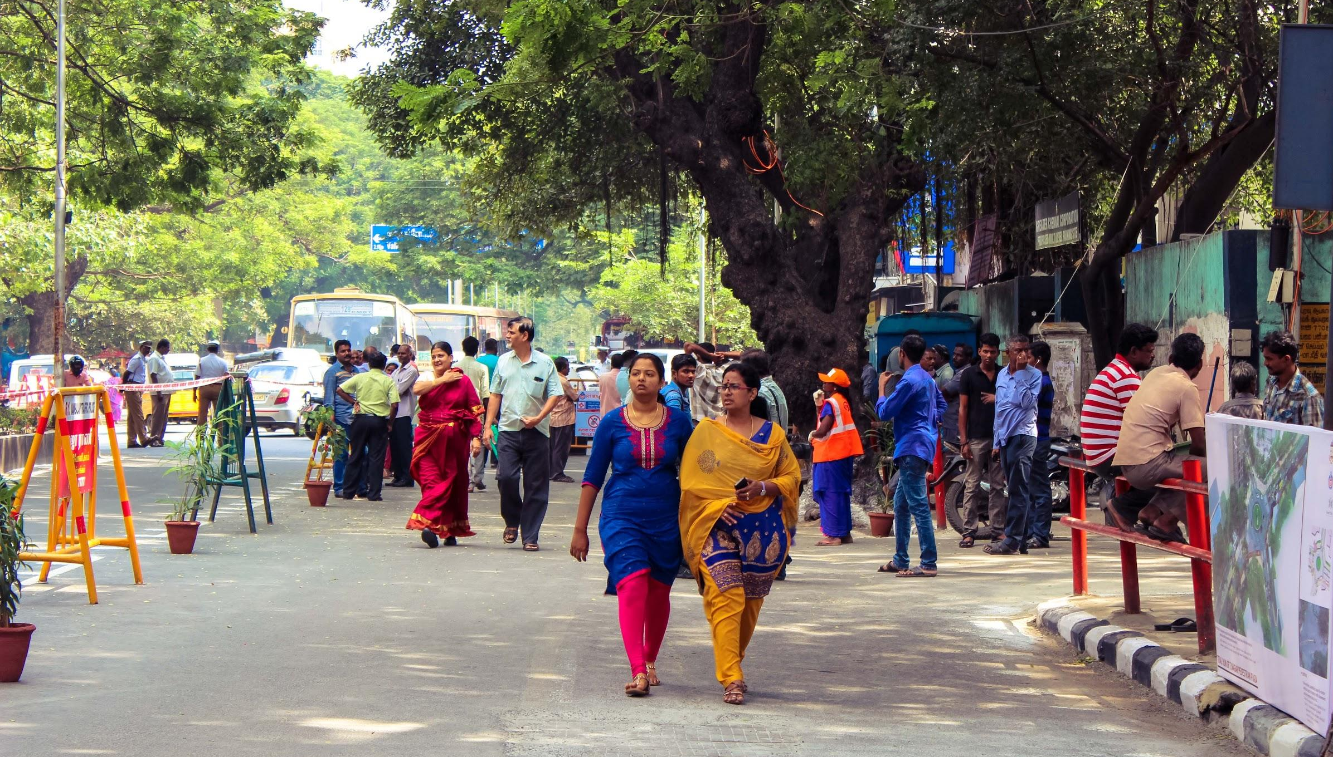
Photo: Citizens experiencing the space during a trial run of the project (2016)

Slide 15
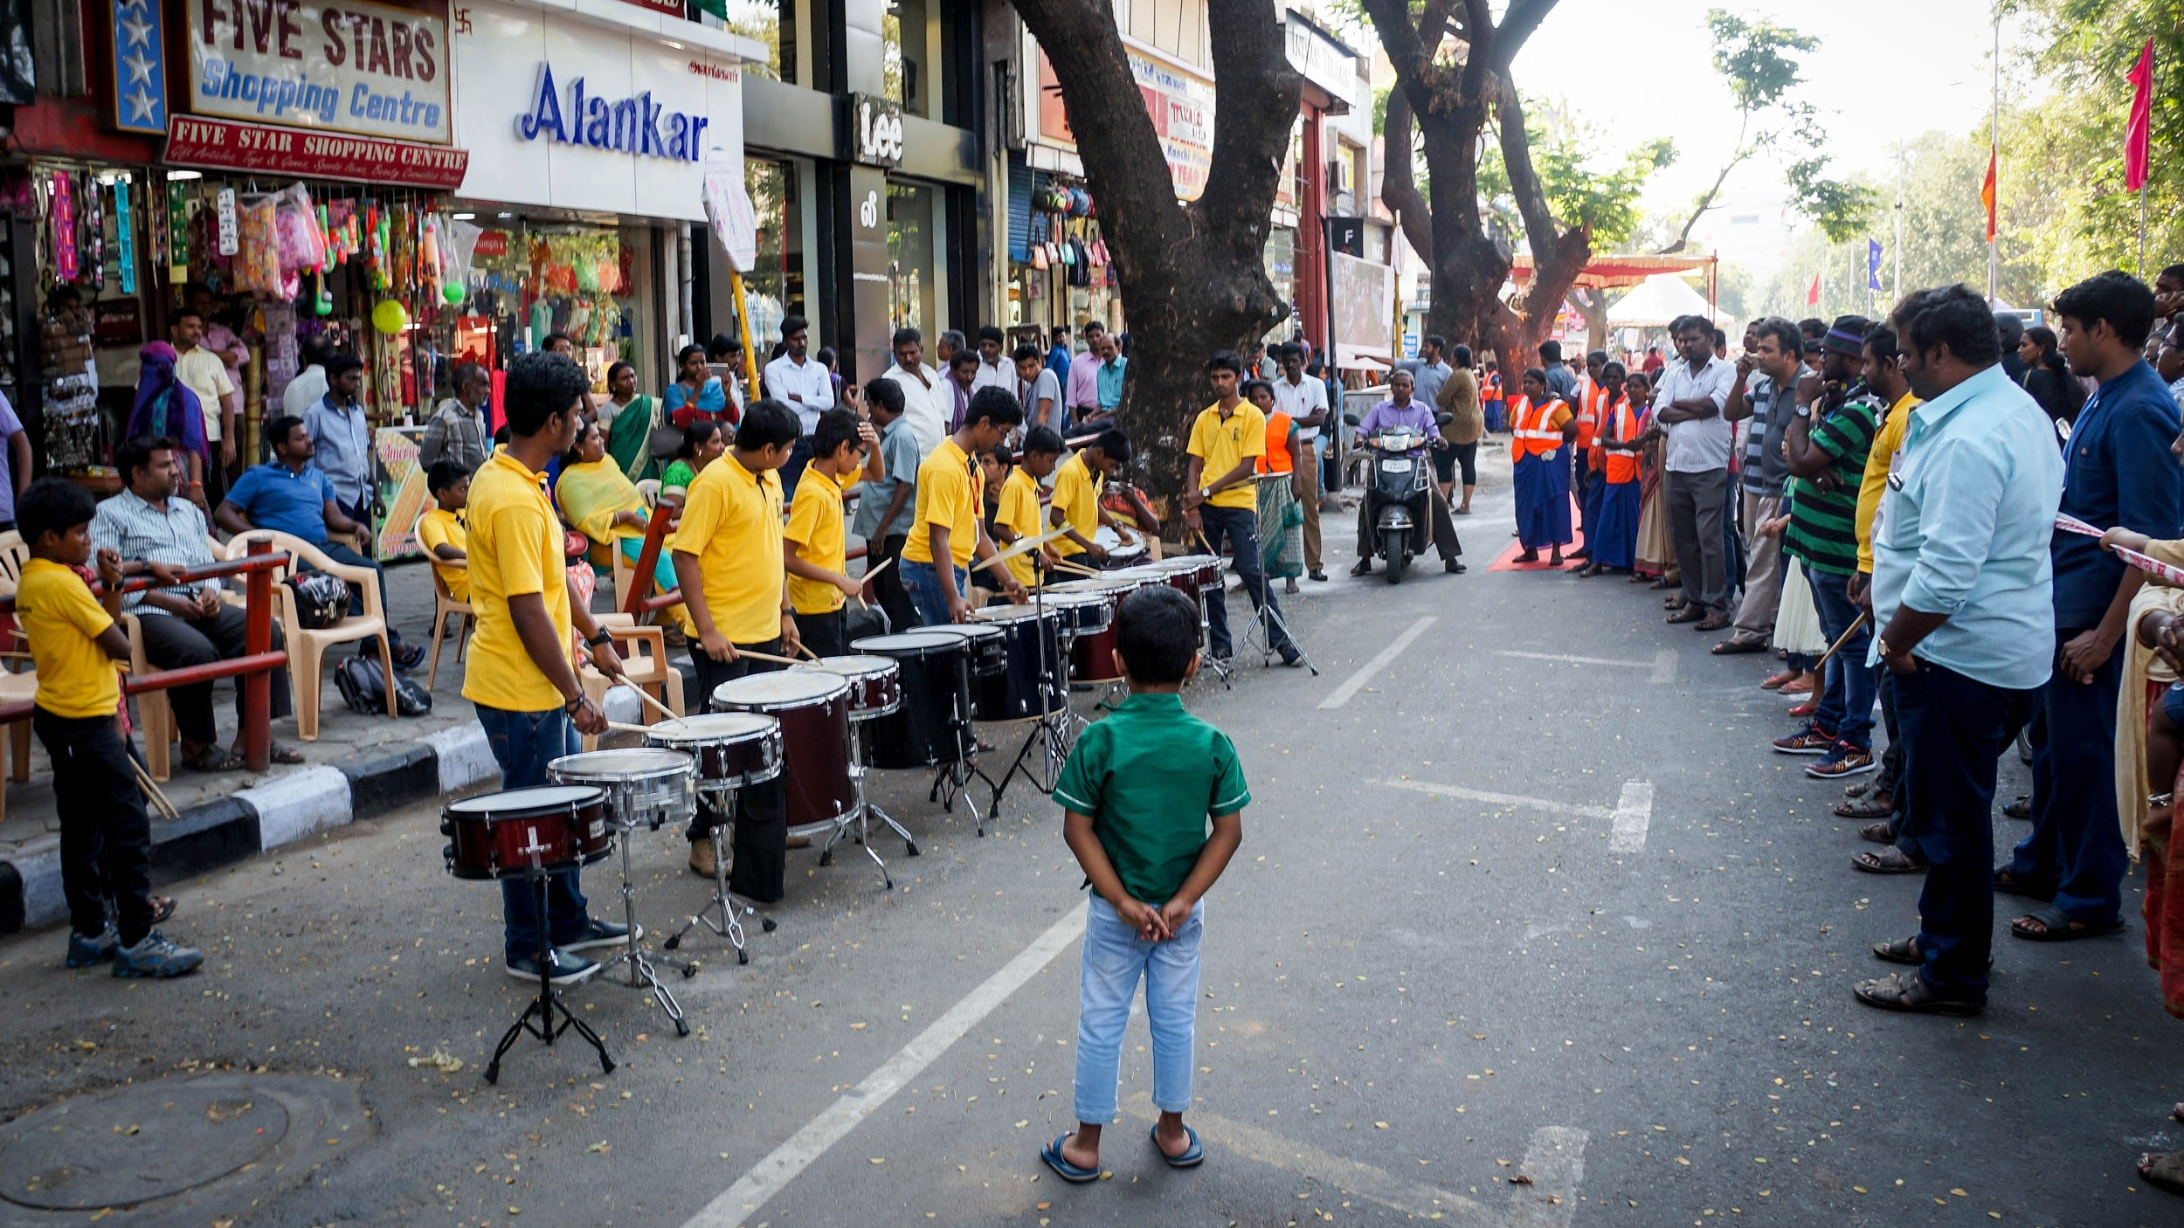

Slide 16
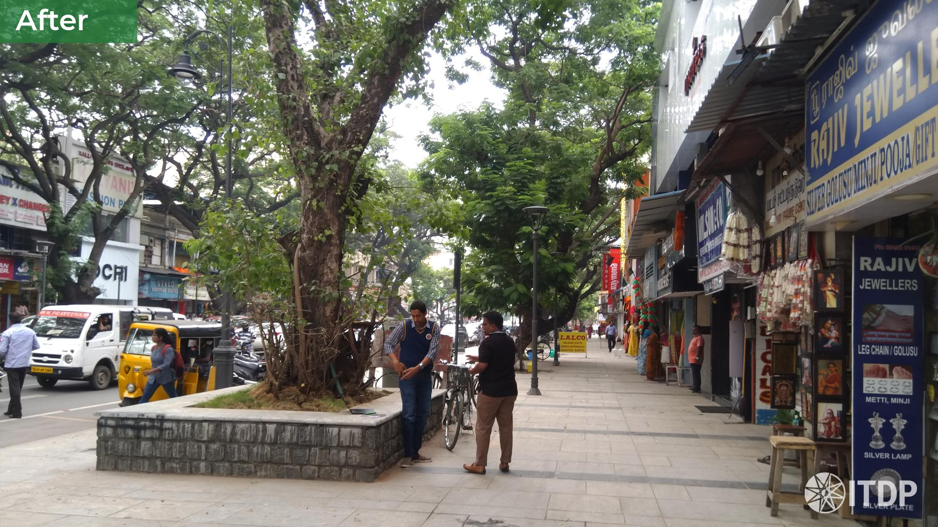

Slide 17
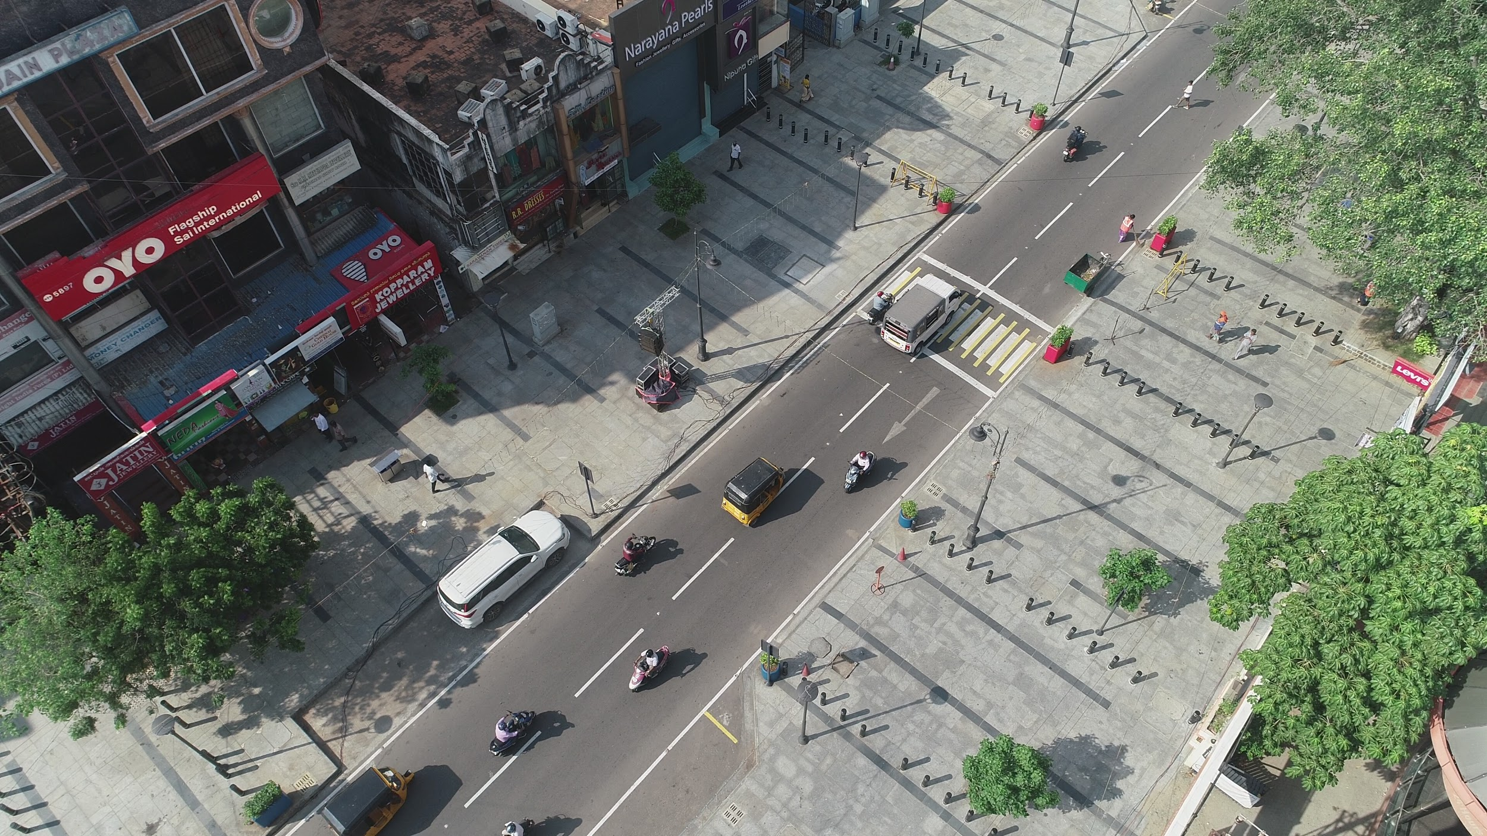

Slide 18
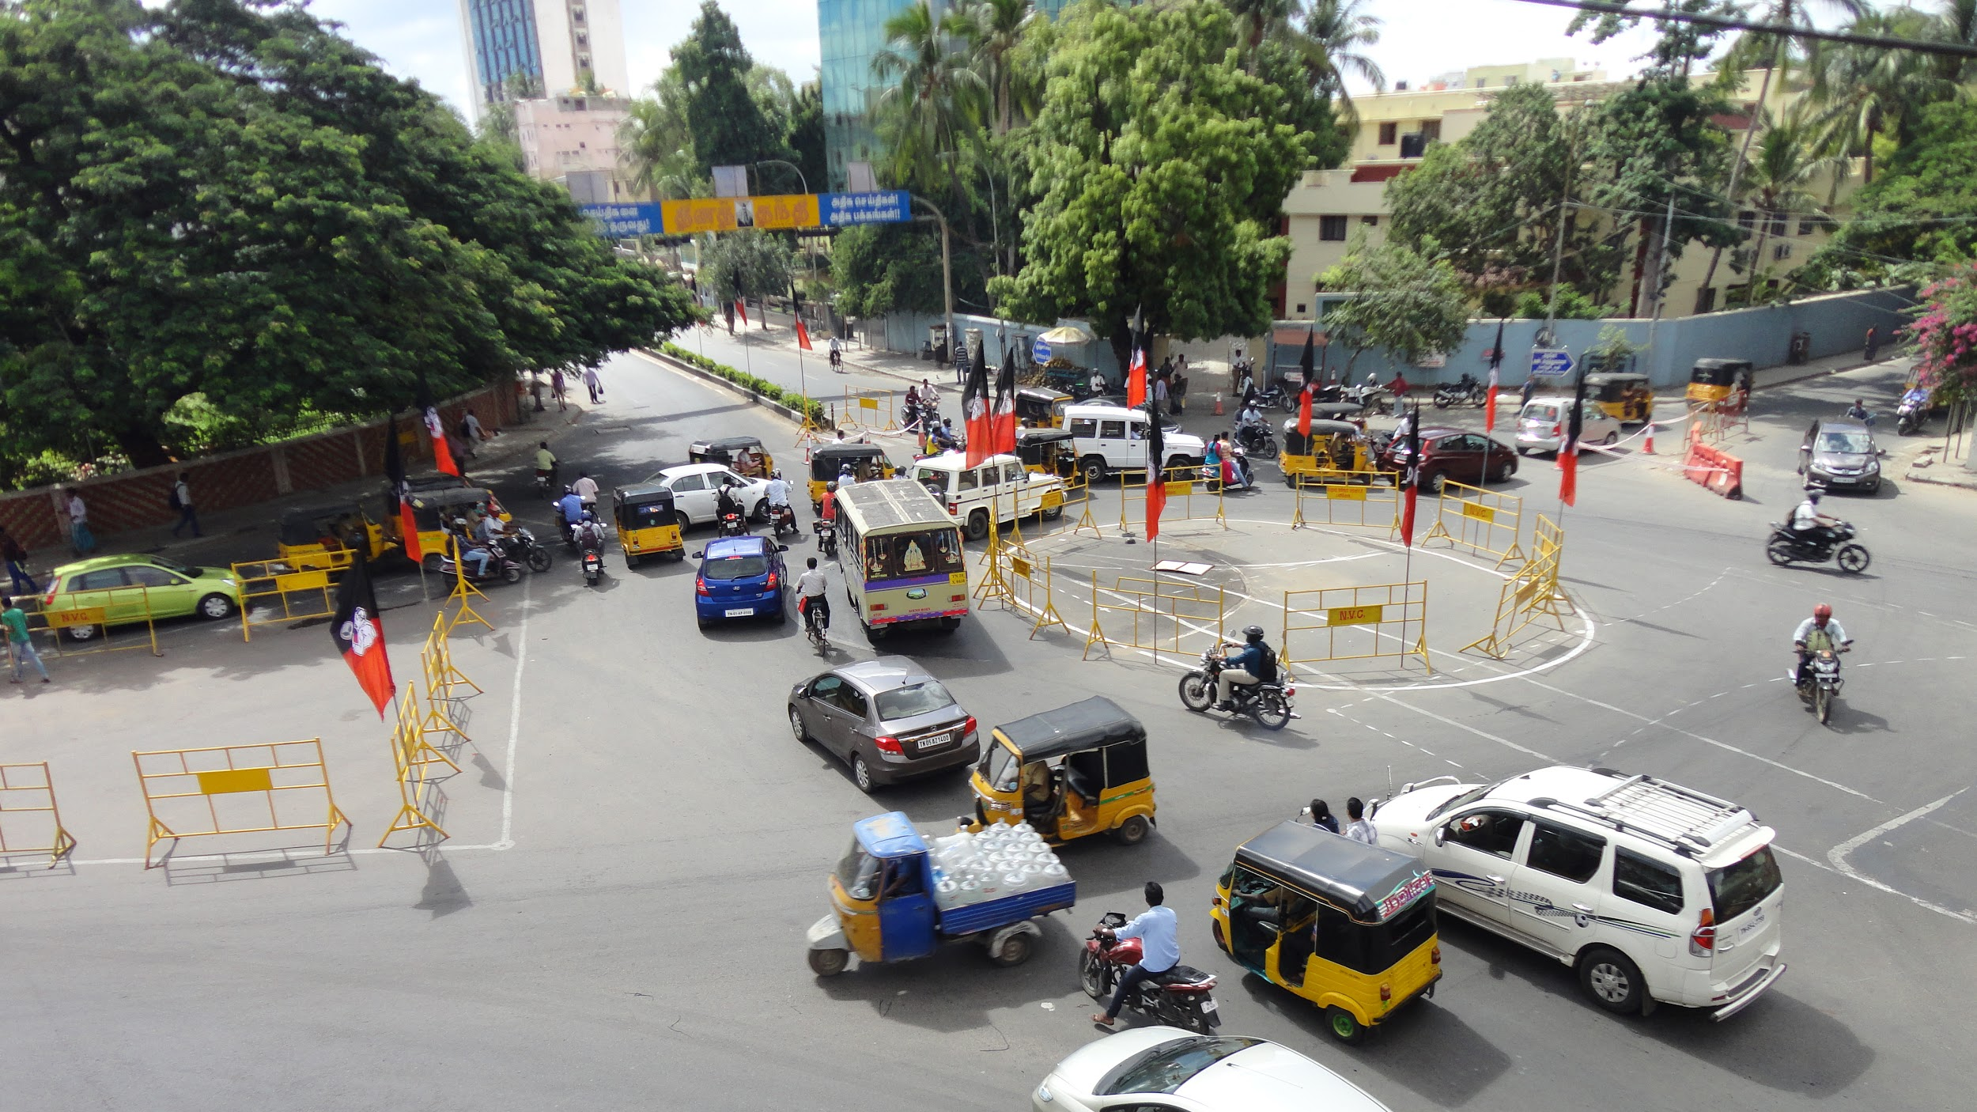

Slide 19
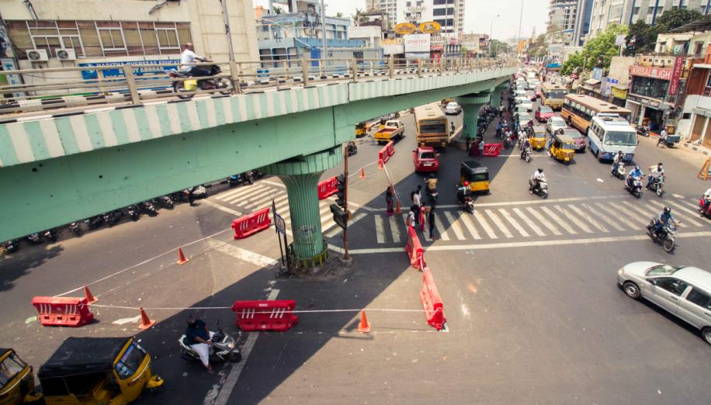

Slide 20
Transforming streets with TU
3. Creating Safe Neighbourhood
Streets

Slide 21
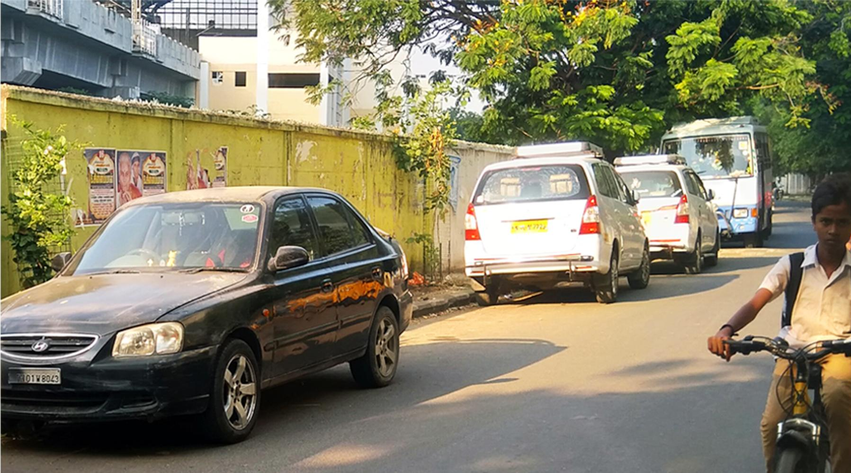

Slide 22
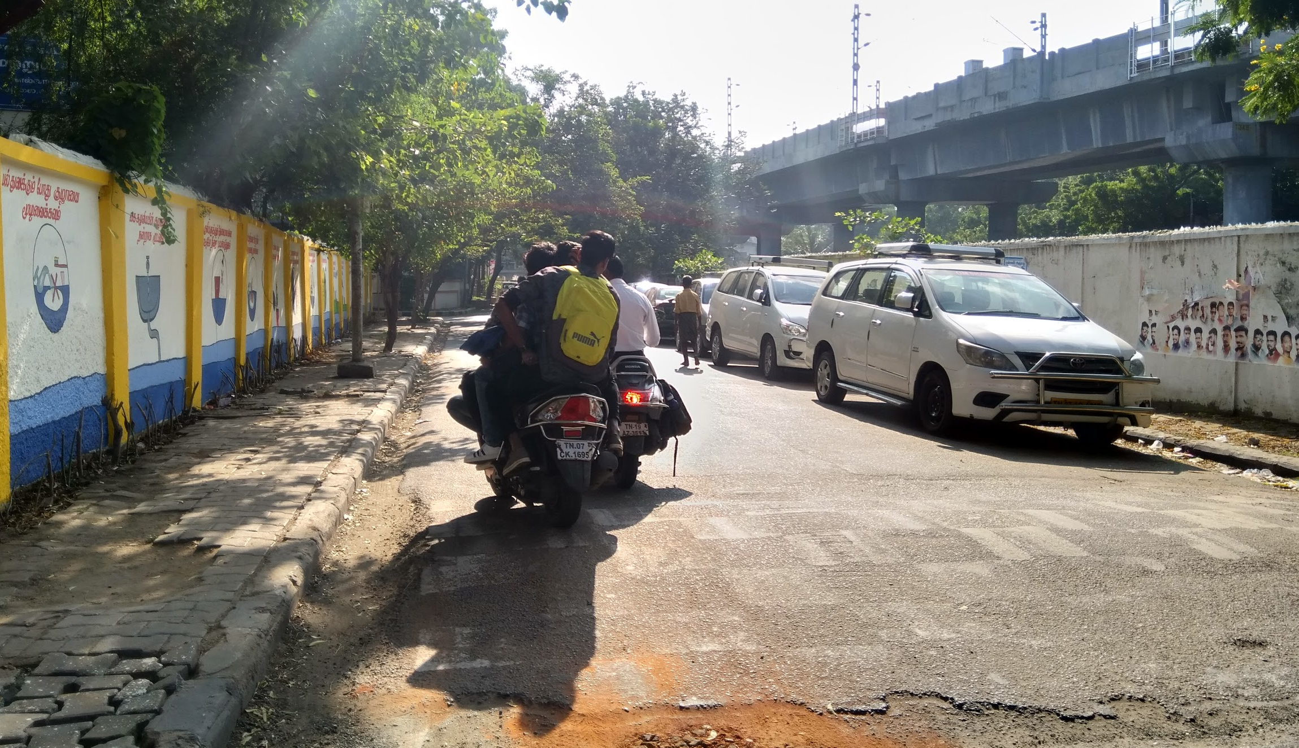

Slide 23
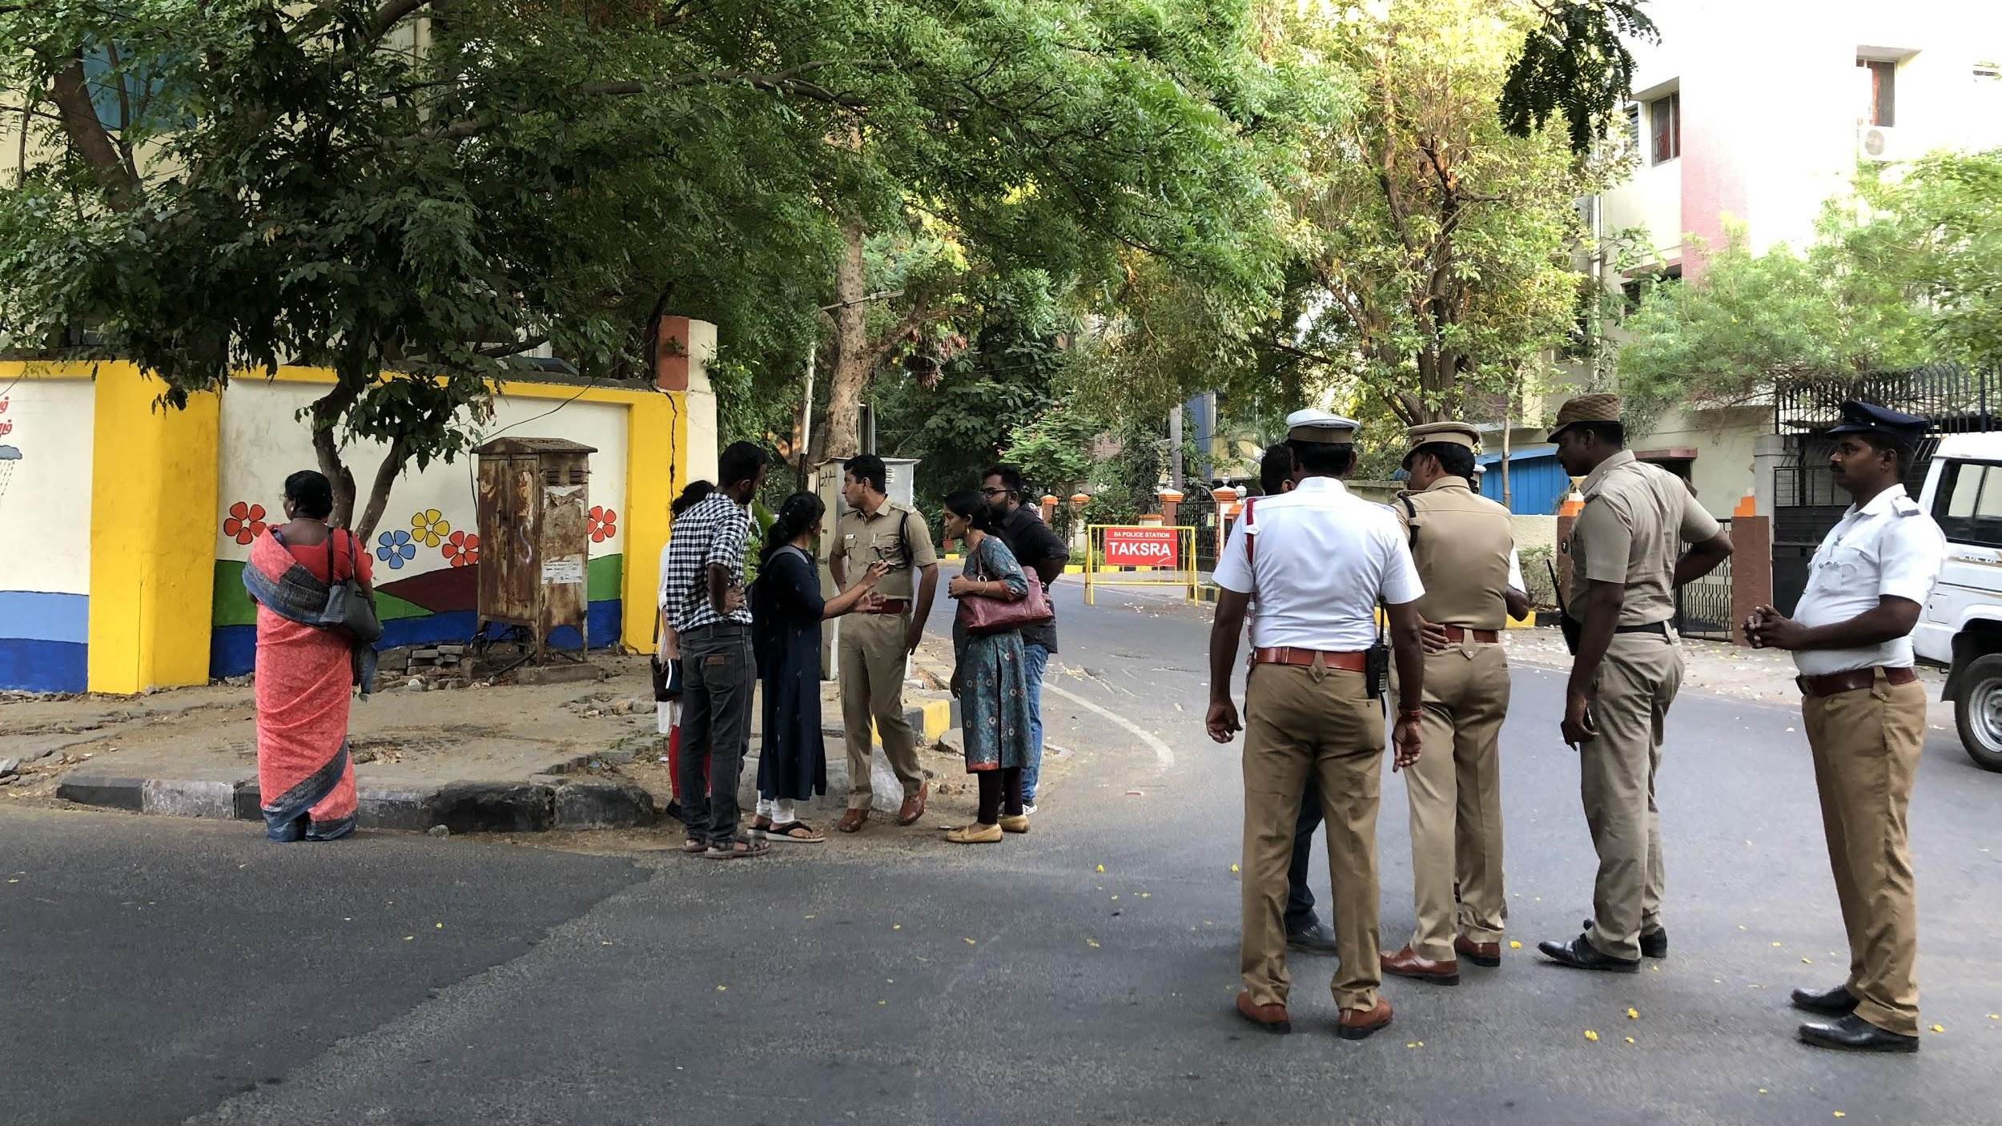

Slide 24
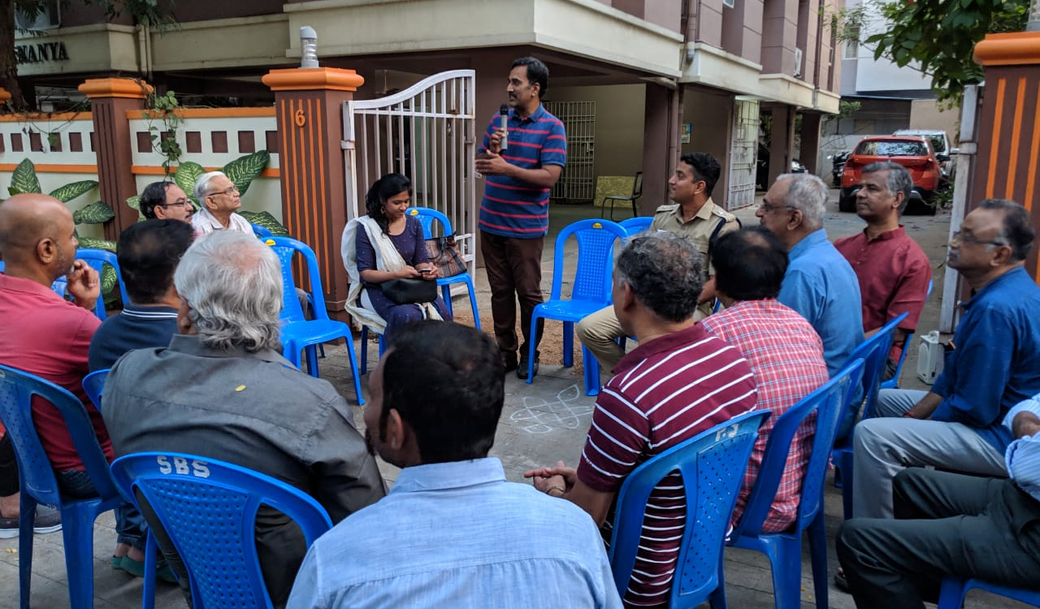

Slide 25
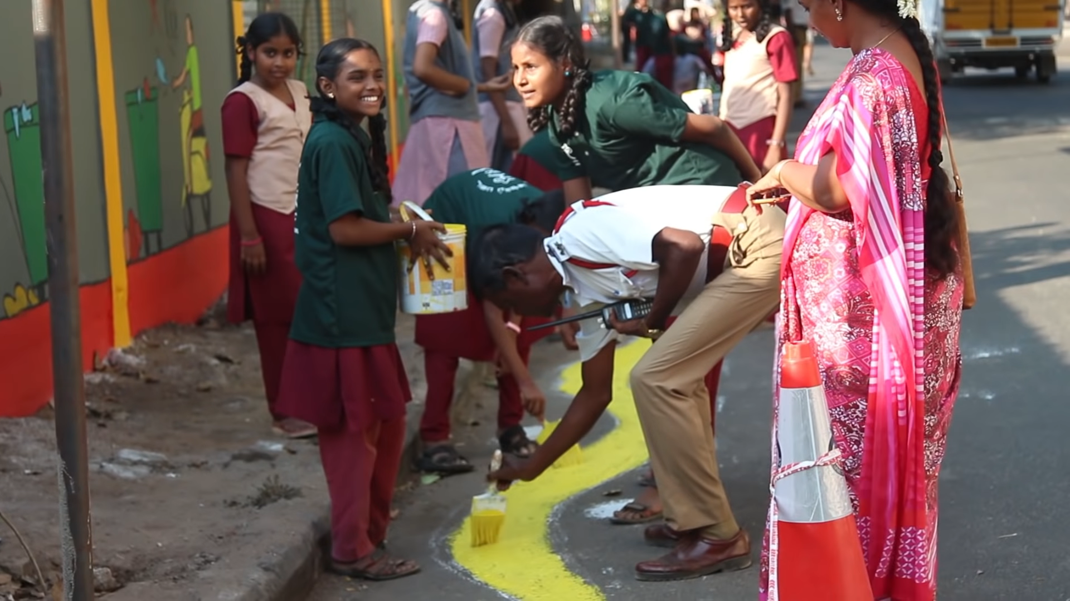

Slide 26
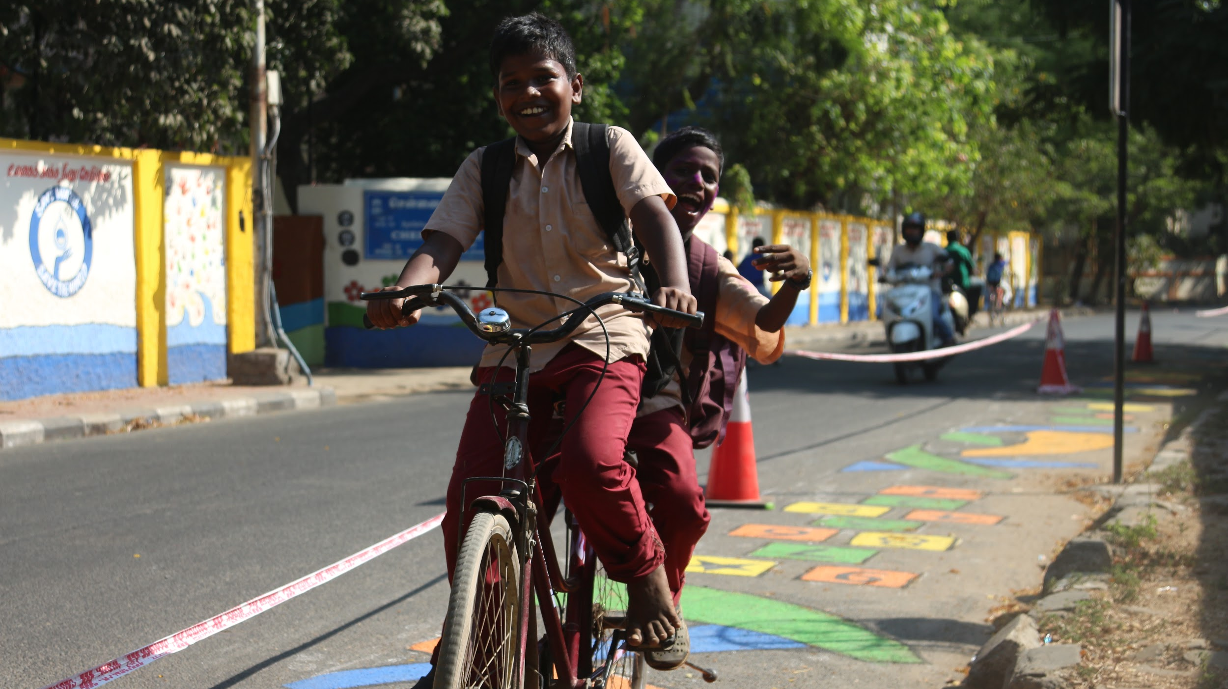

Slide 27
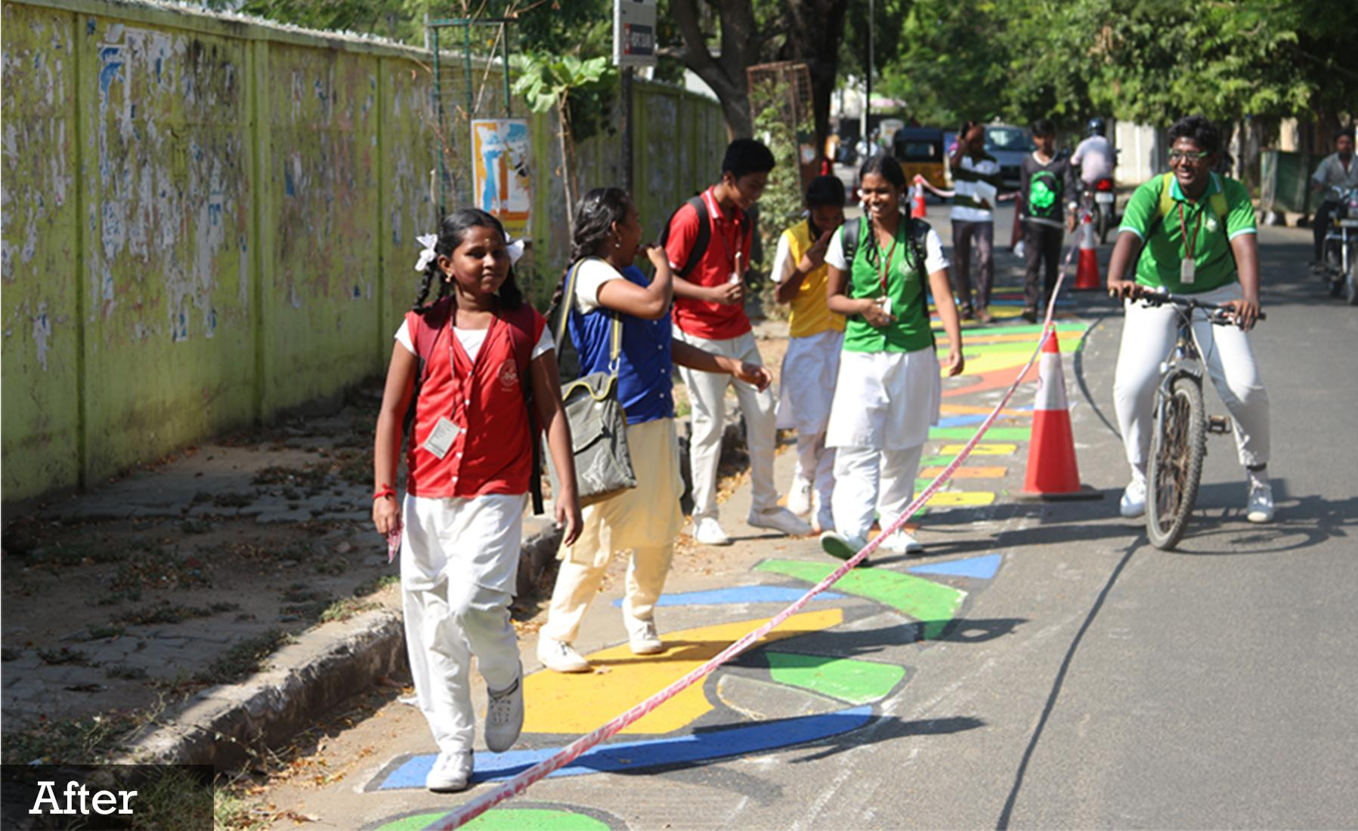

Slide 28
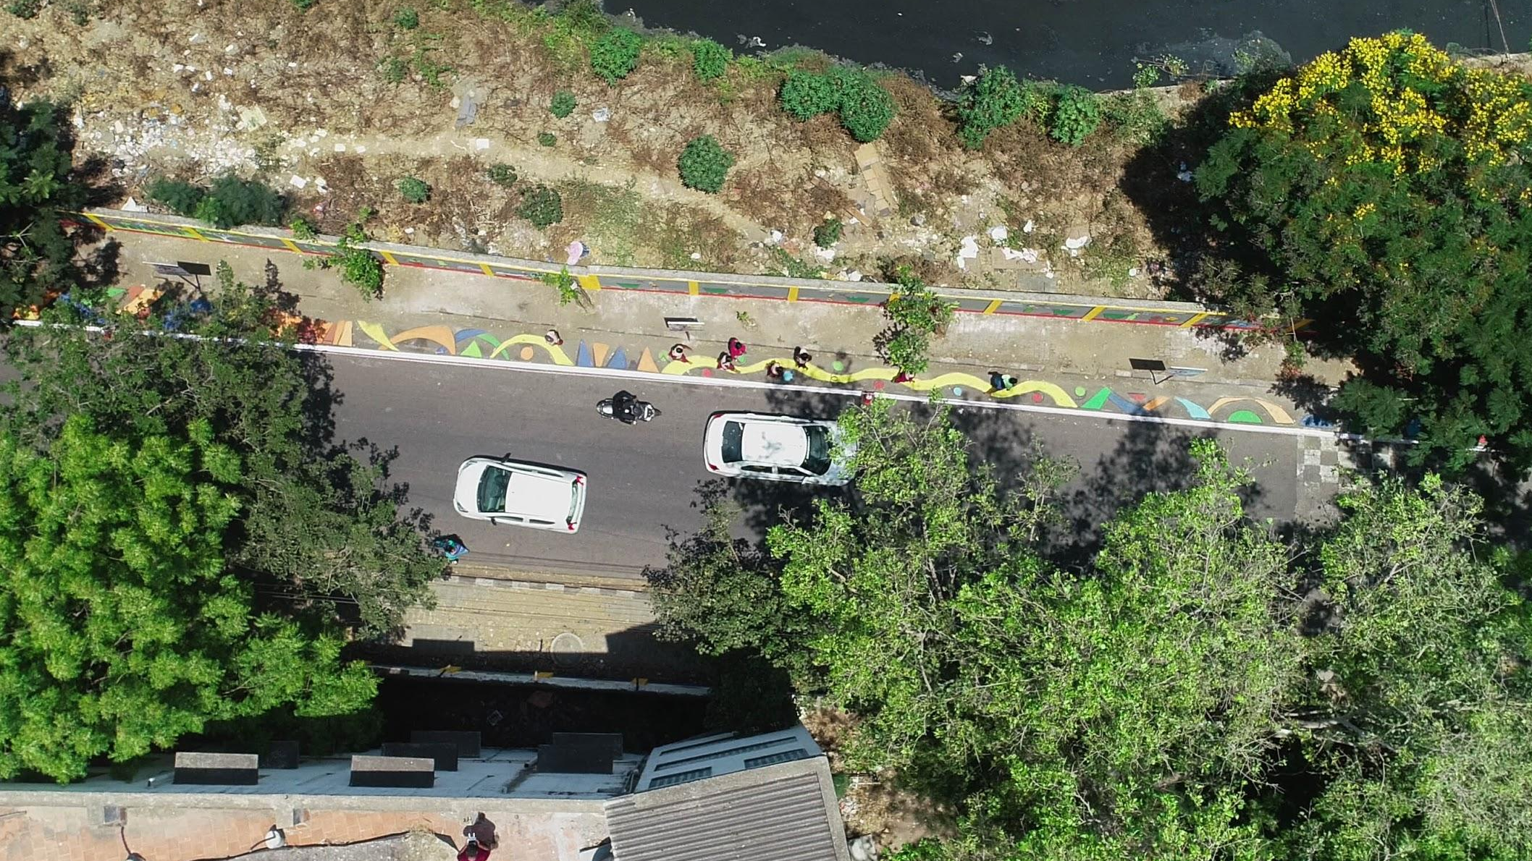

Slide 29
Transforming streets with TU
4. Using TUs to build
momentum for long term
change

Slide 30
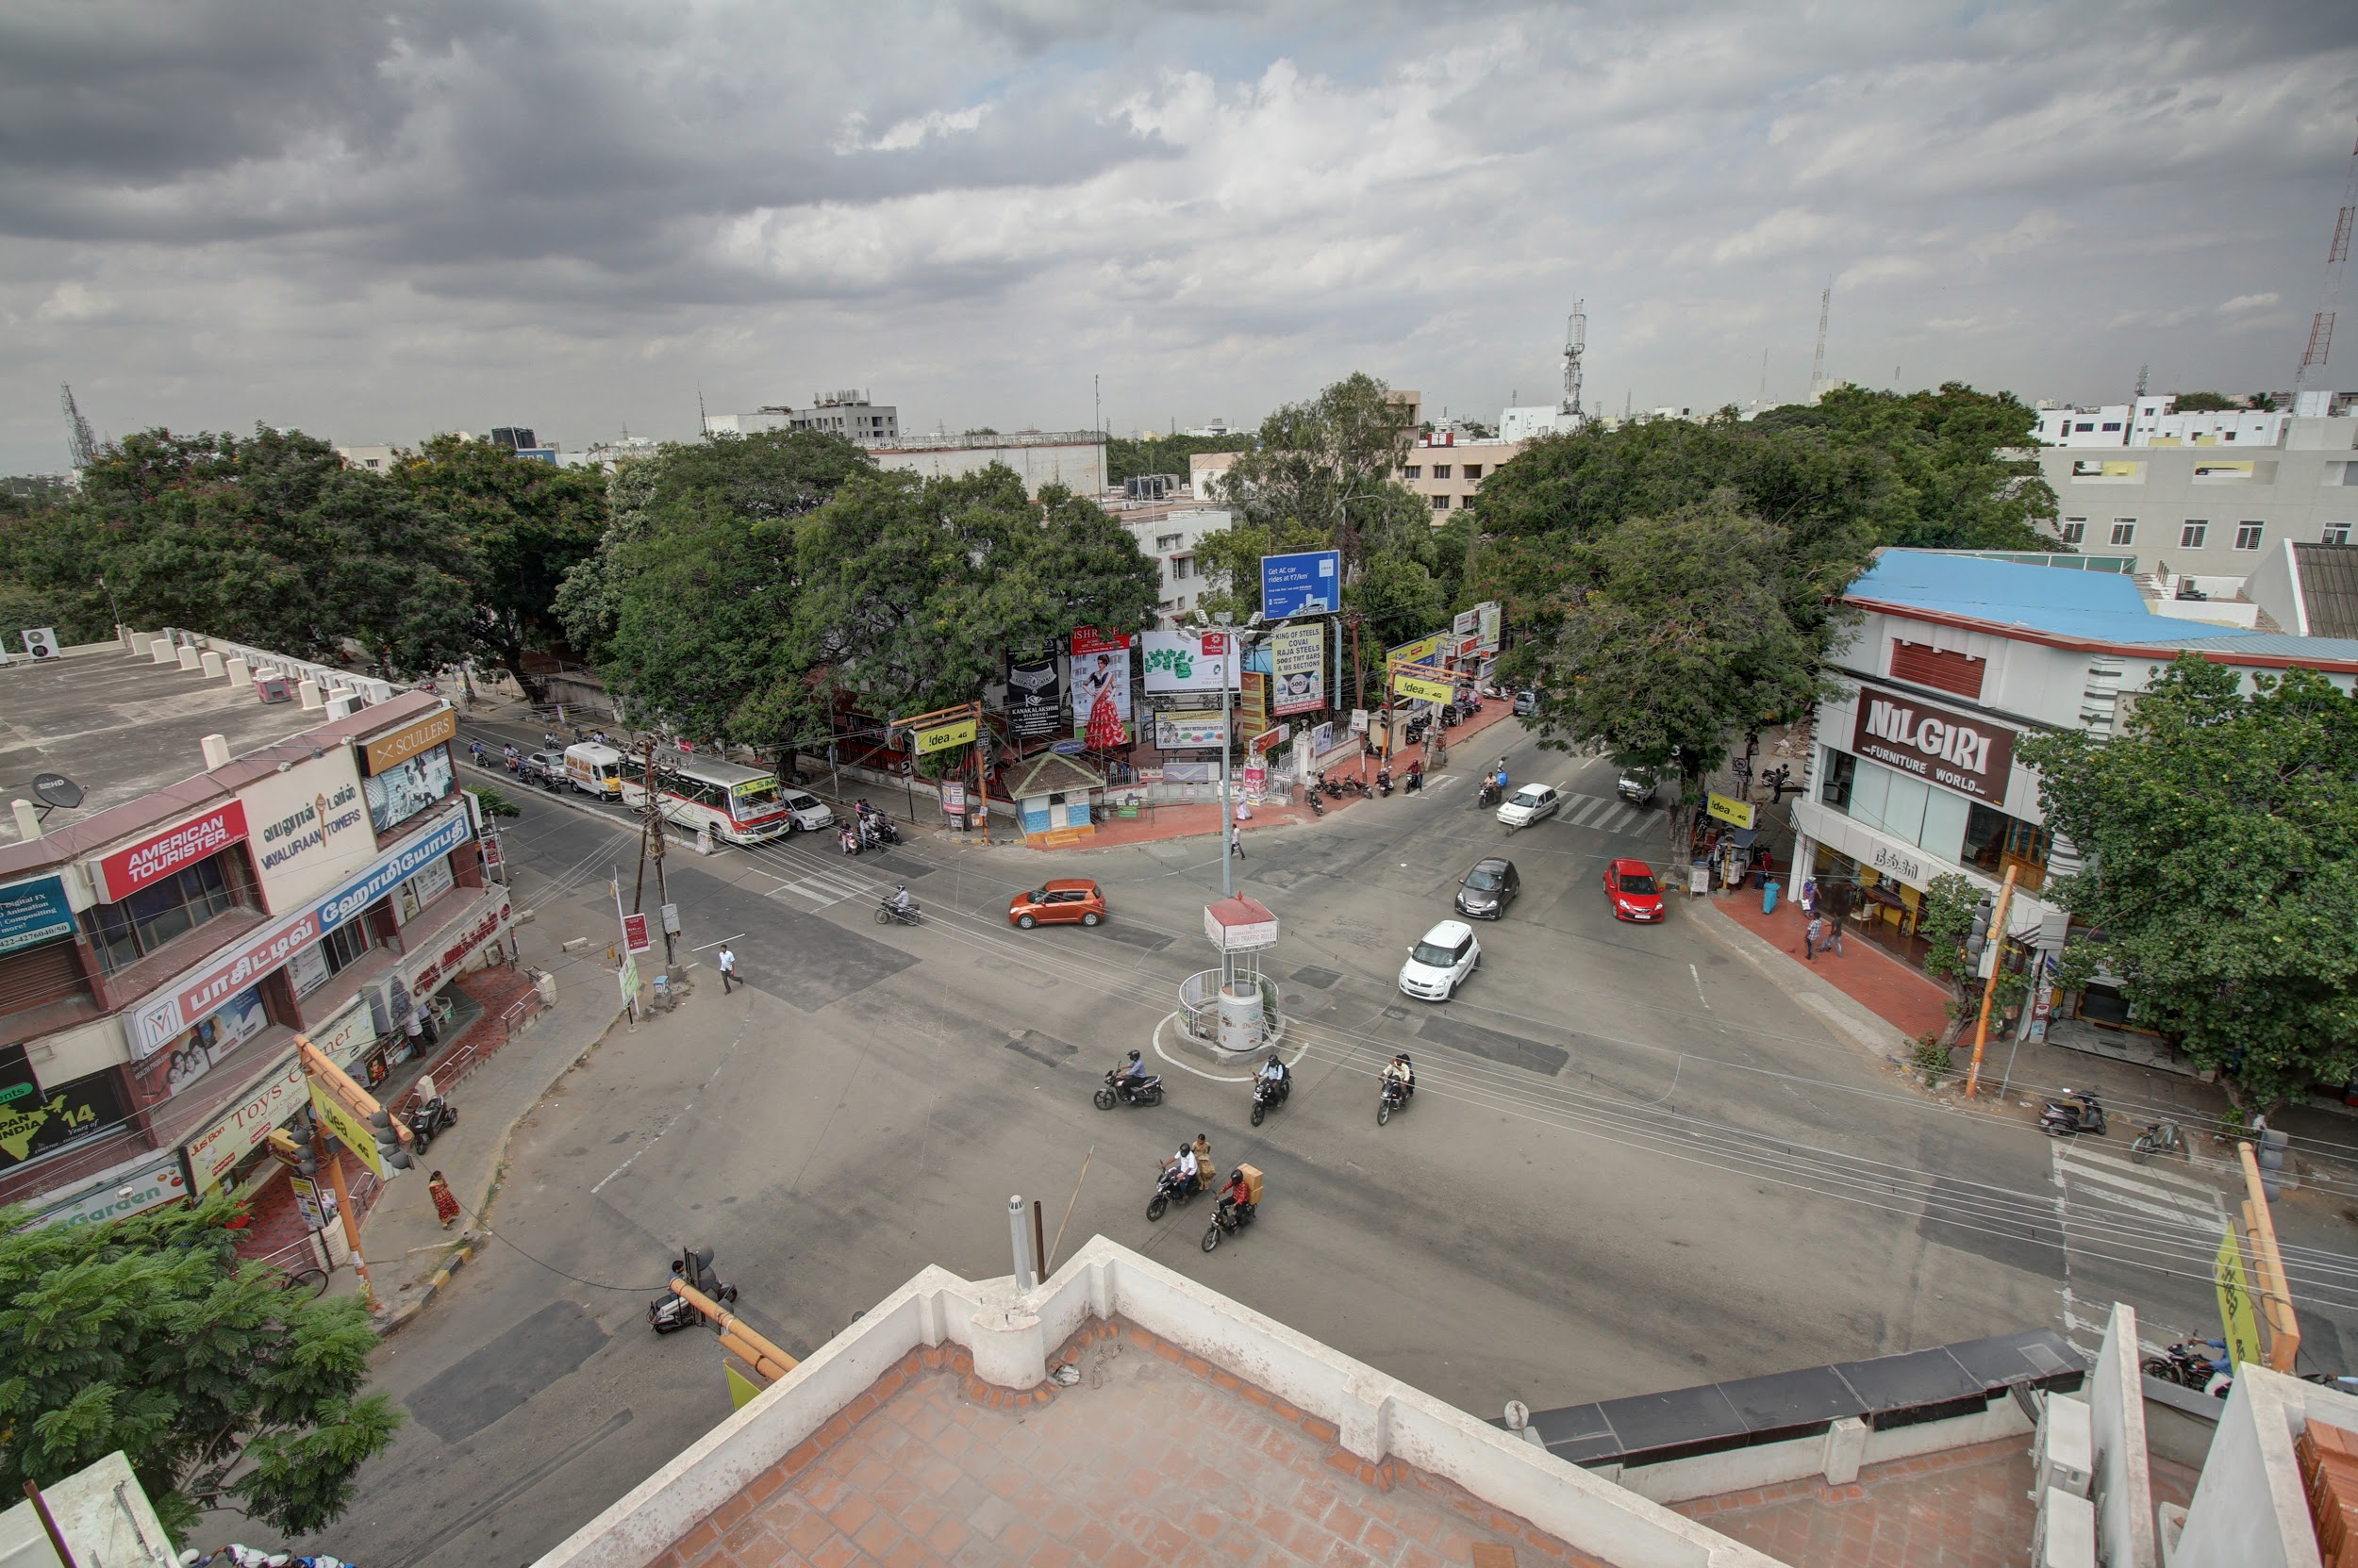
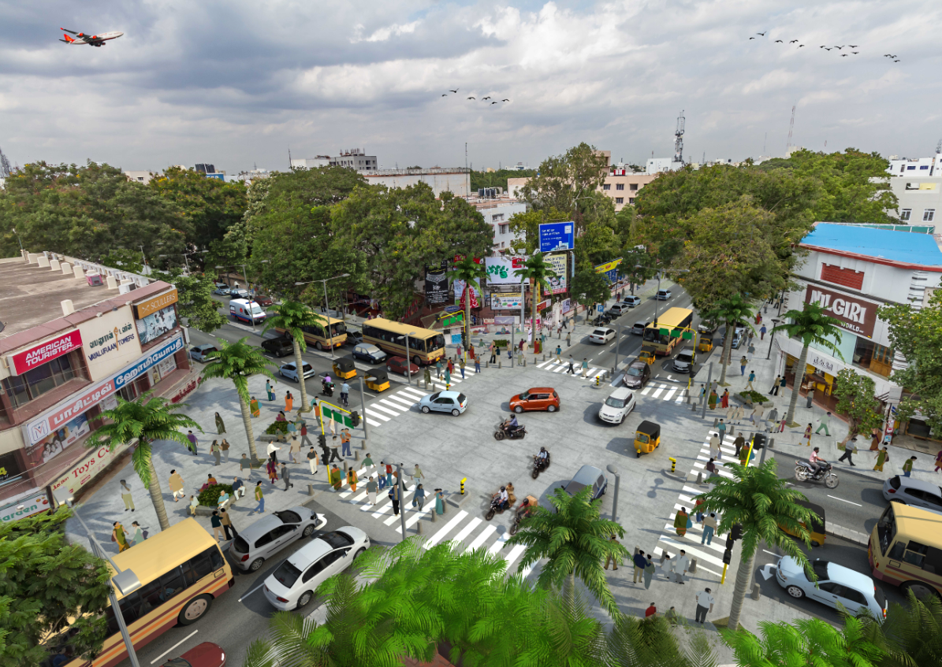
Transforming streets with TU

Slide 31
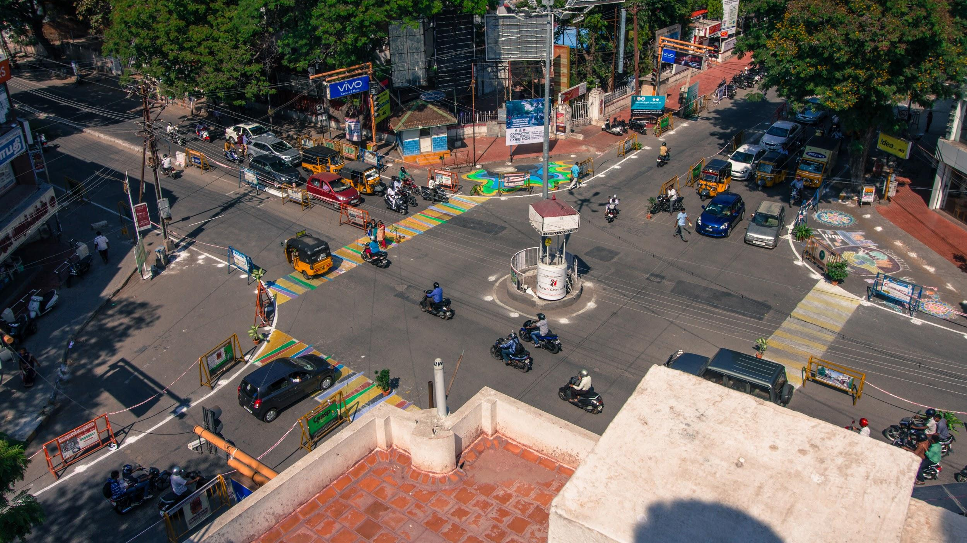

Slide 32
Transforming streets with TU
5. Reimagining streets as public
spaces — Car-free Sundays

Slide 33
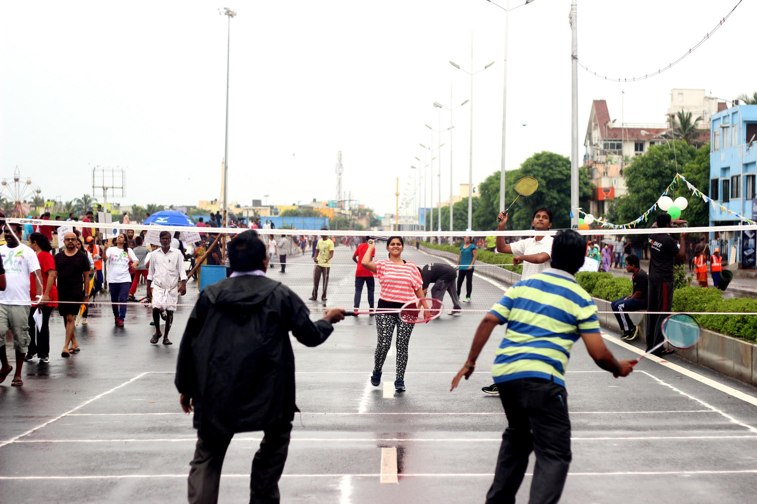

Slide 34
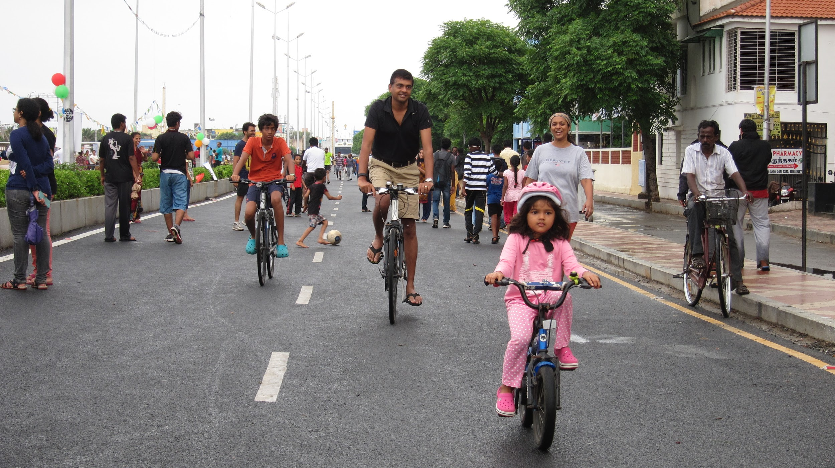

Slide 35
Transforming streets with TU
The process of transformation:
Identifying the site
Engaging and building support with all stakeholders
Pre-intervention analysis
Developing design / Envisioning change
Preparation of site
Implementation of intervention
Post-intervention analysis
Publicising change

Slide 36
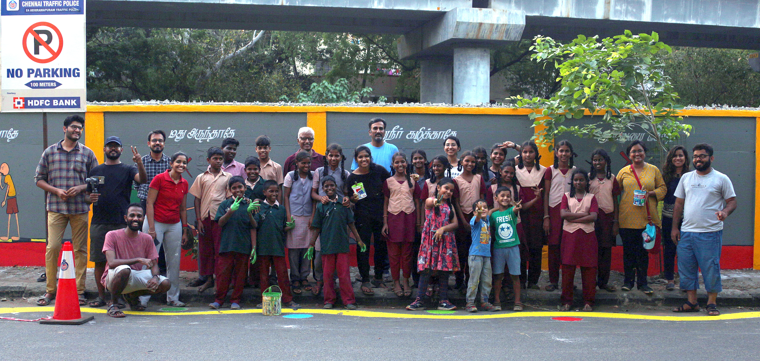
fb.com/itdpindia
twitter.com/itdpindia
india.itdp.org
india@itdp.org

