Slide 1
13/07/2020
COVID-19 Experience of
Shenzhen Bus Group
Hallie Liao
Head of International Development Department
Shenzhen Bus Group

Slide 2
Latest COVID-19 Update
City | Total Population | Confirm Cases | Infected Percentage
Wuhan | 14 Million | 50,340 | 0.36%
Shenzhen | 20 Million | 462 | 0.0023%
Shanghai | 24 Million | 708 | 0.0030%
Beijing | 21 Million | 912 | 0.0044%
Guangzhou | 15 Million | 553 | 0.0038%

Slide 3
About COVID-19
SZBG Statistics | June
Bus Ridership | 32,222,610 (30%↓)
Taxi Ridership | 4,753,200 (22%↓)
During the peak of pandemic, Shenzhen has continued to offer reduced public transportation services.
All ridership is expected to return to normal as the pandemic eases.
Wuhan Emergency Response
Emergency Vehicle Mobilized | 590
Residential Area Serviced Per Driver | 10+
Items Delivered Per Driver | 1000+
While some cities has shutdown public transportation. However, take Wuhan as example, limited services were still offered by public transport operators to essential personnel such as medical professionals, delivery and emergency services.

Slide 4
Ridership Comparison
First Confirmed Case
in Shenzhen on Jan. 11
Resumption of Work
on Feb. 21
On-Demand services were suspended since Jan. 11 and resumed on Feb. 3
Extended Lunar New Year Holiday
*Comparison with corresponding period in 2019

Slide 5
On-demand Ridership Change

Slide 6
SZBG’s Measures

Slide 7
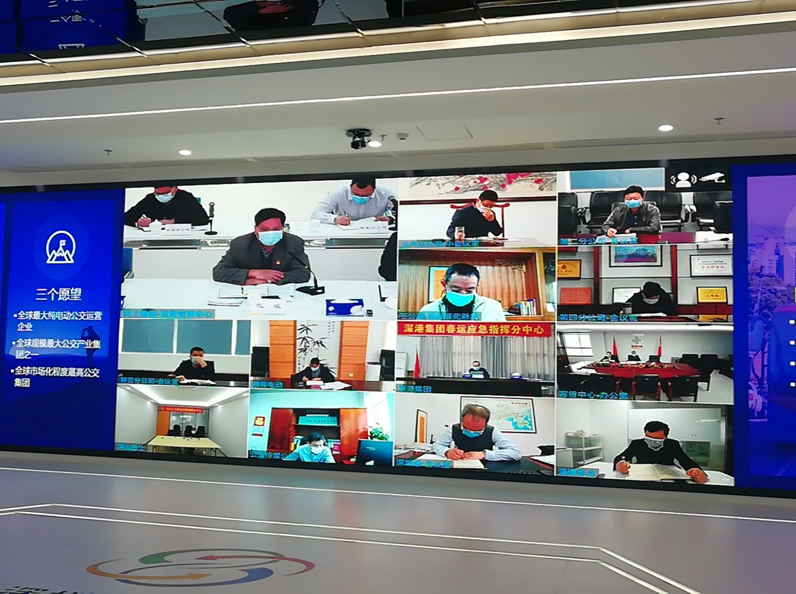
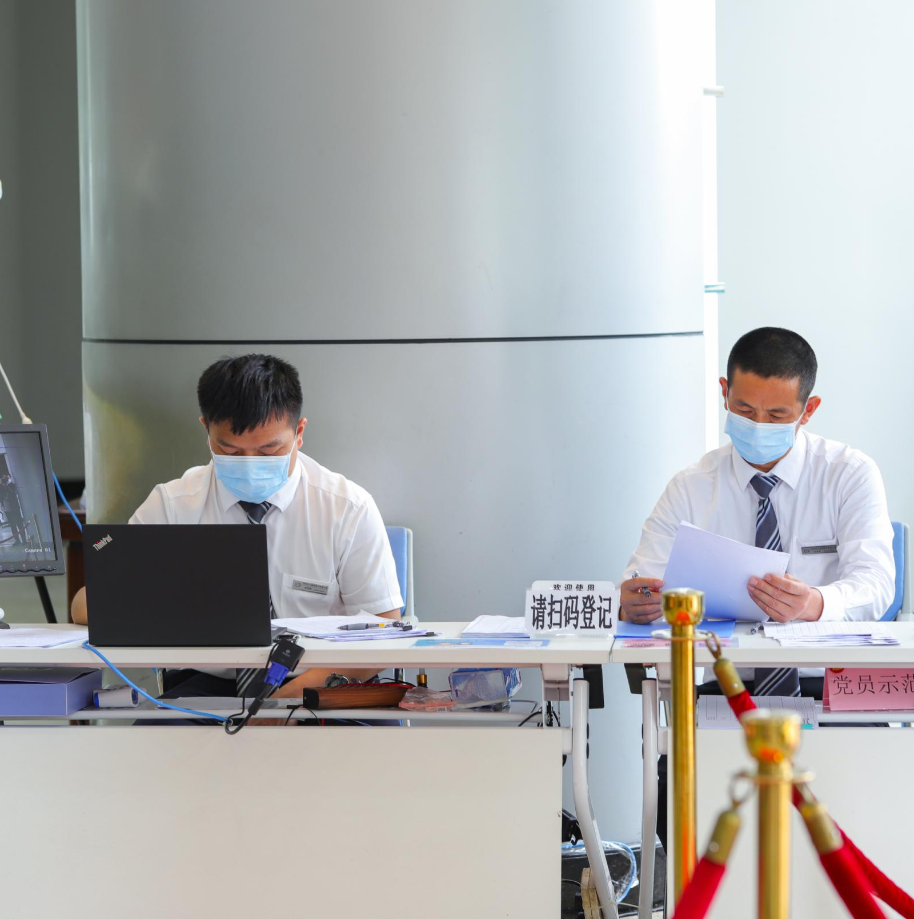
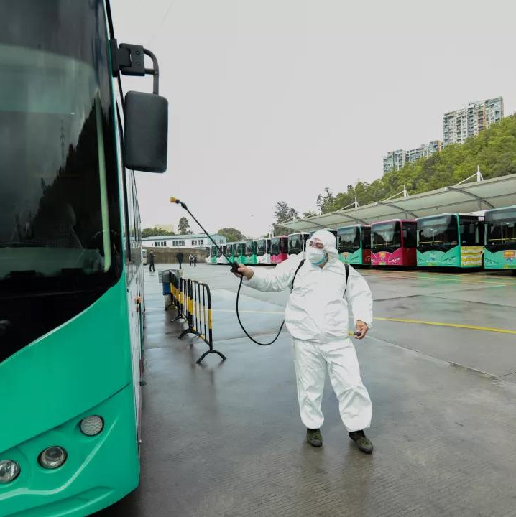
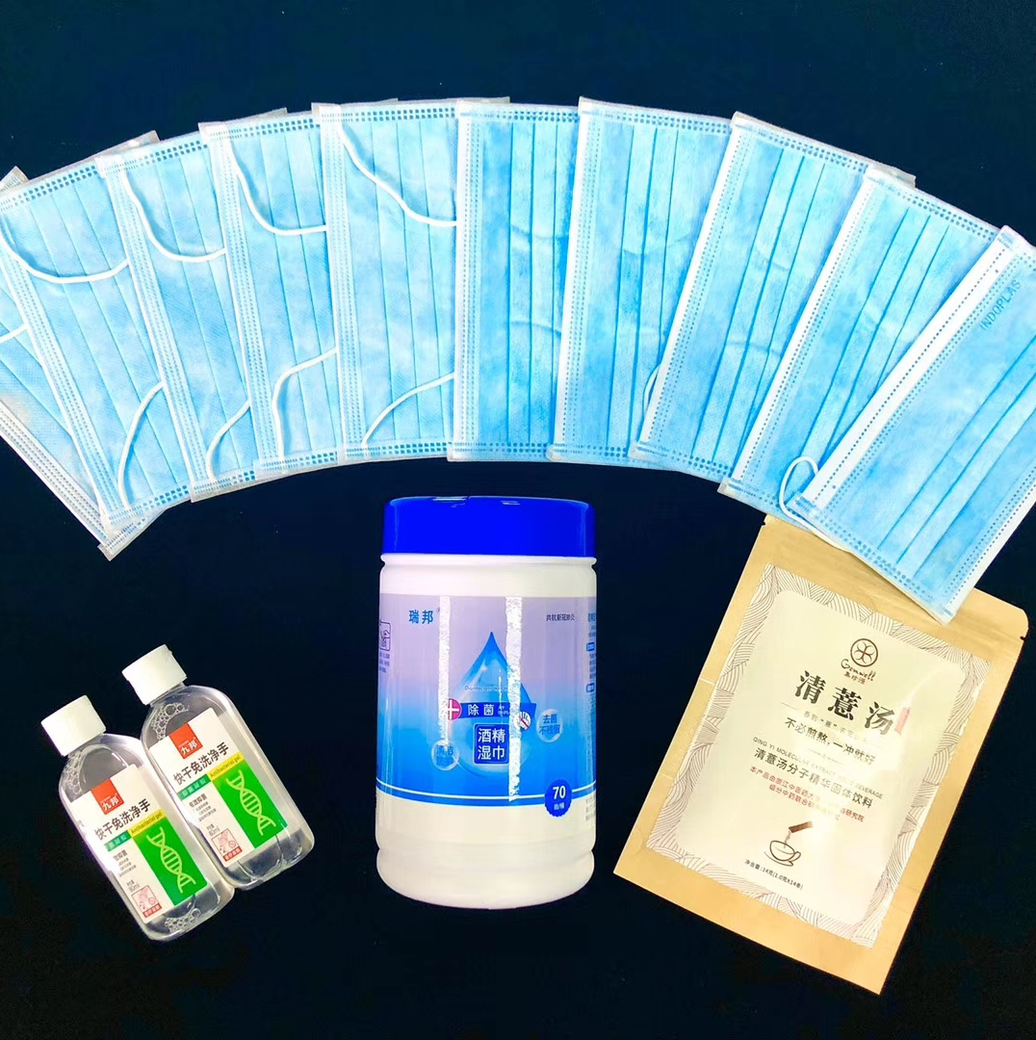
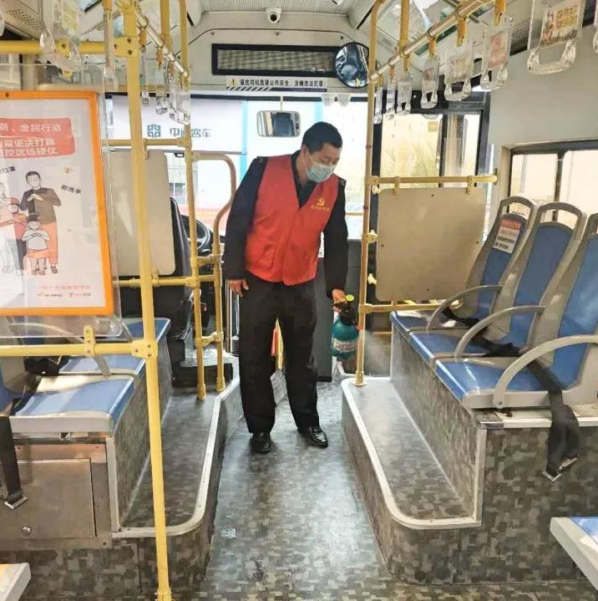
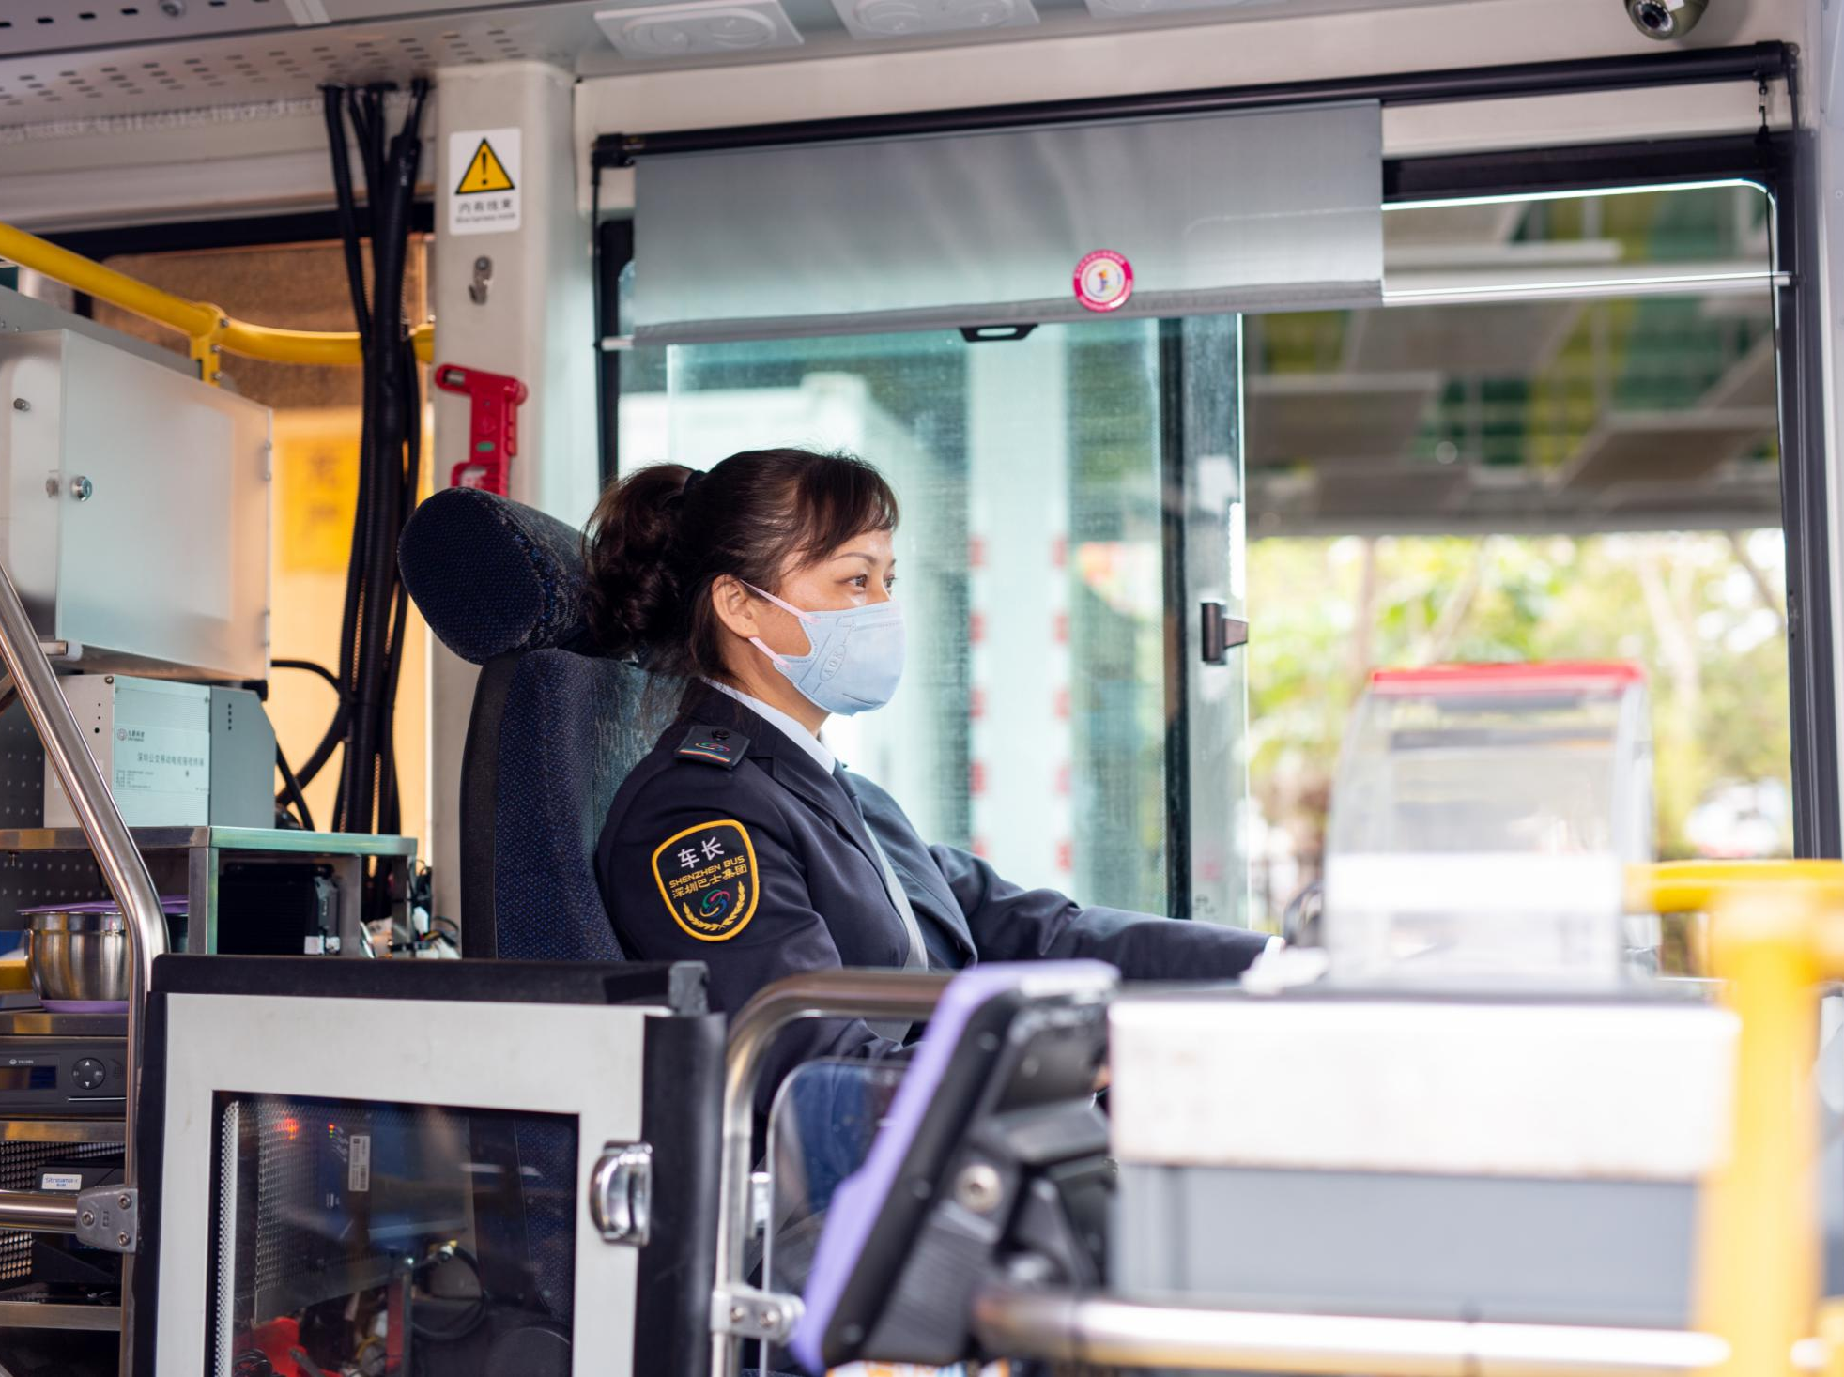
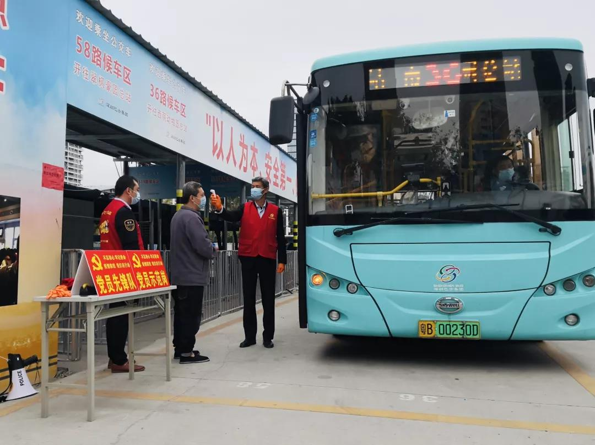
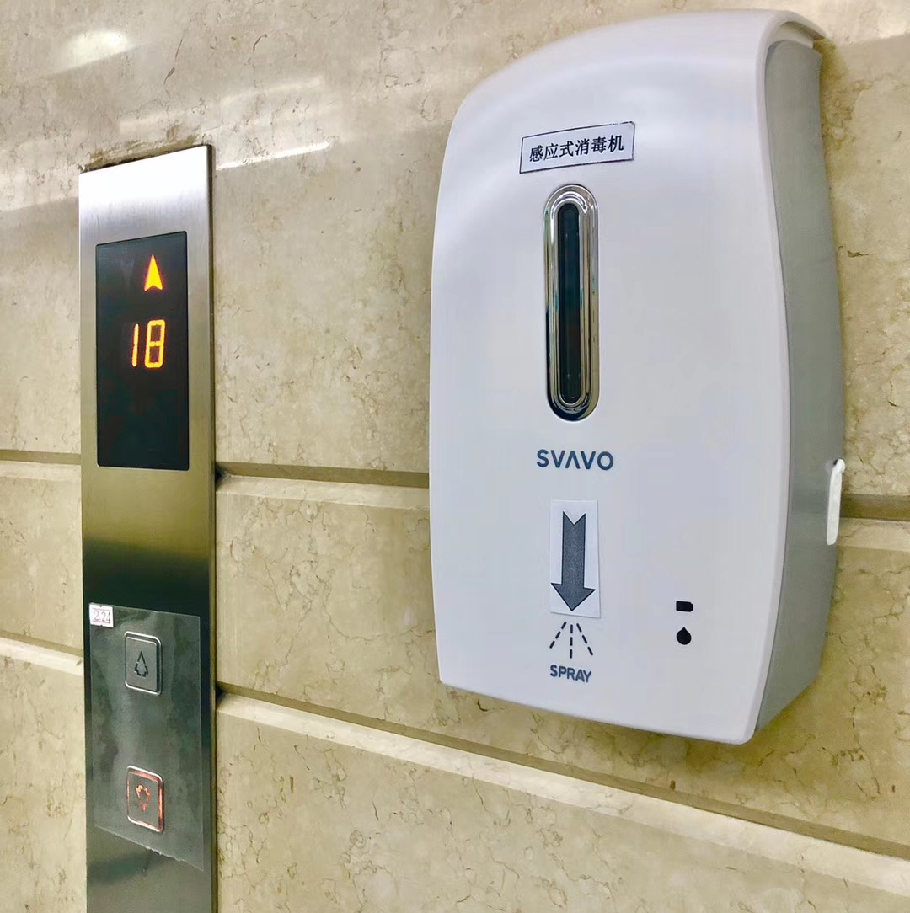
Emergency Measures

Slide 8
Emergency Measures
Measures to adjust bus services during the epidemic
Emergency procurement procedures
Robust management of staff movement and deployment
Clear & unified information communication platform

Slide 9
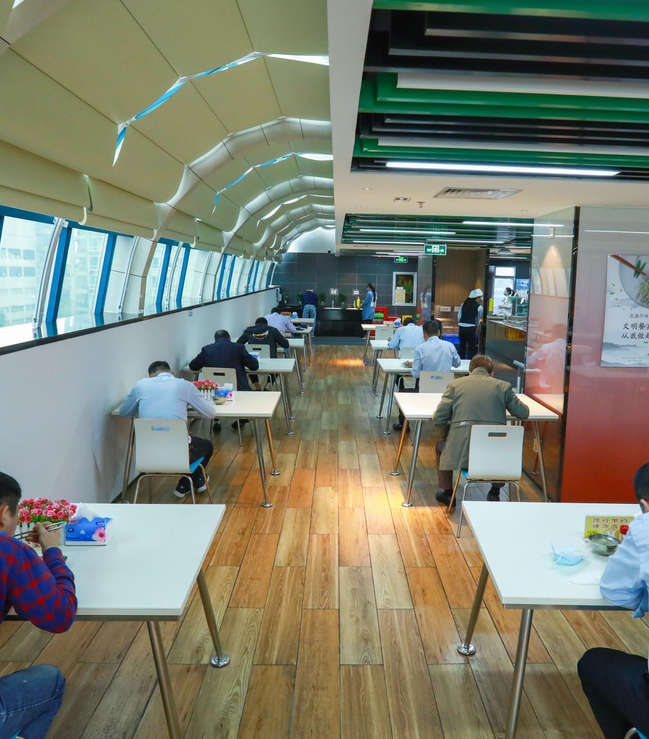
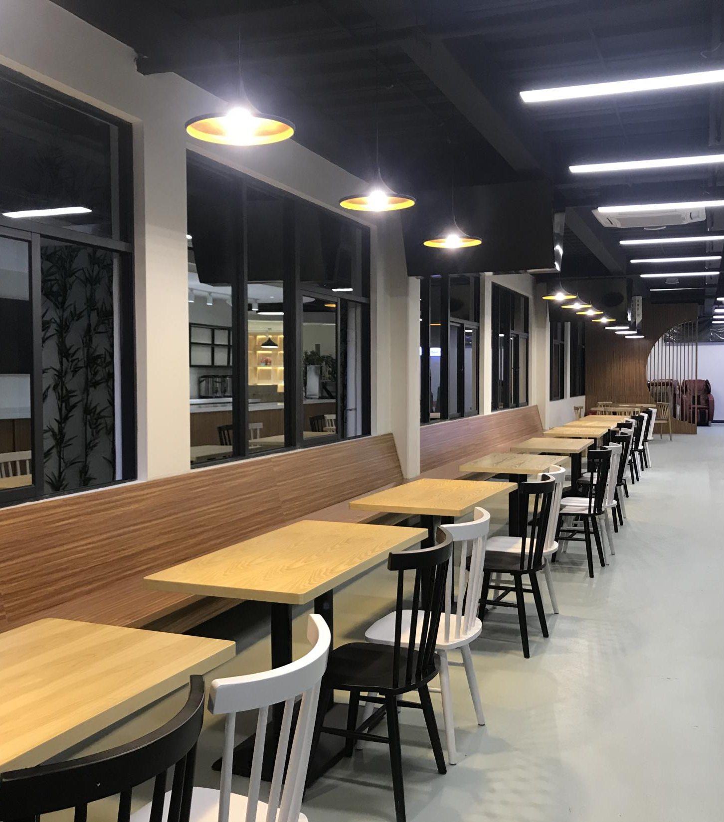
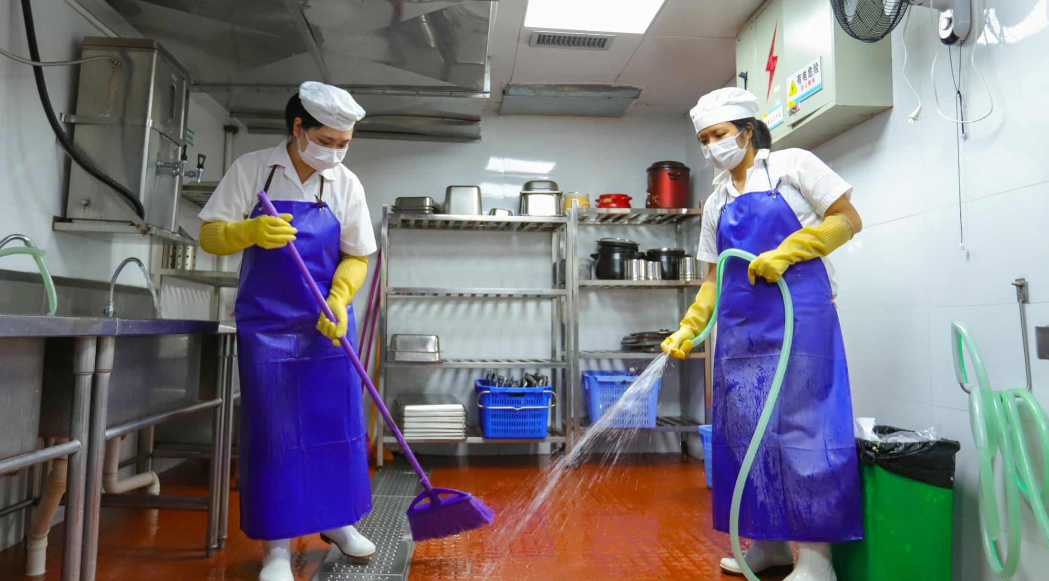
Emergency Measures
Canteen & Cafeteria Management

Slide 10
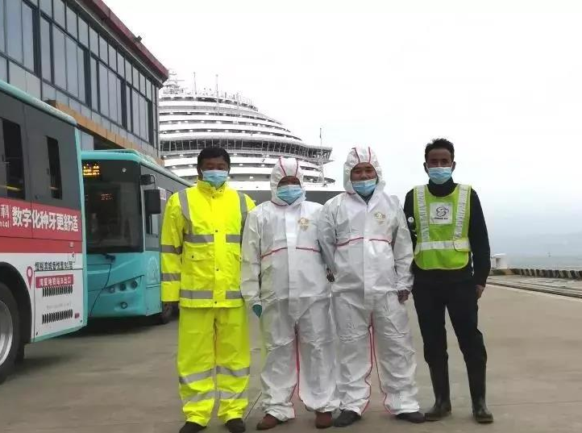
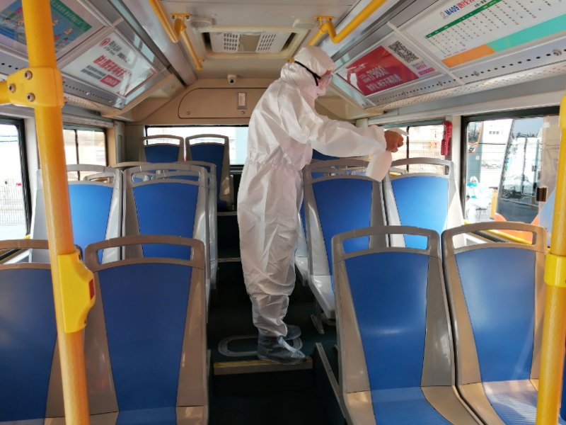
"Costa Venezia" Cruise Ship
SZBG Immediately launched an emergency evacuation plan mobilizing 70 emergency vehicles.
Front-line staff participating in this emergency evacuation were equipped with the highest measures including face masks, gloves and protective clothing.
All participating emergency vehicles were subsequently given throughout disinfection treatment.

Slide 11
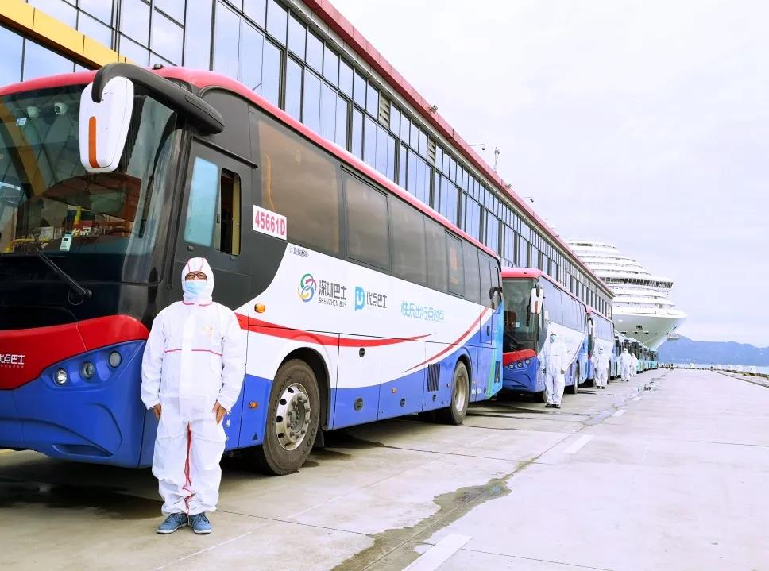
"Costa Venezia" Cruise Ship
Shekou Port
5,000 Passengers
148 Hubei Passengers
70 Emergency Vehicles
Seven Emergency Vehicles
Costa Venezia

Slide 12
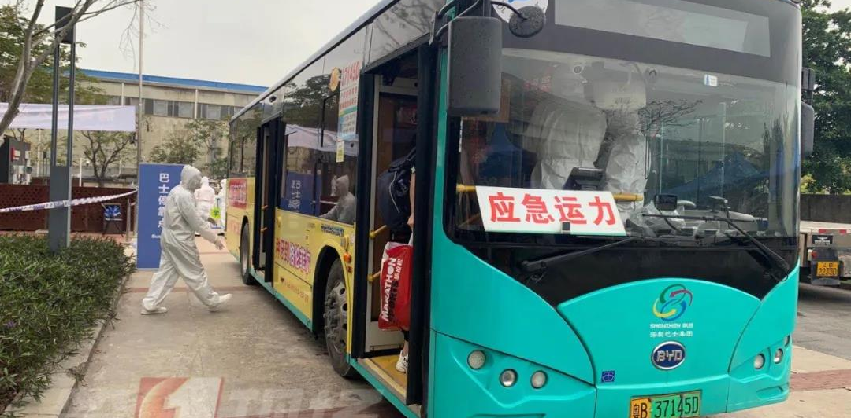
Shenzhen Bay Port
8 Disinfected Emergency Vehicles on Standby
202 Passengers were Transferred in 4 Days

Slide 13
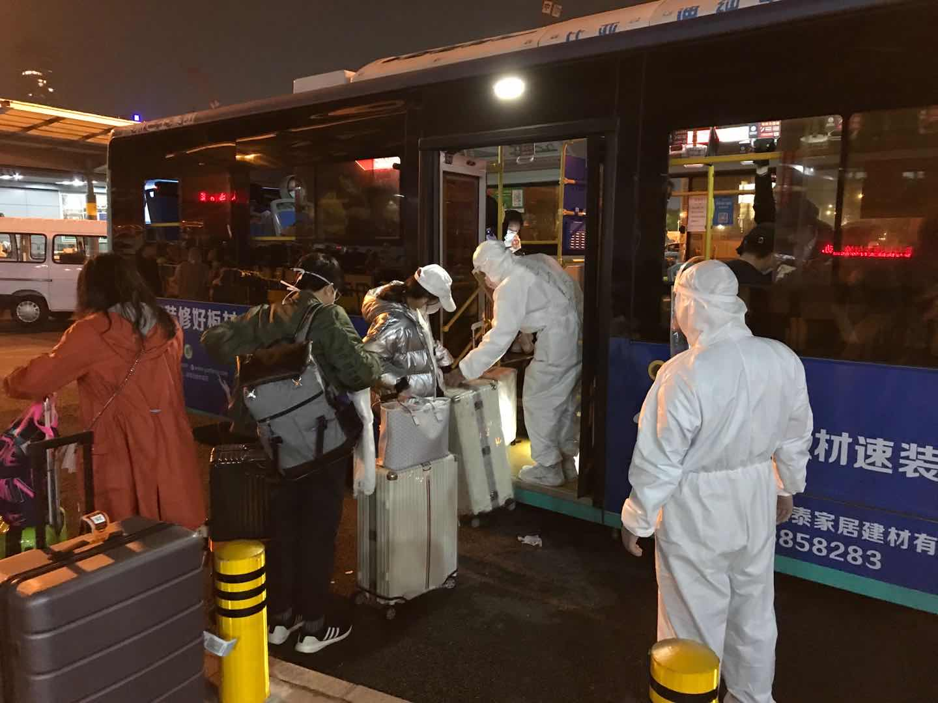
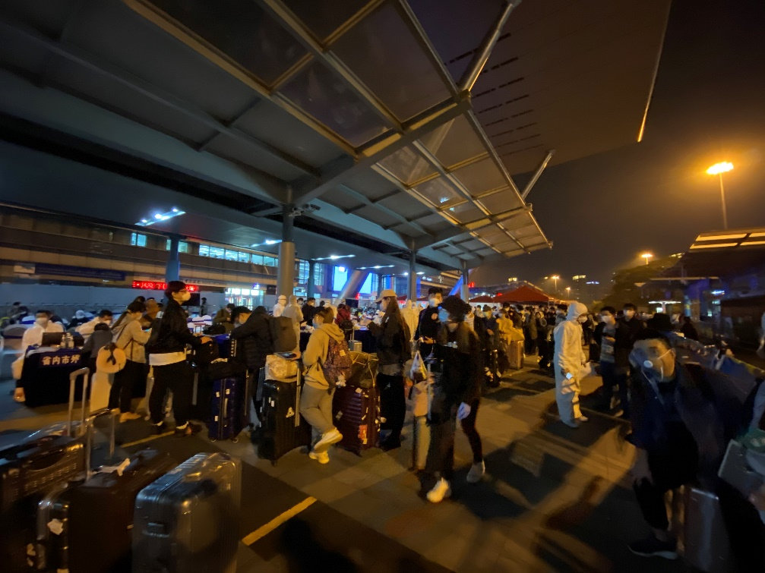
Other Border Checkpoints
With COVID-19 more under control, Shenzhen started to re-open some of its boarder checkpoints. As more citizens and travelers come in, the municipal government developed dedicated policies towards them.
Shenzhen Bus Group, as a public transportation operator, immediately starts to diverge resources at the checkpoints to assist passenger for their journeys from the checkpoints to designated quarantine hotels.

Slide 14
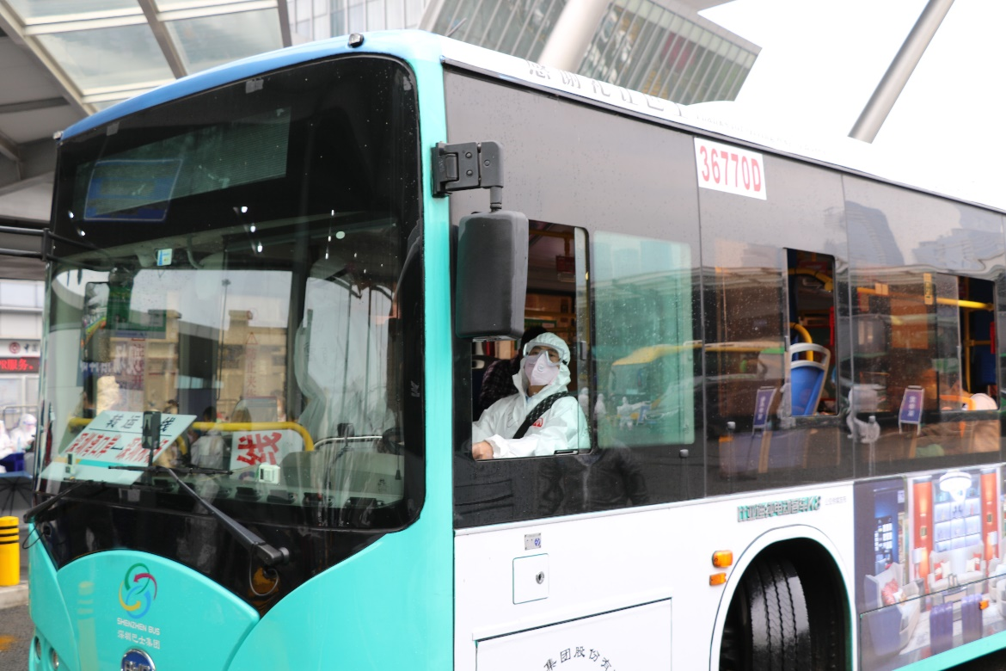
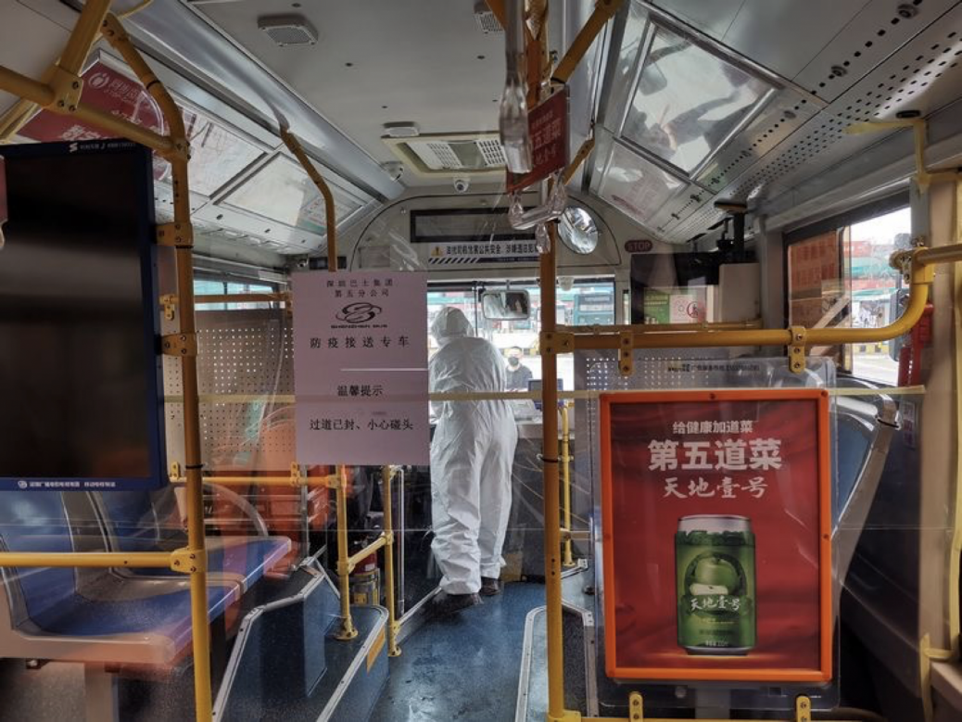
Other Border Checkpoints
Similar to its sister services for passengers on Costa Venezia, all front-line staff are equipped with the highest protective measures, and the vehicles in this service are thoroughly after each service.

Slide 15
Facing Up the New Normal

Slide 16
Resumption of Business and Work
1
14 Temperature Check Stations
2
“One Route One Plan”
“iShenzhen”
“Epidemic Prevention” APP
3
87 Lines for Key Areas
4
No more than 50% Passenger Loads

Slide 17
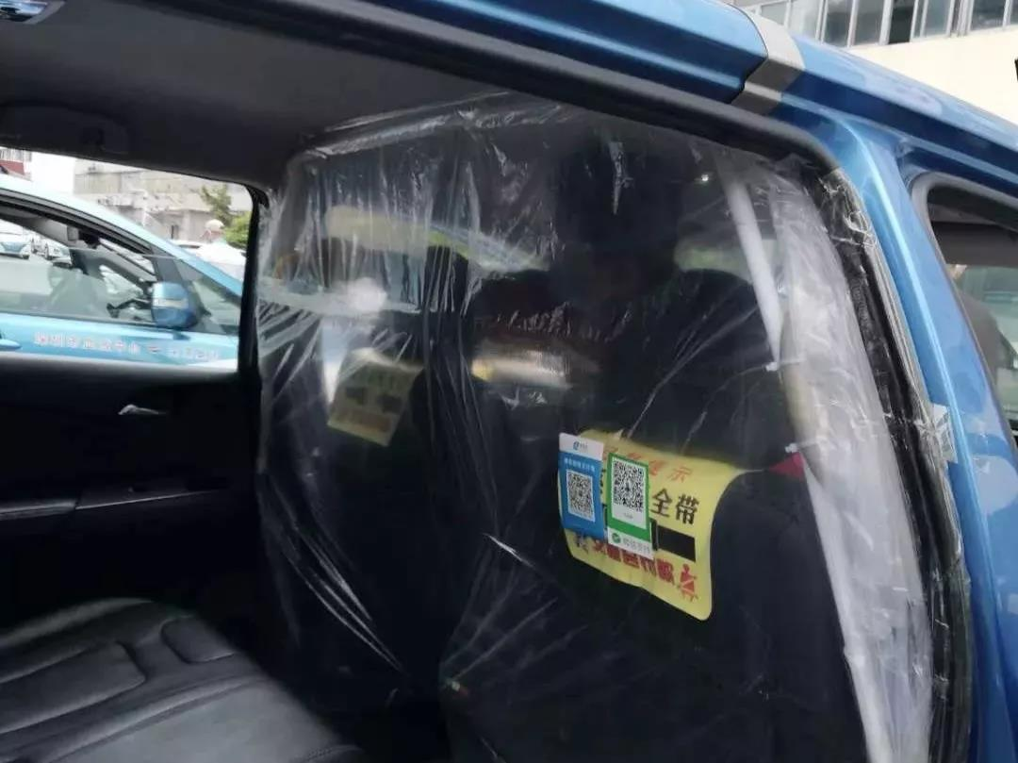
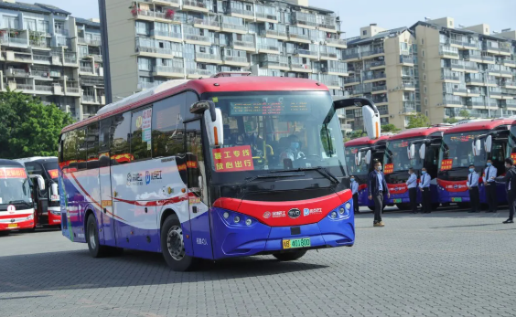
Resumption of Business and Work
Enhanced Safety Measures
Resumed On-Demand Services
Continued Passenger Load Monitoring

Slide 18
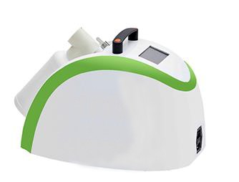
Sanitizations
Eliminates 95% of Gems/
Viruses
Safer for Passengers
Auto H₂O₂ Dispense
Remote Controlled Sanitizing
Covers up to 300m³ of Space
5-7 Days Between Refill

Slide 19
Online Training Courses
A Guide to Public Transport Epidemic Prevention
Technical Guide for Public Transport Disinfection
Training Evaluation Management System
Notification to Shenzhen Citizens, Incoming Visitors and Businesses
Mobilisation Measures Against Covid-19

Slide 20
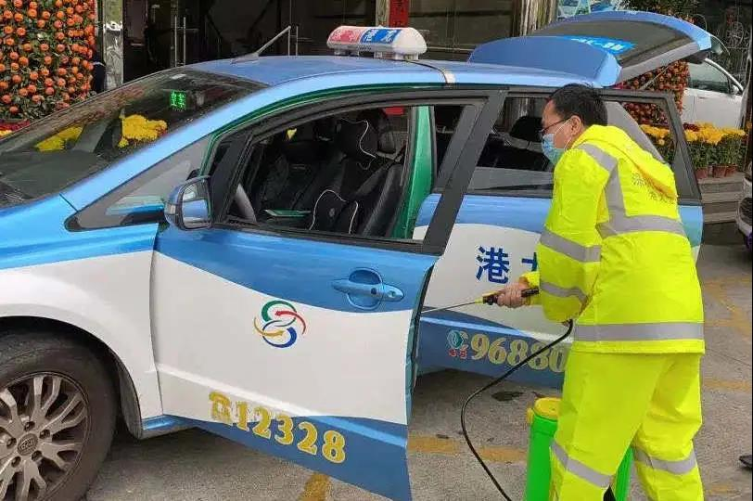
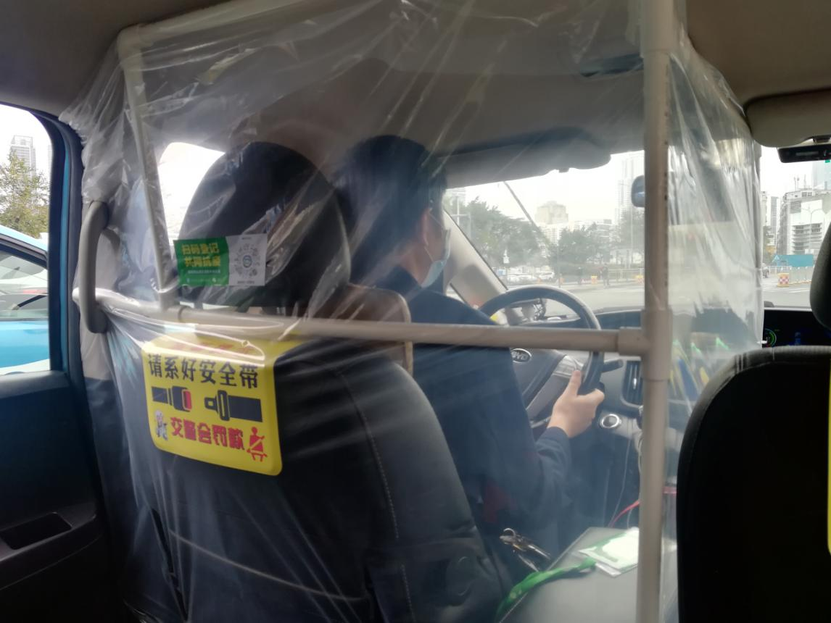
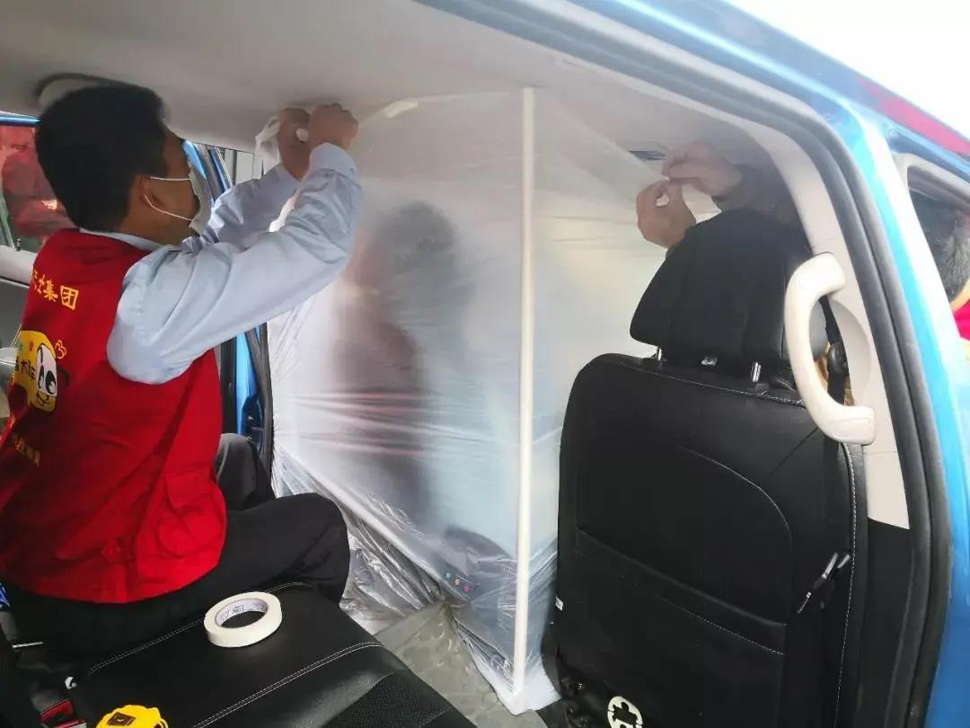
Taxi Services
Minimal Contact Anti-Virus Taxis
Disinfecting all vehicles at least 3 times everyday
Pengcheng Taxis & Shum Kong Taxis
All drivers are asked to register via a QR code
A 14-day mandatory quarantine
Stringent Measures at All Taxi Depots

Slide 21
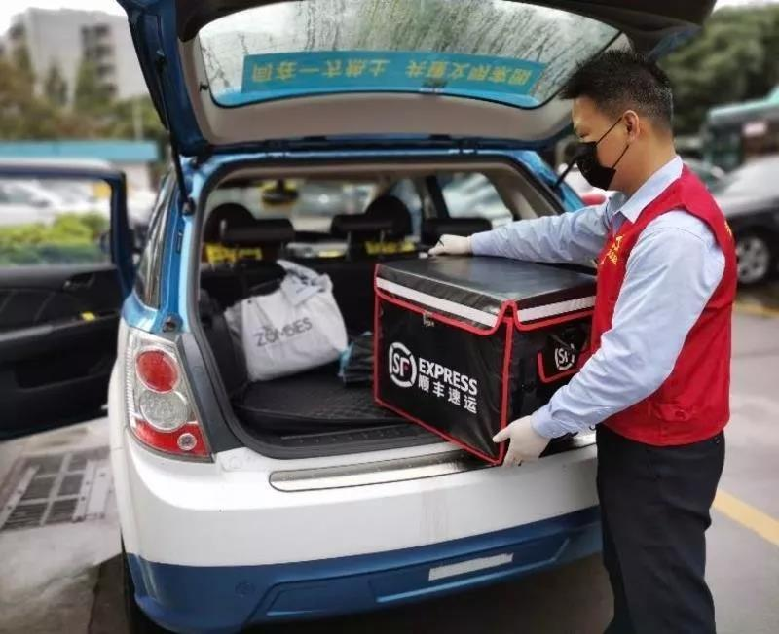
Taxi Services
750 Taxi Drivers & 4,000 Urgent Items
Reducing monthly taxi rental fee & Cutting electricity charging service fee by half in 10 charging stations operated by SZBG.
Pengcheng Taxis & SF Express - Joint Courier Services.
All Taxi drivers - Online Learning APP “Training Evaluation Management System”

Slide 22
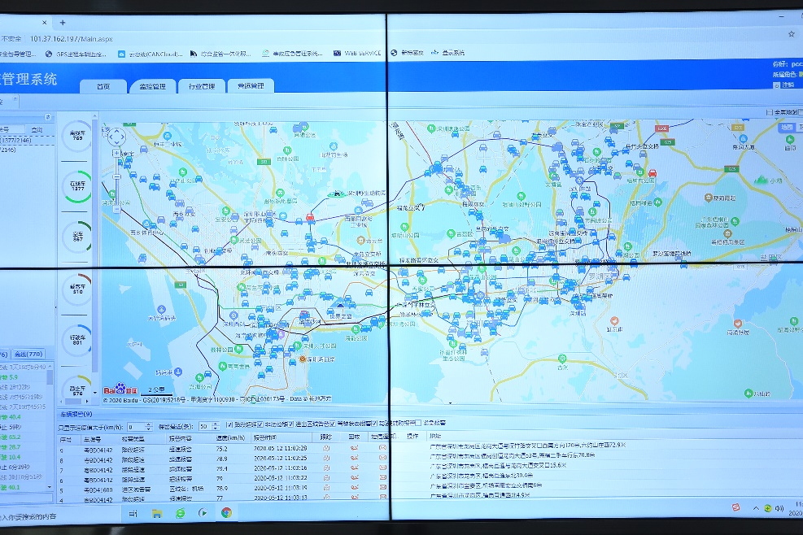
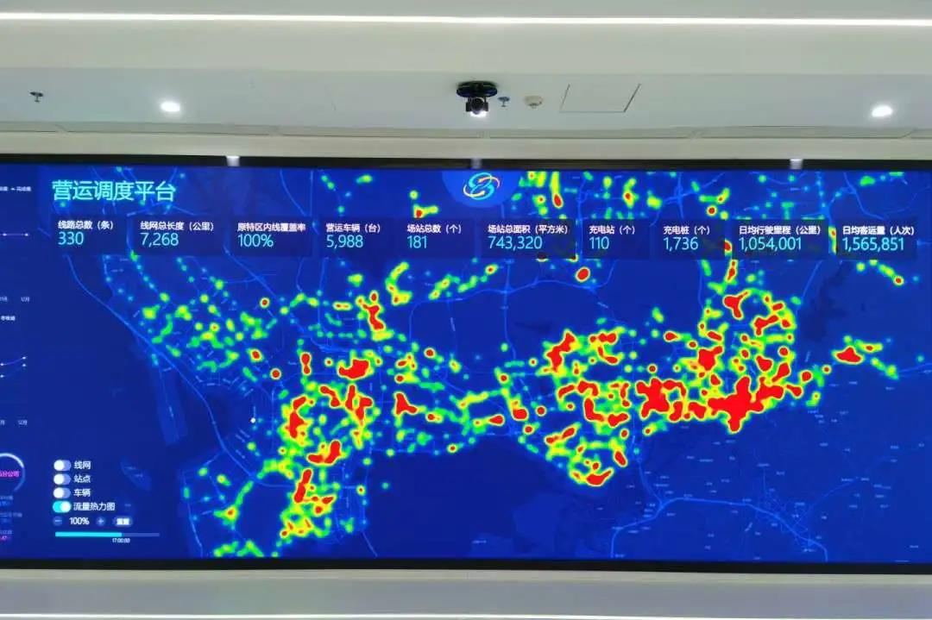
Intelligent Transportation System
High-density Passenger Carriage Early Warning
Video Conference, Video Networking & Intelligent Dispatch

Slide 23
Caring for the Community & Staff
Free Transfer Service for Blood Donors
Free Health Service to Public Transport Staff through Online Clinics
Employee Assistance Programme (EAP)
Hotline for Counseling
Hairdressing Services

Slide 24
QUESTIONS?

Slide 25
Thank you!
For further information, please visit en.szbus.com.cn or email us directly (info@szbus.org)

