Slide 1
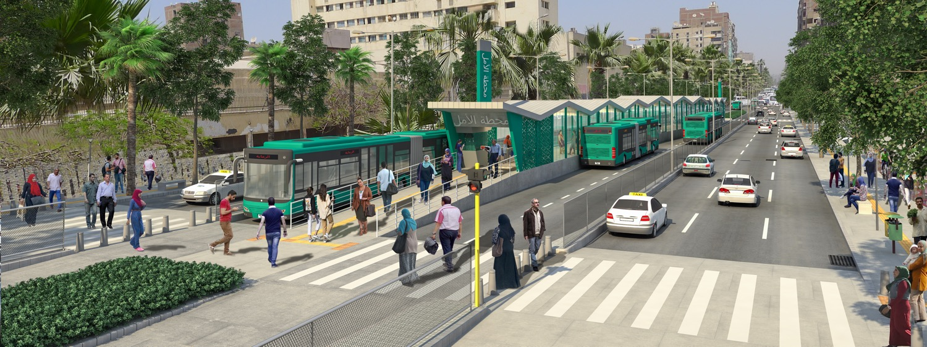
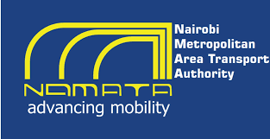

Cairo BRT Western Corridor design
GUC
April 2021

Slide 2
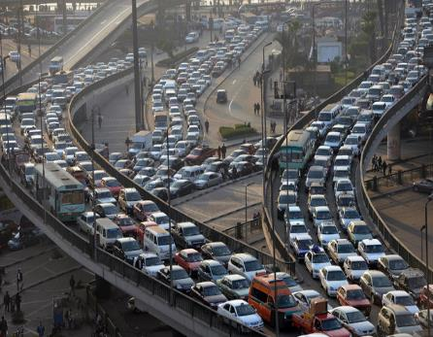
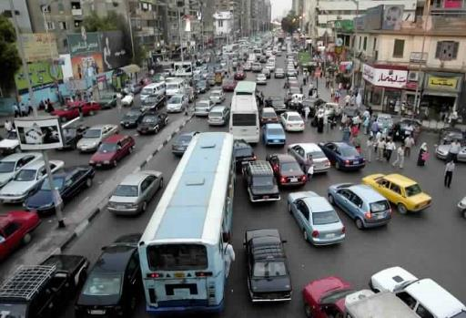
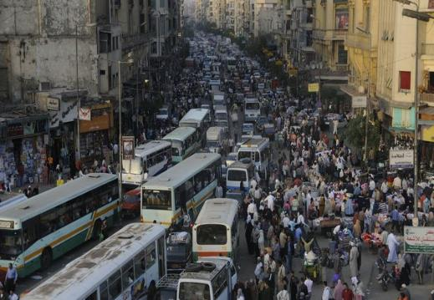
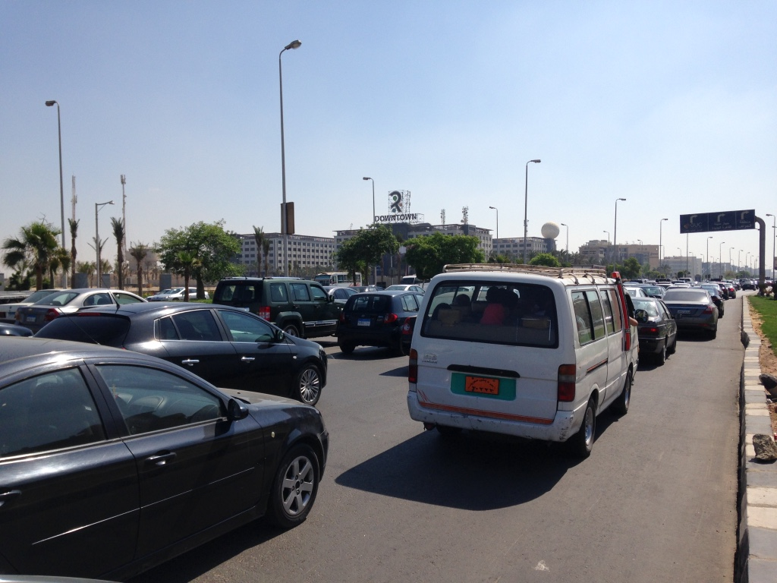
Cairo traffic congestion
Source: Google images
Notes:
tab3n e7na kolena 3la deraya bel sowar dy w benwagh el wake3 dh kol youm
Traffic congestion and how its affecting us: za7met el mrour wel khathafa el mororeya el 3alya ba2et ta2asr 3alina be shakl fa3al
1)Longer Trip times إختناق السير ساعة الذروة wa2t el re7la ketr
2)Not enough time to do many activities أنشطةper day (Chart on how much people spend in traffic/day)
3)Pollution (Cairo levels of pollutions; if it exceeds WHO guidelines; if people are dying because of that every year)
4)Tiring; accordingly affects our productivity not working efficiently يؤثر على الإنتاجية بشكل فعال

Slide 3
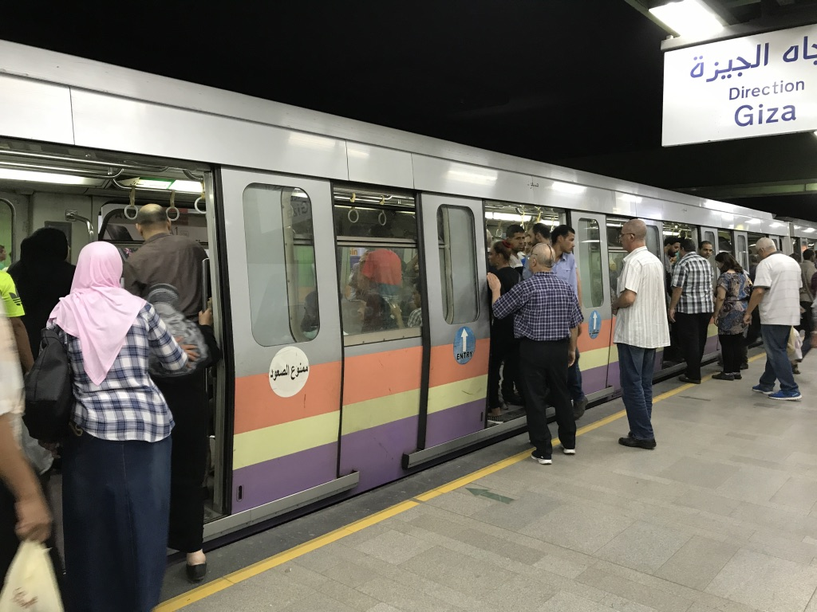
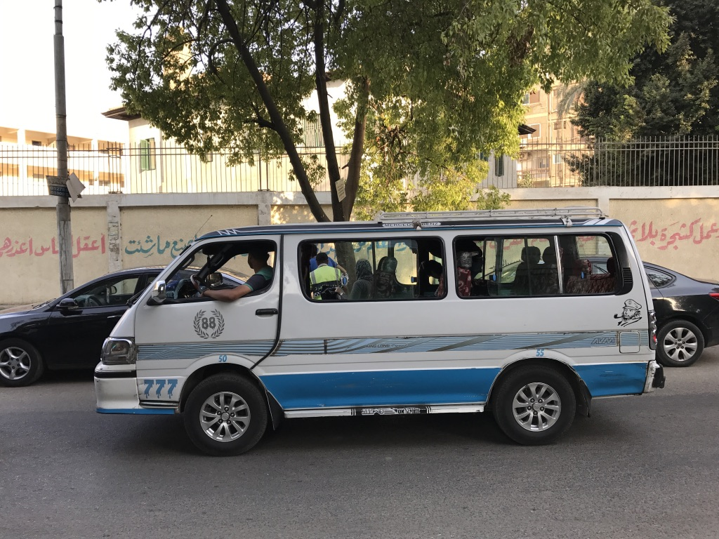
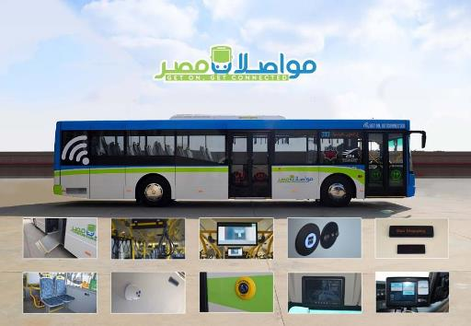
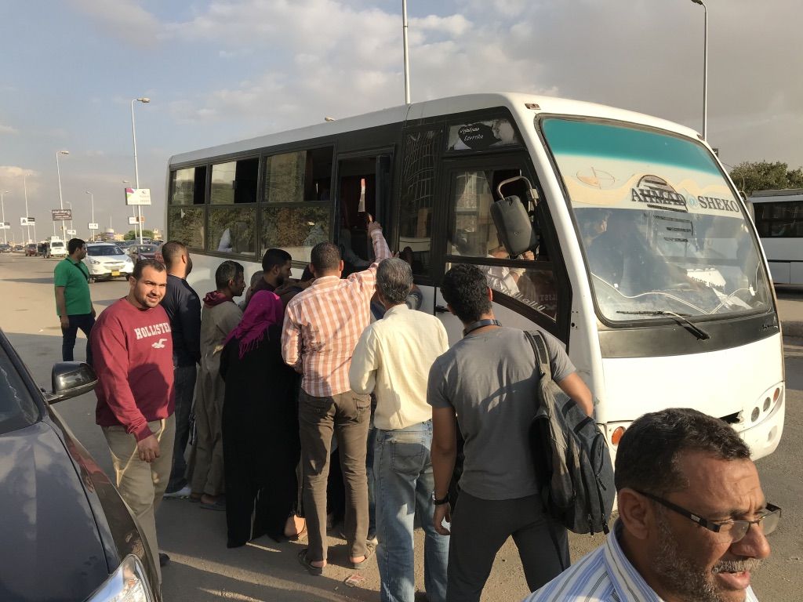
Most Public transport trips depends on microbuses
78 km metro network
Microbus - 14 seats
Modernized public transport buses
Minibus – 26 seats

Slide 4
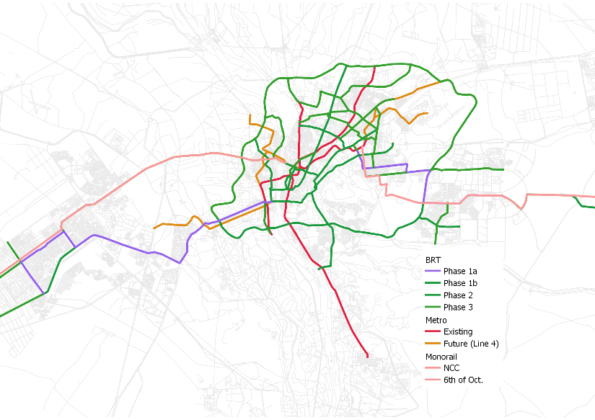
Cairo BRT Master Plan
Year 2033
6th of
October City
New Cairo
Giza
Cairo
Year | Population | Metro (km) | BRT phase | BRT (km) | BRT fleet* | Total MRT (km) | RTR
2018 | 20,000,000 | 74 | Existing | 0 | 0 | 74 | 4
2021 | 21,000,000 | 74 | 1a | 67 | 538 | 141 | 7
2023 | 23,000,000 | 74 | 1b | 115 | 917 | 188 | 8
2028 | 26,000,000 | 131 | 2 | 251 | 2,011 | 382 | 15
2033 | 29,000,000 | 131 | 3 | 415 | 3,323 | 546 | 19
Notes:
Rapid Transit to Resident Ratio
Alignment of existing CTA & paratransit routes
Public transport passenger volumes (where counts are available)
Integration with existing and planned metro corridors
Available street right-of-way
Links to development areas (e.g., New Capital)
Bus Operational Plan in NCC and BRT in 6th of Oct.

Slide 5
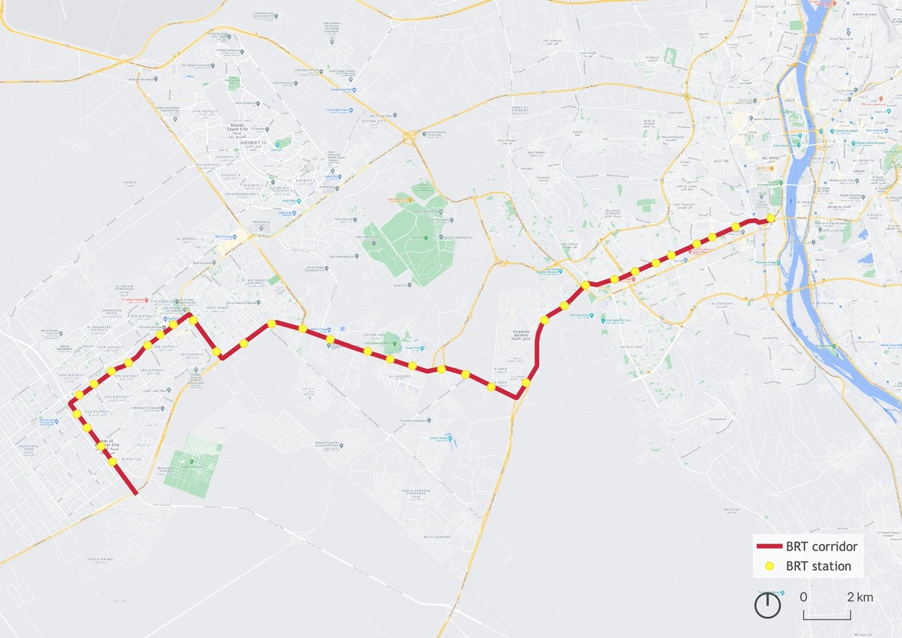
Cairo BRT Western Corridor
41.5 km corridor
34 stations
3 terminals: Giza Square, Metro Faisal, & Industrial Rd
1 depot: Industrial Rd
Giza
6th of
October City

Slide 6
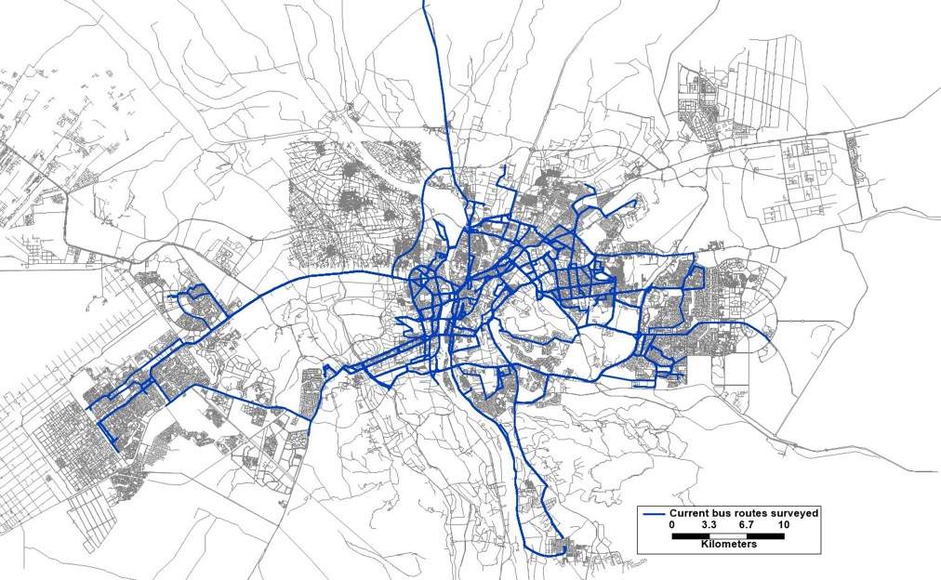
Planning process
Passenger demand assessment
Corridor identification
Service plan
Infrastructure design
Financial model
  Mapping of existing public transport routes
Business & institutional plan
Notes:
Last two steps inconcurrent
تقييم الطلب على الركاب
Coding of CTA, minibus, and microbus routes using Transcad & Emme
- 103 routes surveyed (2018) + around 87 routes (2019)
- Routes not surveyed don’t interact with corridor and low frequency

Slide 7
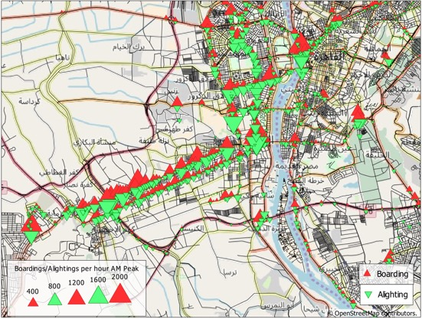
Data collection process
Available right of way
Public transport speeds
Public transport volumes
Boardings/ alightings
Notes:
data collection process that informed the service plan

Slide 8
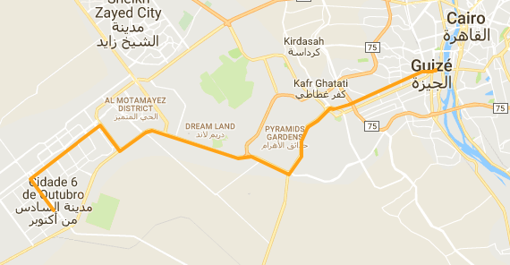
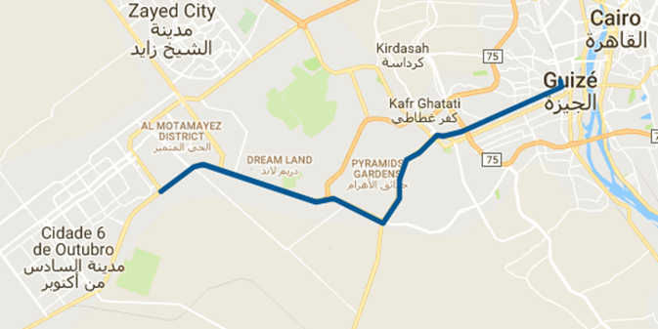
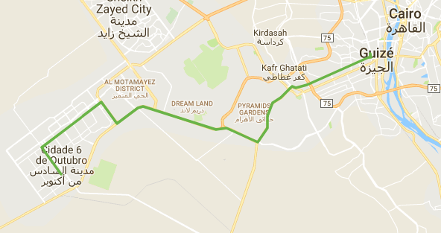
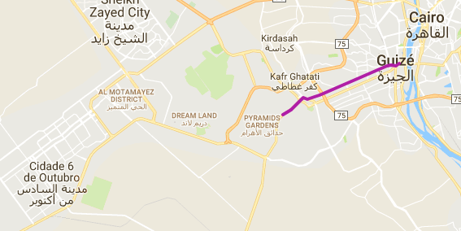
Service plan - Western BRT
Daily boardings: 126,000 (express and regular services)
Speed: 21-35 km/h (vs. speed of 5-10 km/hr on Mehwar Markazi & Faisal today)
Stations: 34
Fleet: 119 articulated buses (18 m bus)
Line 1
39 km
97 min
28 stops
Line 3
26 km
59 min
9 stops
Line 2
38 km
93 min
24 stops
Line 4
10 km
27 min
11 stops
Notes:
*Ticket price : 4.5, 6.5, 8.5 EGP

Slide 9
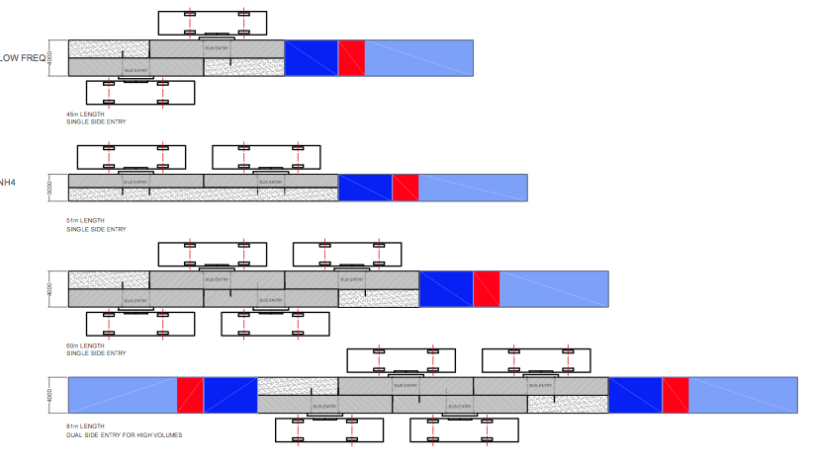
Planning process
Passenger demand assessment
Corridor identification
Service plan
Infrastructure design
Financial Model
  Station configuration based on passenger demand
Business & Institutional Mod.

Slide 10
Al Mehwar Al Markazi
Cross section on stations
Design Criteria
Bi-directional with at-grade pedestrian crossing station
Station with 2 platforms per direction on higher demand stations
Uses central median for stations
Eliminates service road on narrow stretches (stations), except on wider sections
3.00
2.00
9.00
9.00
2.00
3.00

Slide 11
Al Mehwar Al Markazi
Cross section outside stations
Design Criteria
Parking spaces out of the station areas
Median of 5,5 meters is preserved
3.00
2.00
2.50
2.50
2.00
3.00

Slide 12
Station typologies
Number of stations | Station Typology | Station Type
1 | Bidirectional with Pedestrian Bridge (2 platform per direction) | A
7 | Bidirectional At-Grade (1 platform per direction) | B
3 | Bidirectional with Pedestrian Bridge (1 platform per direction) | C
9 | Staggered with Pedestrian Bridge (1 platform per direction) | D
3 | Staggered with Pedestrian Bridge (2 platform per direction) | E
2 | Staggered At-Grade (1 platform per direction) | F
1 | Staggered At-Grade (1 platform per direction) | F*
2 | Staggered At-Grade (2 platform per direction) | G1
1 | Staggered At-Grade (2 platform per direction) | G2
2 | Bidirectional At-Grade (2 platform per direction) | H1
1 | Bidirectional At-Grade (2 platform per direction) | H2
1 | Staggered At-Grade (2 platform per direction) | J
1 | Bidirectional At-Grade (2 platform per direction) | K

Slide 13
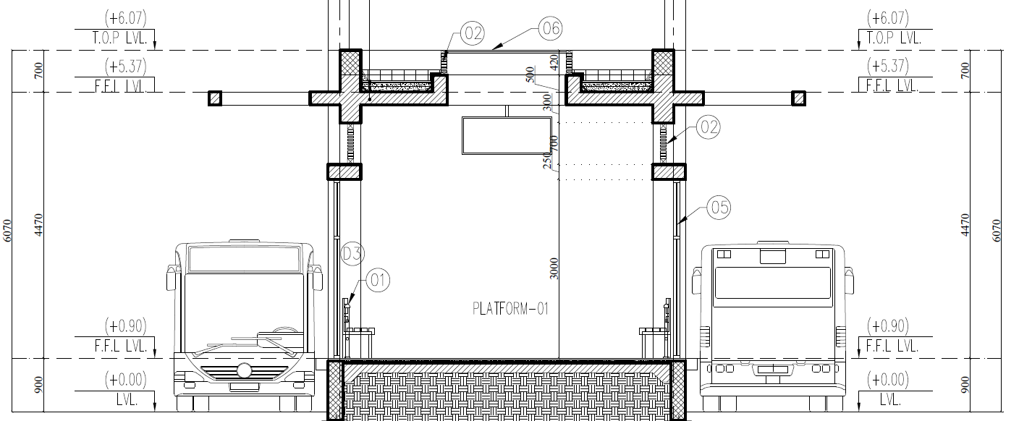
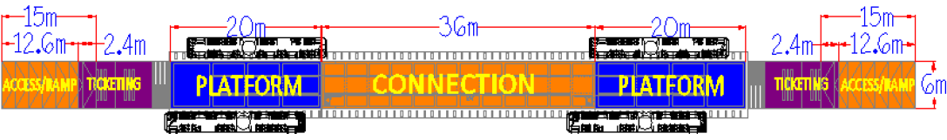
Type H1: At-grade station
Elevation view
(Type H1)
Plan view

Slide 14
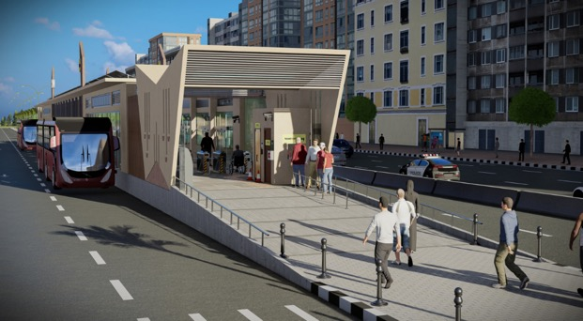
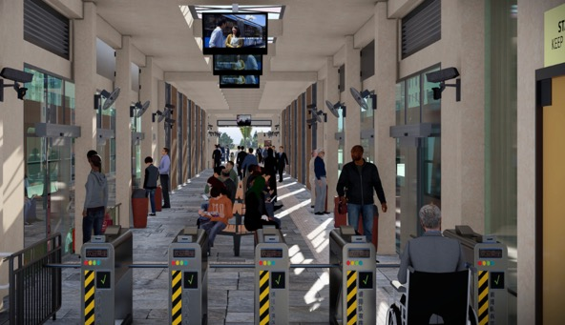
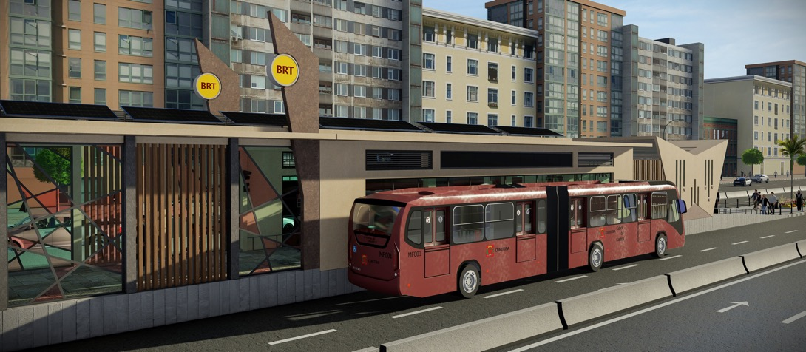
At-grade station
Station entrance
Station interior
Station view

Slide 15
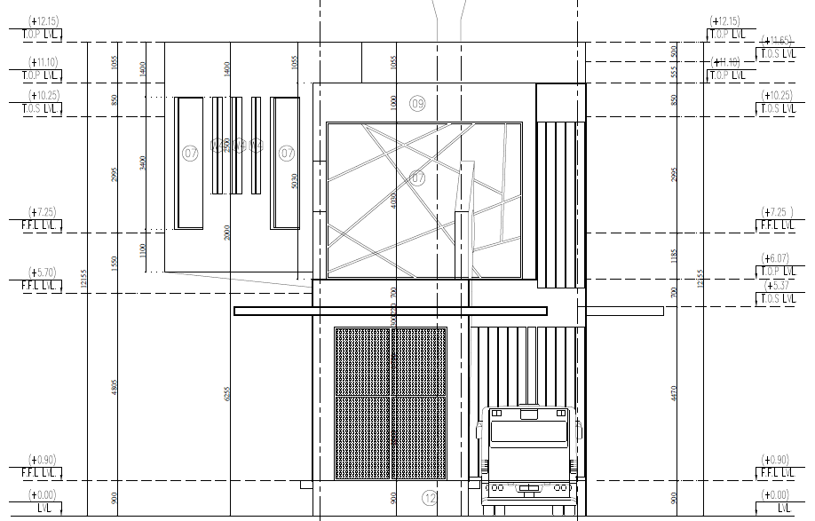
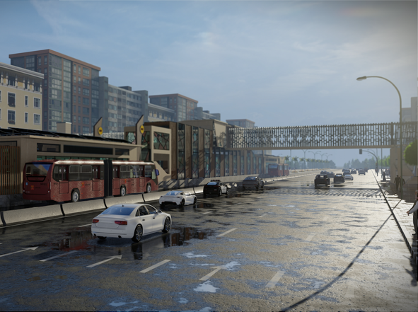
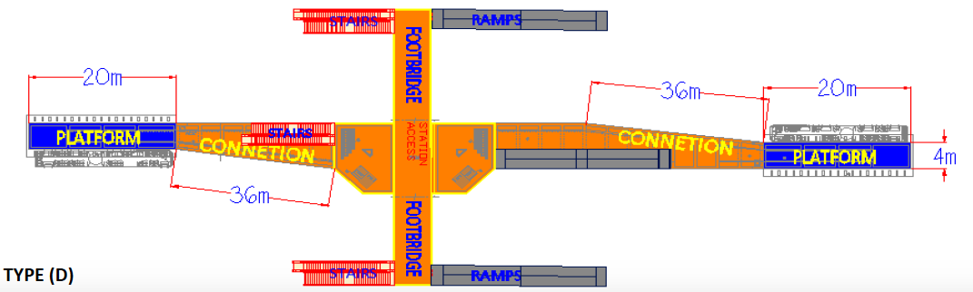
Type D: Pedestrian bridge station
Elevation view
Station render
Plan view

Slide 16
Station-bus interface
High ceiling with partial roof cover over bus
Minimal gap for easy boarding
(< 50 mm)
Platform extension
(200 mm) to ensure safe distance between bus and station
Platform and bus floor
at same level (e.g. 900 mm)

Slide 17
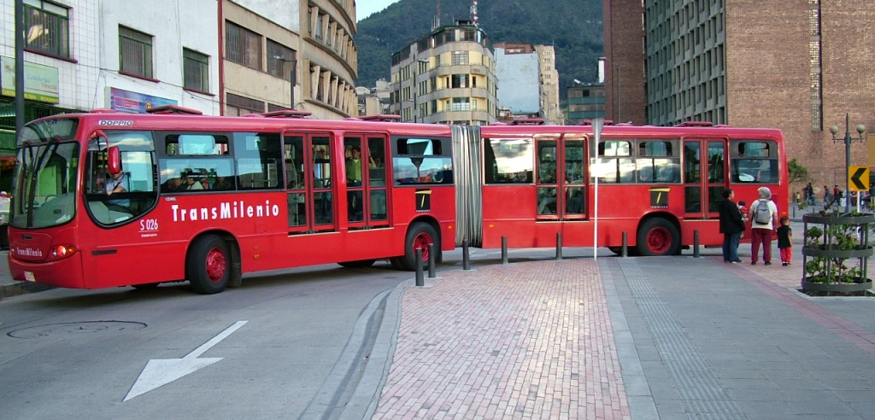
Bus specifications
Specifications:
Articulated
Length of 18 m
Four left doors
Engine emission technology
  Euro III or superior
Air Conditioning
High floor
Articulated: 140 passengers

Slide 18
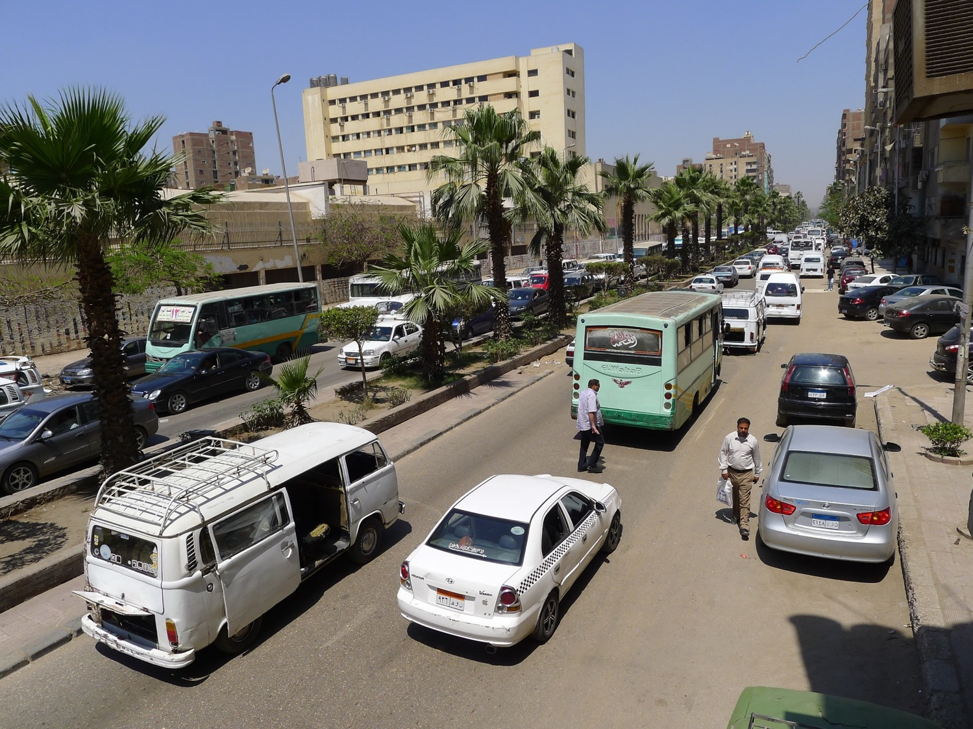
Faisal Street - existing

Slide 19
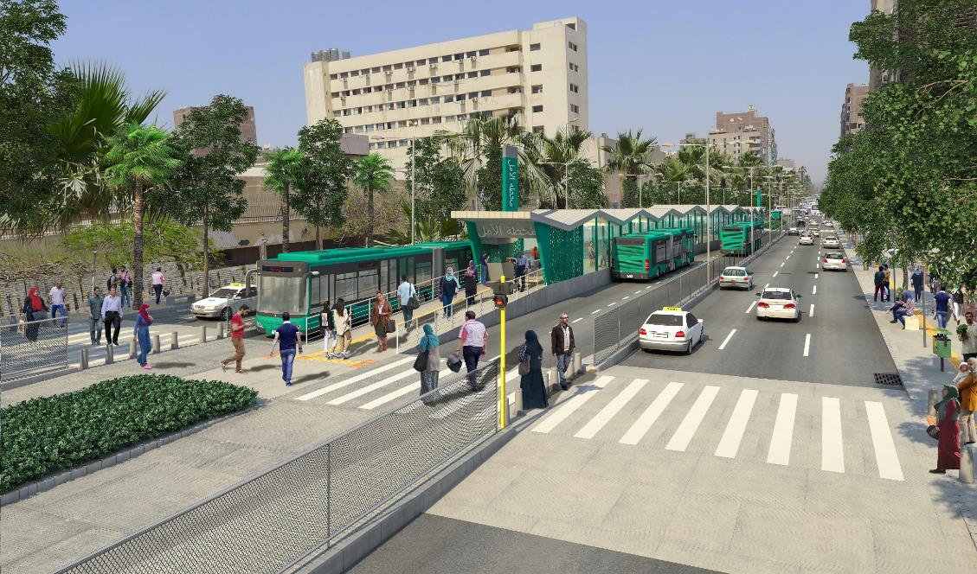
Faisal Street - proposed

Slide 20
BRT bridges and tunnels
Bridge/Tunnel | Activity
1 | Bridge to Faisal Metro Station and Giza Terminal
2 | Bridge from Mansoureya to Faisal
3 | Tunnel at Old Fayoum x New Fayoum
4 | Tunnel at Wahat x Old Fayoum road
5 | Bridge 4 (Wahat x 26th of July)
6 | Dolphin Bridge (Mehwar Markazi x 26th of July)
7 | Depot Bridge
1
6
2
5
3
4
7

Slide 21
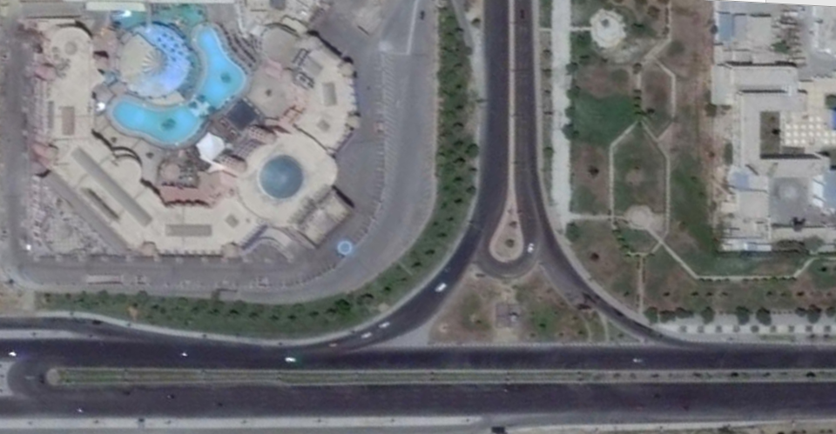


26th of July Intersection
Existing

Slide 22
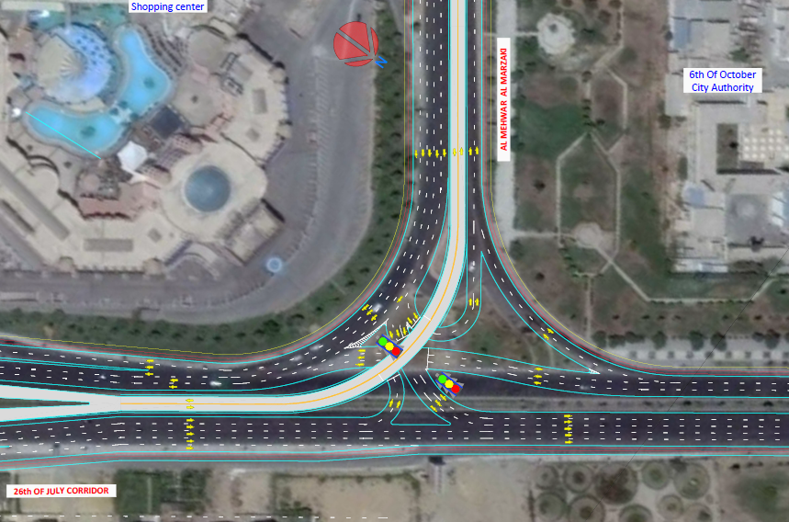
26th of July Intersection
Alternative 1 with BRT crossing at grade

Slide 23
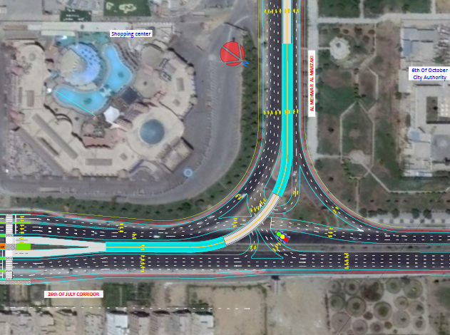
26th of July Intersection
Alternative 2 with BRT exclusive flyover
*From Al Mehwar Al Markazi to 26th of July north, currently vehicles use the U-Turn. The solution proposed allows the left turn directly with traffic lights

Slide 24
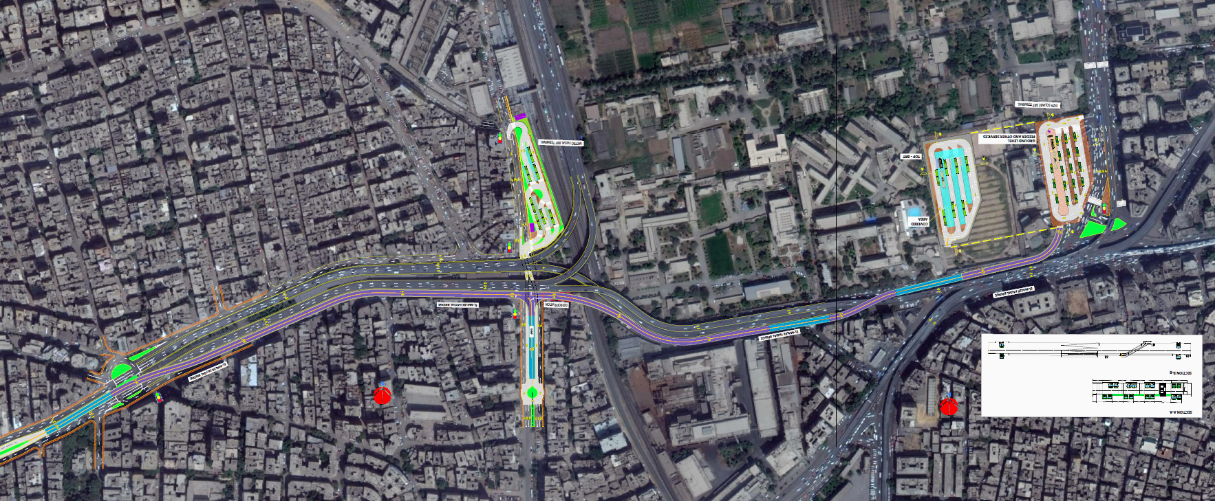
Giza Bridges
Metro Faisal BRT Terminal
Giza Square BRT Terminal

Slide 25
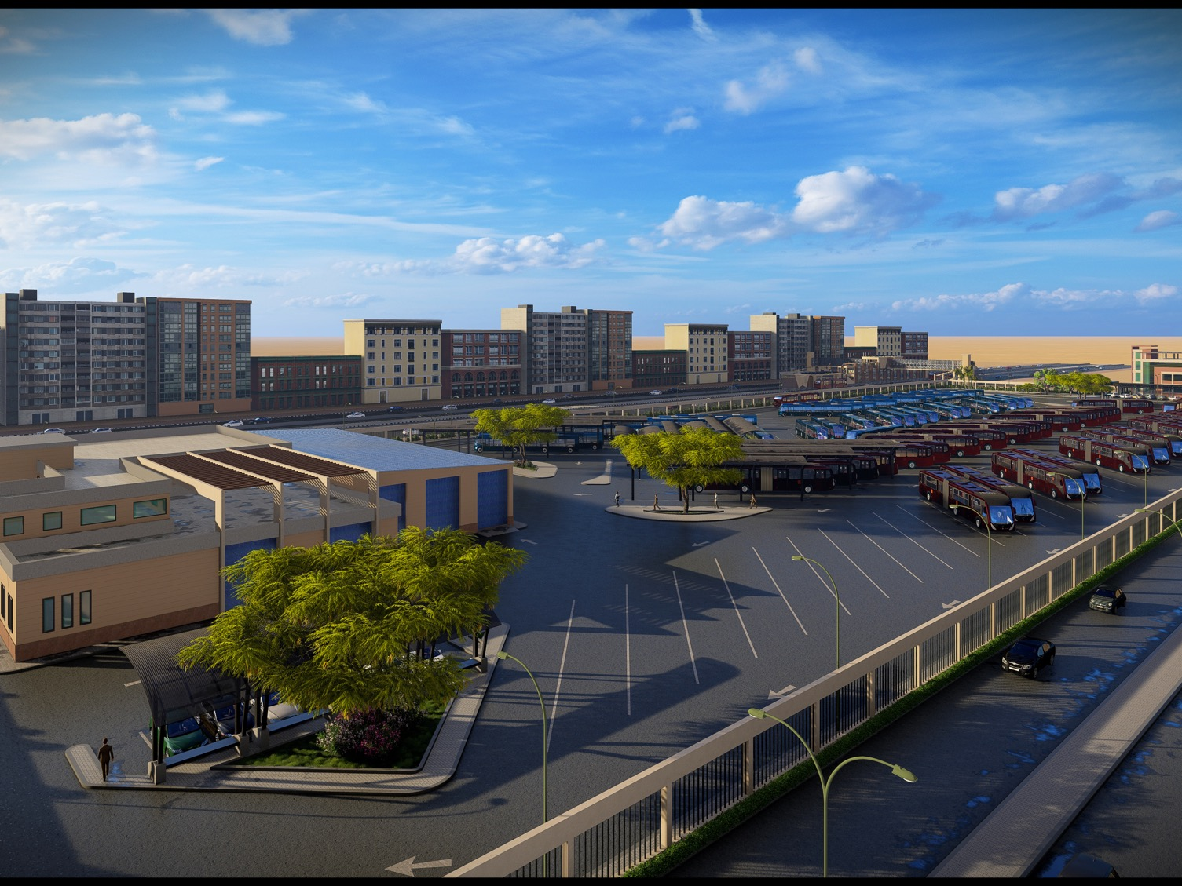
Industrial Rd. Depot

Slide 26
Planning process
Passenger demand assessment
Passenger
$ fare
Corridor identification
Fare Collection Company
Service plan
$ fare
revenue
$ remuneration
$ subsidy
Government
Trust Fund
Infrastructure design
$ remuneration
$ remuneration
Bus Operator Company
Financial Model
Business & Institutional Mod.

Slide 27
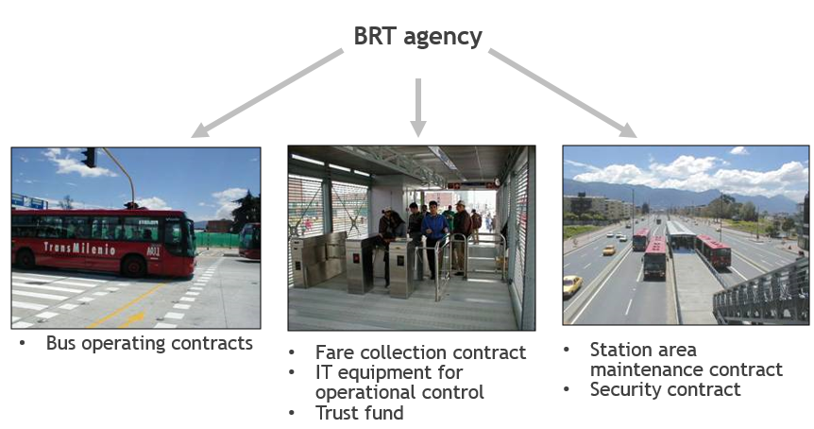
Planning process
Passenger demand assessment
Corridor identification
Service plan
Infrastructure design
Financial Model
Business & Institutional Mod.

Slide 28
Thank you
africa.itdp.org

