Slide 1
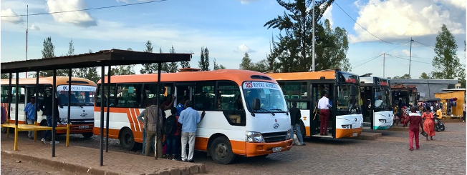



Public Transport Reforms
April 2021

Slide 2
Current status
Matatus provide essential service
Minimal government involvement
All risk is allocated to the private sector
Resulting challenges
Dominance of rent seeking cartels
Police demand bribes
Old fleet, inadequate maintenance –pollution affecting passengers, crew and pedestrians

Slide 3
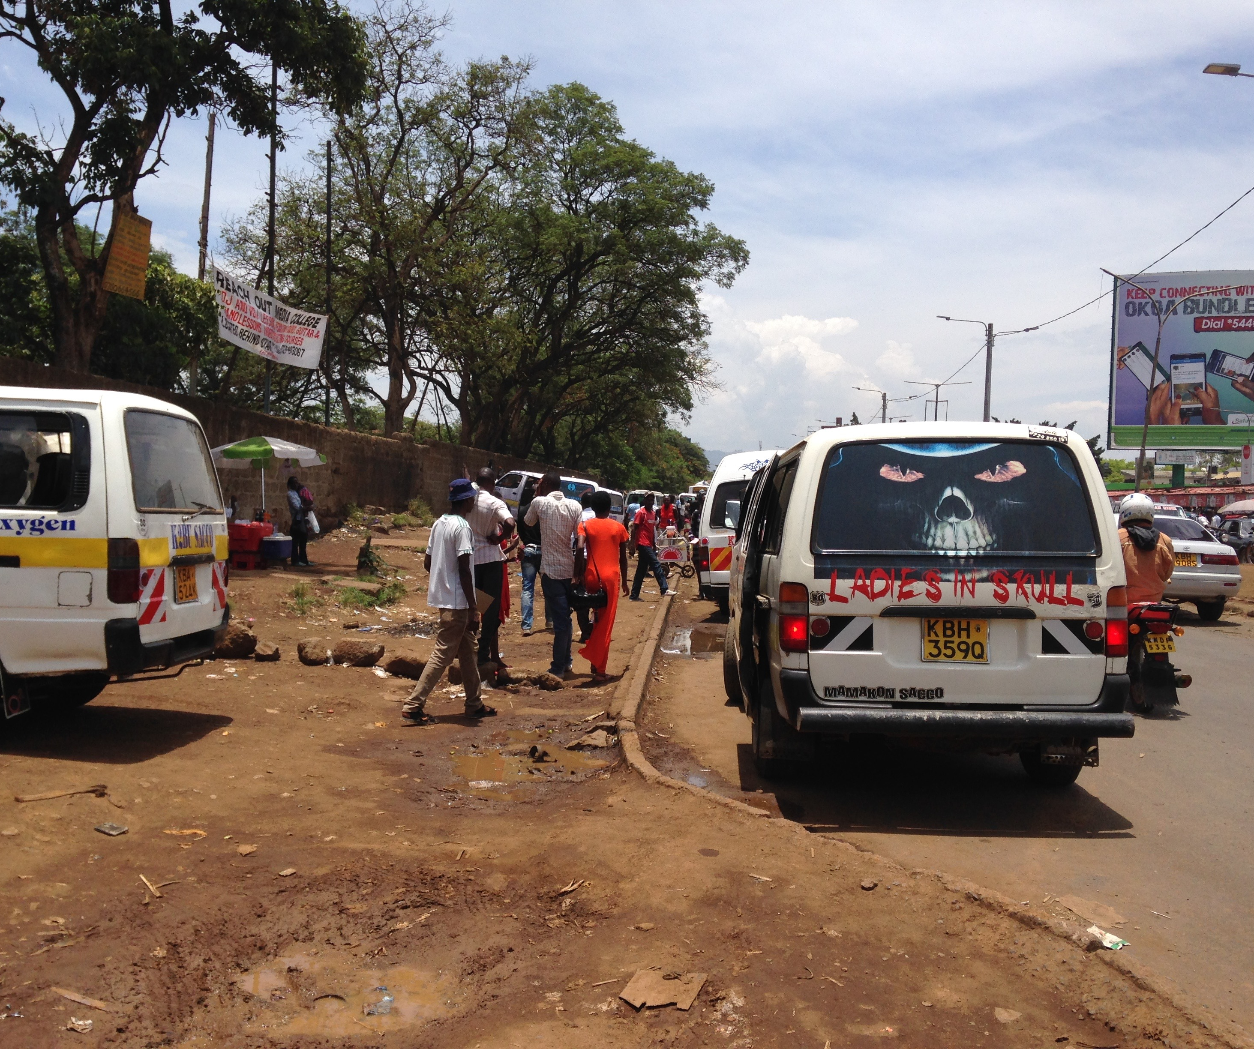
Low service levels
Routes & schedules based on profits not passenger convenience
Low system efficiency
Poor customer service
Notes:
Note Note

Slide 4
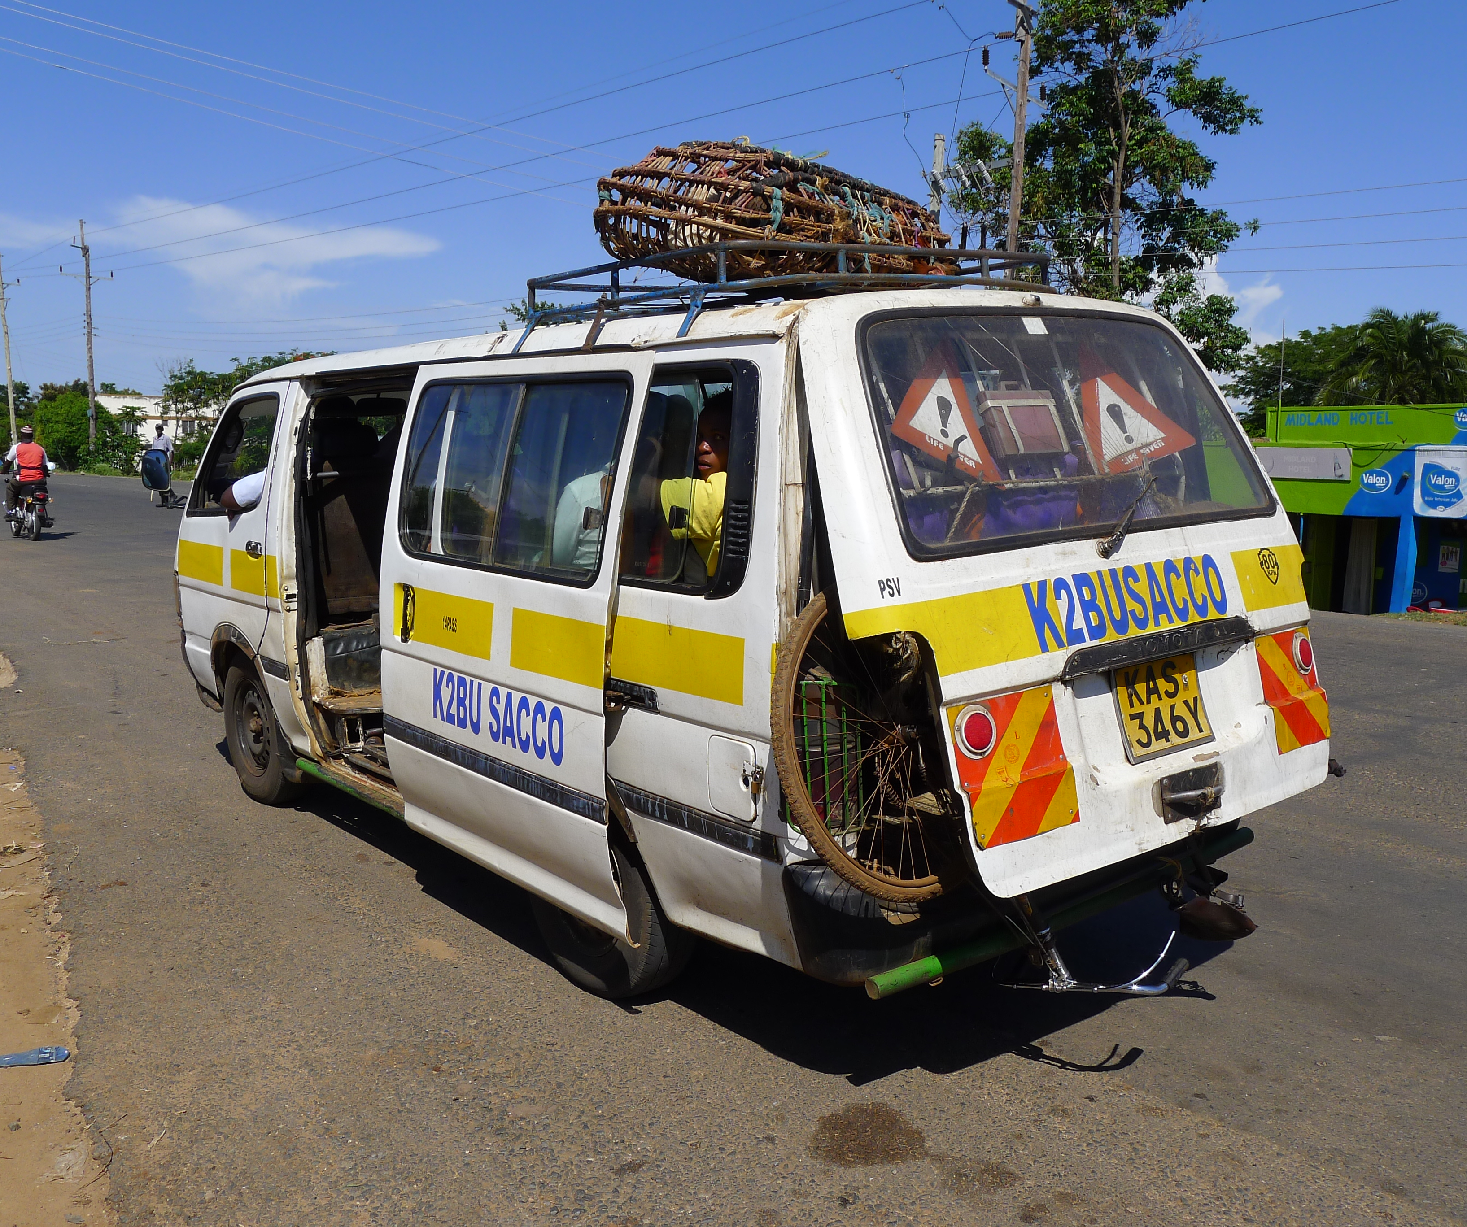
Labour issues
Crew work long hours
Drivers compensated based on the target system
Speeding resulting in frequent crashes.
No benefits (medical, maternity, leave etc)
Poor working conditions especially for women
Notes:
Note Note

Slide 5
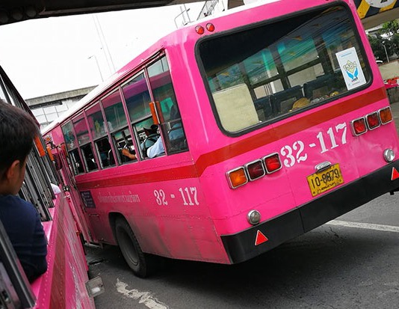
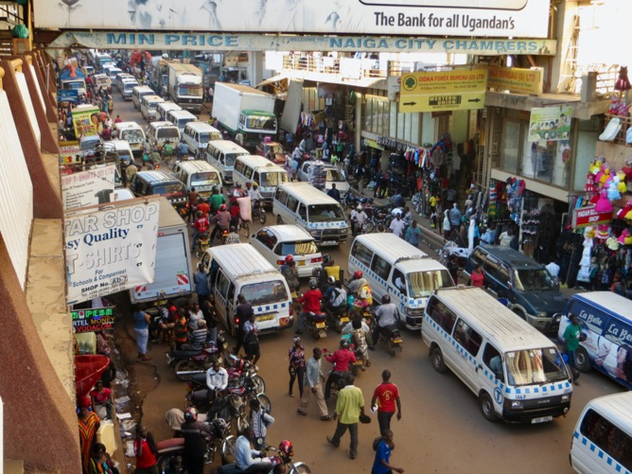
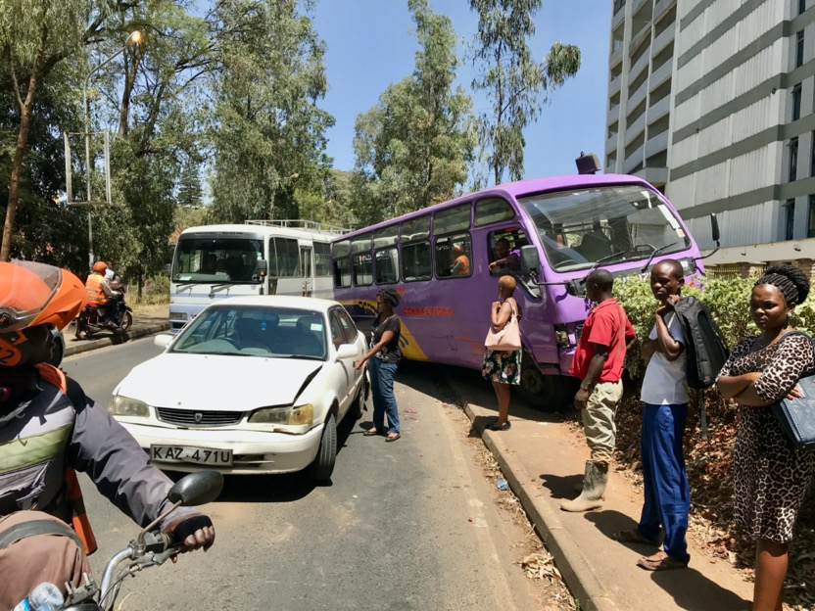
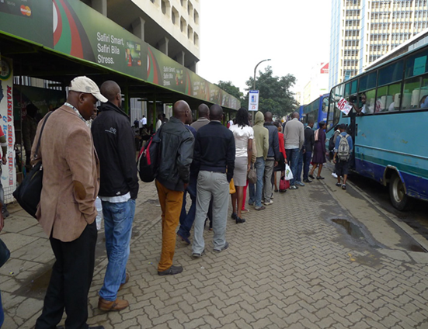

Slide 6
Regulating public transport operations

Slide 7
Regulating modern Bus Company
Government must be;
    Strong/firm
      Enforce standards, deal with cartels and traffic police corruption
    Consistent
    Fair regulator

Slide 8
Role of Government
Provide infrastructure
Policies and regulations
Set the minimum service levels
Enforce regulations and standards
Develop an operation Contract
Procure operators through competitive process
Support through subsidies

Slide 9
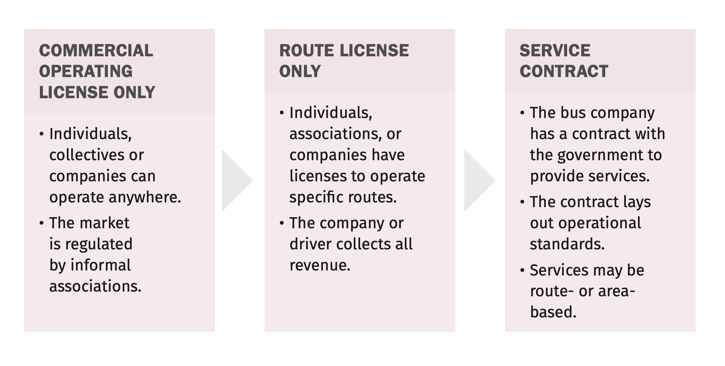
Evolution of bus sector regulation

Slide 10
What are the components of a bus operating contract?
Detailed bus specifications
Payment model (e.g., per kilometre, per passenger, etc.).
Depots where the service will be based, and who is responsible for paying for what.
Detailed explanation of quality of service- bonuses and penalties.
Process for settling disputes.
Role of Operating Company and role of Government agency
Clear explanation of the assets the government is providing to the company, if any, and the terms of use.

Slide 11
How should bus operators be compensated?
Net cost contract
Gross cost contract
Customer fares
Customer fares
Public transport authority
Subsidy
Bus operator
Trust fund
Payments with service level adjustments
License fee
Public transport authority
Bus operator 1
Bus operator 2
Fare collection/
ITS operator
Trust fund manager

Slide 12
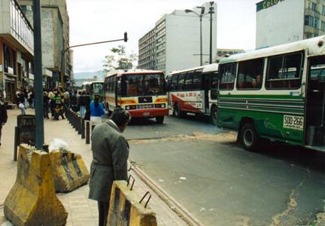
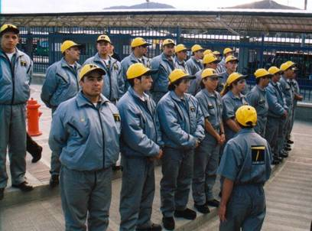
New economic model for public transport services
Company earnings based mostly on vehicle kilometres travelled rather than number of passengers*
Lloyd Wright
Lloyd Wright
After: Drivers work 6 hours per day under greatly improved conditions and earn more
Bogotá before BRT: Drivers worked 16 hours per day under difficult conditions
*Km operated must be controlled and monitored by GPS

Slide 13
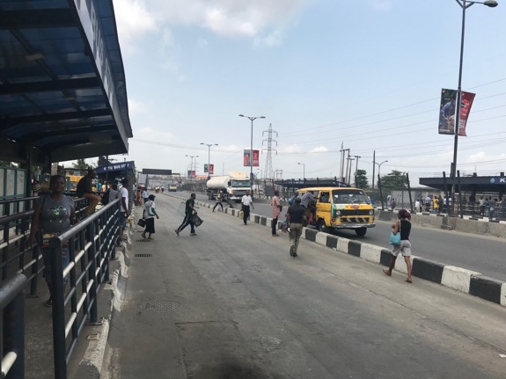
Preventing predatory competition
Competition within the corridor increases the financial risks for government and operators
Ways to reduce the risk of competition:
  Regulate access to the market/corridor (cancel competing route licenses, police enforcement of illegal operators)
  Facilitate an inclusive reform process so that affected operators transition to the new system rather than compete with it
  Introduce a physical barrier to entry in the form of a dedicated BRT corridors
  Introduce a widespread and popular fare collection media only usable with contracted operators

Slide 14
How to manage subsidies
Subsidies can ensure a higher level of service and improve affordability
Potential sources of funding: fuel taxation, parking fees, congestion fees, property tax and other taxes
How to minimize subsidies:
  Know in advance how much subsidy will be needed, if any.
  Design the system for efficiency
  Link operator profits to system profits
  Increase fares if operator costs increase (eg. Significant increase in fuel cost)

Slide 15
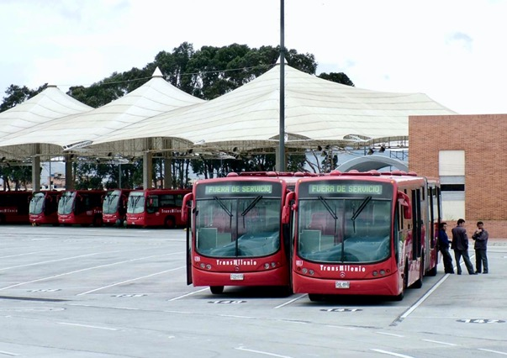
Who should own the buses?
Companies often know more about buses and are better able to specify the appropriate technical specifications for city conditions
Companies have established relationships with suppliers. They can negotiate a lower price with more service support
Private owners have a big financial incentive to properly maintain the buses if they own them
The contract duration should match the lifespan of the buses

Slide 16
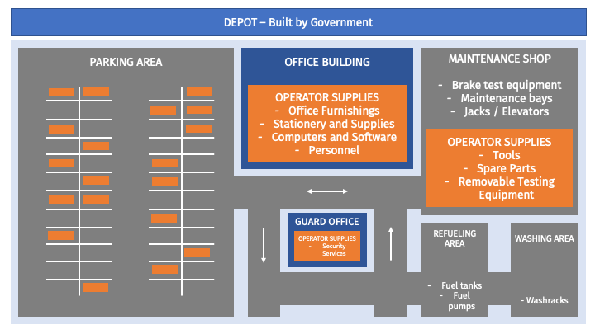
Who should own the depots?
Government ownership of depots allows government to retain the depots in the case of a bus operator change
Typically, the government builds and owns the physical structures, while the operator provides movable furnishings and supplies.
Key to involve operators during the design of a depot.

Slide 17
Relationship between transport agency & operators
Public transport agency
Private bus operators
Fare collection
Fund manager (bank)
Station management
Control centre
Procure vehicles
Operate services
Maintain fleet
Procure fare equipment
Operate fare collection system
Verify revenues
Distribute revenues
Cleaning
Light maintenance
Landscaping
Provide ITS equipment
Maintain equipment
Operate control centre

Slide 18
Division of responsibilities between government and operators in BRT systems
 | Bus operations | Bus procurement | Fare collection | Trust fund | Control center | Operations planning
Curitiba | Private | Private | Public | Public | Public | Public
Transmilenio, Bogotá | Private | Private | Private | Private | Public | Public
Transantiago, Santiago | Private | Private | Public | Private | Private | Public
Transjakarta, Jakarta | Private | Private | Private | Public | Public | Public
Rea Vaya, Johannesburg | Private | Public | Private | Public | Public | Public
MyCiti, Cape Town | Private | Public | Private | Public | Public | Public
Janmarg, Ahmedabad | Private | Private | Private | Public | Public | Public
Guangzhou BRT, Guangzhou | Private | Private | Public | Public | Public | Public
Metrobus, Mexico City | Private | Private | Private | Private | Public | Public
Notes:
Most BRTs contract out the bus operations, procurement, and fare collection in order to take advantage of private sector expertise. It’s important to leave procurement to the operator because the operator will have an incentive to minimize costs. If the government procures the buses the process could become mired in corruption and the technology choices might be sub-optimal. In most systems, the government handles the planning and monitoring activities.

Slide 19
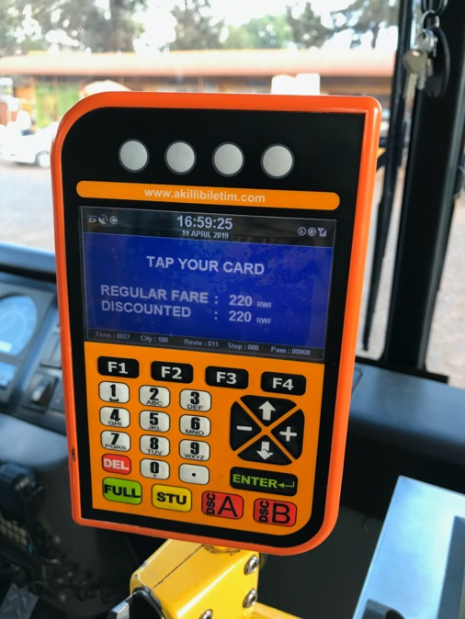
Advantages of independent fare collection
Government has more control over service quality if it controls the revenue
Government receives clear information on the number of passengers and how much money the system is earning
Multiple bus operators can use the same fare collection system, improving convenience for passengers

Slide 20
Transitioning to a modern bus system

Slide 21
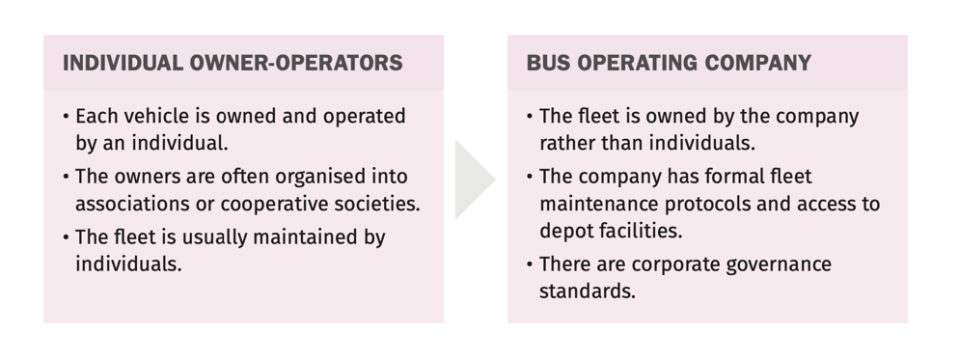
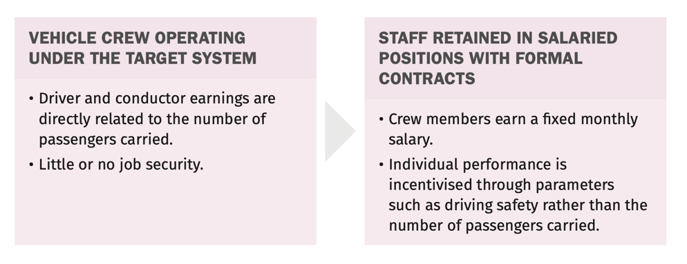
Evolution of the public transport industry
Organisational structure
Staff compensation

Slide 22
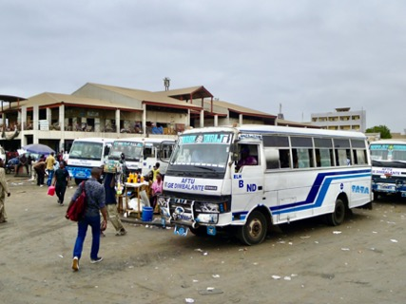
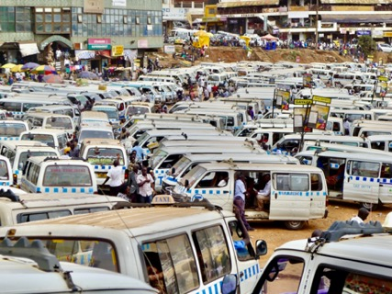
Preparing for the transition
The process for identifying affected operators should be transparent:
  Fully affected: The full route or more than half of its initial length is included in the tender or the route is canceled
  Partially affected: Less than half of its total length is included in the tender
  Not affected: The route and frequency are not changed at all or are changed minimally
Affected operators elect leadership
  May differ from existing industry associations

Slide 23
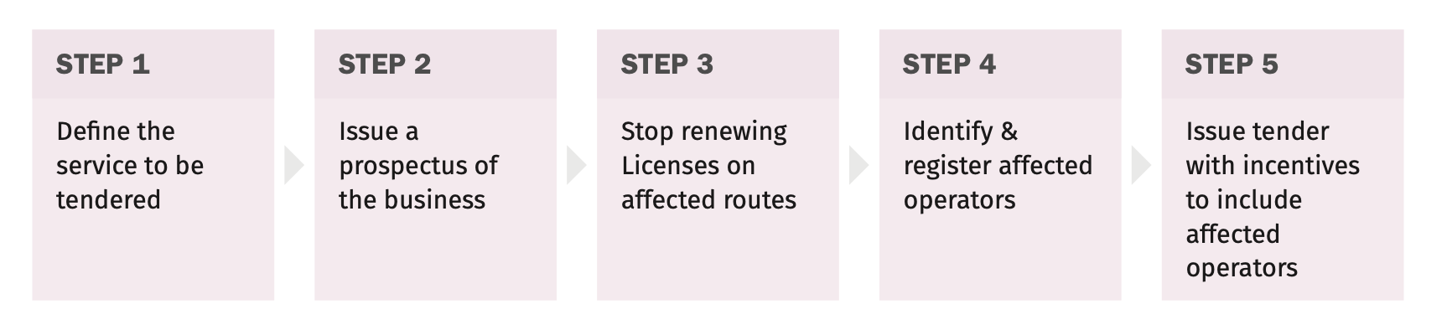
Transition process

Slide 24
Managed competitive tender or negotiated contract?
Managed competitive tender: Bidder is selected based on the highest quality proposal with the lowest price.
Experience points awarded to bidders that include affected operators
Negotiated contract: The government may choose to negotiate with the operators if they form a modern company and sign a new contract.
Advantages of a managed competitive tender:
  An open tender is more transparent.
  The selection process can follow a clear timeline.
  The bidding price will be lower due to competition.
  Minimum qualification criteria (e.g., capital reserves, presence of competent managers, and corporate governance standards) can be enforced.

Slide 25
Bidding criteria –points awarded for involvement of existing operators
Transmilenio bidding criteria
Factor | Description | Eligibility | Min. Points | Max. Points
Legal | Legally registered | X | - | -
Economic | Sufficient investment capital | X | - | -
Price | Price per km offered |  |  | 350
Operations | Bus operator in city |  | 30 | 150
Operations | Bus operator in corridor |  | 50 | 250
Operations | International experience |  | - | 50
Ownership | Shares held by small bus owners |  | 32 | 200
Environment | Emissions, etc |  |  | 200
Vehicle source | Local manufacturer |  |  | 50

Slide 26
Labour & gender standards
Priority hiring list: staff from affected and partially affected routes
Employment benefits: Defined work hours, paid annual and sick leave, and paid maternity leave
Gender representation: Contracts can ensure gender inclusion- including drivers, mechanics, and management

Slide 27
Inclusion of existing operators in BRT systems
 | Former operators form companies | Former operators plus private investors | Former private companies under new contract form | Outside private investor | Public bus operator
TransMilenio, Bogota | X | X
Guadalajara, Mexico | X | X
Lima BRT | X | X
Megabús, Pereira | X | X
GBRT, Guangzhou |  |  | X
BRT, Curitiba |  |  | X
Mio, Cali | X | X
Rea Vaya, Johannesburg | X
TransJakarta, Jakarta | X |  |  | X
Metrobus, Mexico City | X |  |  |  | X
Jan Marg, Ahmedabad |  |  |  | X
HealthLine, Cleveland |  |  |  |  | X
Lanzhou, BRT |  |  |  |  | X
MiCity, Cape Town | X |  | X
LAMTA (Orange Line) |  |  |  |  | X
Notes:
They systems are categorized per the BRT Standard (i.e., gold/silver/bronze). The world’s best systems involve the existing operators, or at least have a hybrid model with an outside investor plus the existing industry.

Slide 28
Industry Transition
Compensation:
Who do you bring in and how?
Who do you buy out?
Key industry concerns
What will happen to our vehicles?
Will the government honour their word?
Won’t we lose our jobs?
What about vehicles without permits but are operating?
This project sounds too good to be true. Will we really be better off?
The most important questions are not being answered. How much will I make? And when?

Slide 29
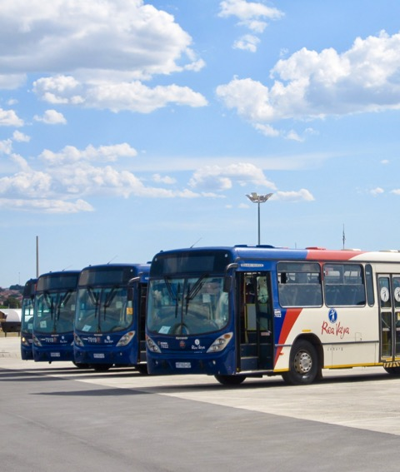
Modern bus company
Fleet owned by the company
Fleet secured in a depot
Services regulated by operational control system
Drivers are salaried employees
Modern fleet
Modern fully equipped depot
Optimised operations
Good corporate governance
Optimised maintenance protocols
Sufficient reserve fleet (i.e., at least 6 percent)

Slide 30
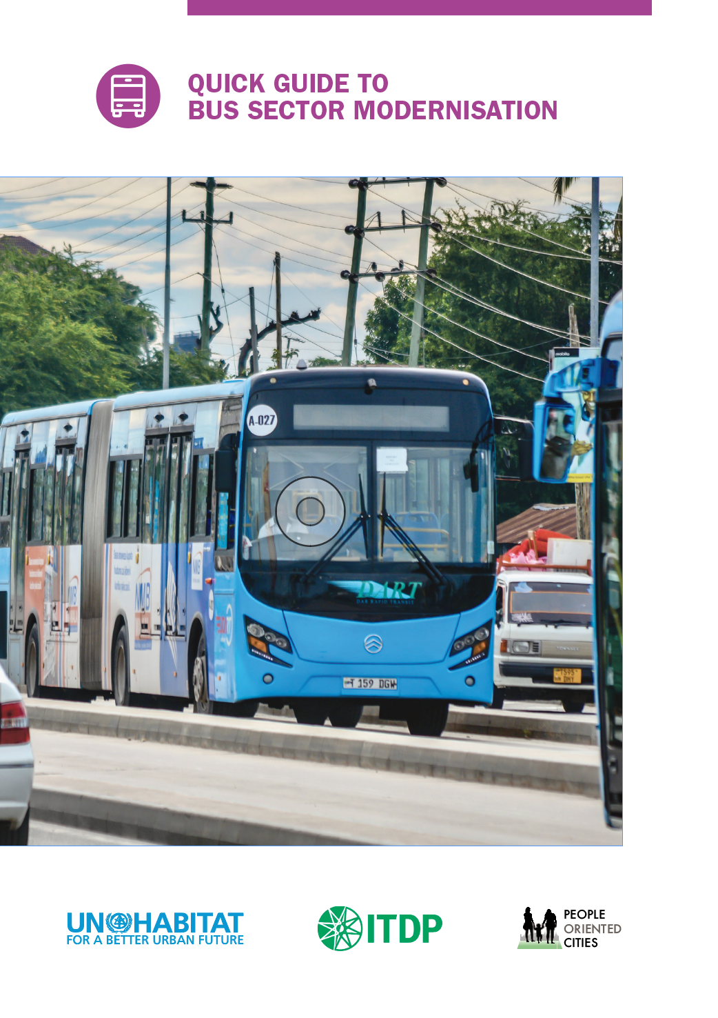
For more information
Quick Guide to Bus Sector Modernization
africa.itdp.org

Slide 31
Thank you
africa@itdp.org

