Slide 1
Kigali Public Transport Reforms
April 2021

Slide 2
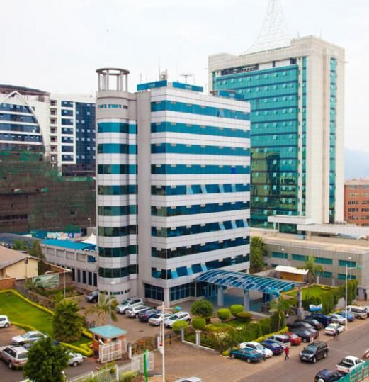
City general overview
In 1907, Kigali was founded by German colonists Richard Kandt,
1962, has become the capital city after Rwandan independence
1994, Genocide against tutsi, Country destruction
Present, Kigali knows a very rapid urbanization as other African cities
It is striving to be more clean, Green and safe city
Kigali has mountainous, total area 731 sq km
Population 1.5 M projected to be 3.8 M by 2050

Slide 3
Kigali public transport evolution
1994
2008
2013
2020
*Minibuses 18 seats each
(Twegerane)
*Public transport policy and service reforms
*Service plan
*Contracts
*Tap &Go Cards
*Buses ( 29, 50-70)seats
*Subsidy of Frw 29.3 billion under Covid 19

Slide 4
Background
The form of public transport started in 1970s, by business men who brought the 16-seater Nissan Urvan omnibuses in Kigali
From 1970s-1990s, city public transport was for individuals who buy minibuses and look for passengers on street
Due to big number of passengers, conductors were calling people to squeeze themselves, where result in local name of Twegerane

Slide 5
Situation before 2013 reforms
Minibuses (18 seats) were owned by individuals
Minibuses were overcrowded
Individuals/owners decided at what route and time to operate
Bus stops and terminals were chaos in peak hours
Women, Children, elderly, disabled people were not able to access public transport

Slide 6
Situation before 2013 reforms/ cont’d
Public transport reforms have progressed since 2008
Minibuses/Twegerane which were owned by individual grouped into associations
First come first serviced (FCFS) approach introduced by queues
Unfortunately, service remains inefficient and inadequate access

Slide 7
Government policy towards public transport reforms
Joint technical team , Ministry of Infrastructure(MININFRA), City of Kigali (CoK) and Rwanda regulatory Agency (RURA)drafted a policy in 2011 A and approved by the cabinet in 20212
In 2012, steering committee composed by government institutions and privates operators formulated to designs solutions
Reforms included forming cooperatives and companies in place of former associations
Strong resistance raised from former minibuses owners but steering played a great role to convince them

Slide 8
Public transport reforms (2013)
United minibus cooperatives formed Rwanda Federation of Transport Cooperatives (RFTC)/early transformed to Jali transport
Other owners formed companies like Kigali Bus Services (KBS) and Royal Express and other
In August 2013, Government signed contracts with 3 operators RFTC, KBS and Royal express to operate the defined routes

Slide 9
Public transport reforms /cont’d
Government facilitated access to loans for the company
Importation for high capacity buses was waived
Small buses consistently replaced by ones with high capacity especially for the trunk routes
Buses with access to disabled people
Consistent Service inspection by steering committee (COK, RURA and RNP)

Slide 10
Impact of the reforms to the drivers
Prior to the reforms minibus owners set returns and the drivers' wages were depending on the remaining balance
As result of the reforms salaries and universal insurance are fixed
Working days become fifteen per month with eight hours per day
Access to bank loans from RFTC microfinance

Slide 11
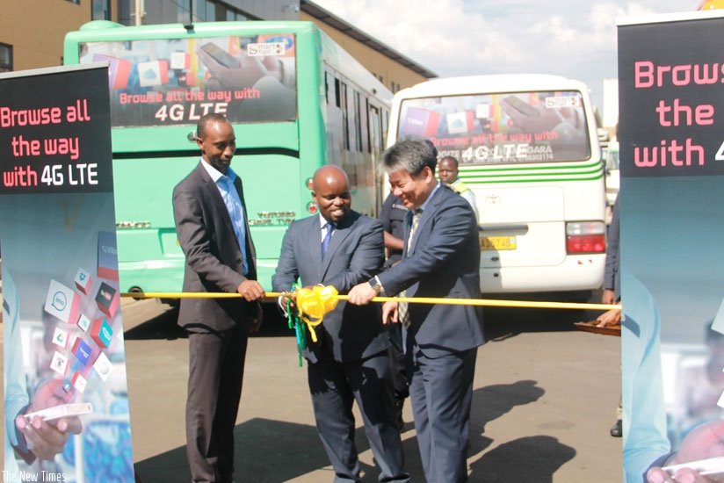
Smart technology & fare collection
Free wifi into public buses since 2015
Smart card payment technology (Tap&go card)
Fares are collected by the first party AC Group who signed contractor with operators
The IT based fare collection system replaced conductors

Slide 12
Current operational status
Vehicle capacity | 30 | 42 | 48 | 56 | 70 | Total
Current fleet | 132 | 9 | 8 | 15 | 216 | 376
376 buses are operated by three mentioned operators
390,000 Passengers per day
Buses are operation under average speed 17km/h reaching below 10 km/h during the peak hours

Slide 13
Public transport services during Covid- 19 pandemic
Due to Covid 19,Buses are operating at 50% of their capacity
The government of Rwanda committed to provide subsidy to bus operators since October 2020
The Government will provide a subsidy of 29.3 billion Rwf into thee categories which are: the payment of 35% of loan, reduction of 150Rwf/l on fuel and direct payment of the remaining balance
Notes:
Vedaste, I reorganised between 2020 and 2021, which I divided into 2 slides, as I had important componants to add for 2021

Slide 14
Upcoming
Second generation contracts aiming to enhance reliable system by:
Improved bus route
Increased capacity
Strict scheduling with a proposed waiting time of 5&10 minutes
Changed fare structure to be in line with travelled distance
Provision of bus dedicated lane and BRT in the future
Restriction of motorcycles taxi to the trunk routes
Notes:
Learning: please have a look at the learning plan for the Africa and Kigali training (recent emails)
For the local innovators, please give some example: e.g. pricing structure for bikeshare systems, gender-inclusive component for electric motorcycle-taxis, for both: key to look at the first and last mile connectivity components
Please say that we want to search at the max for alignement between initiatives, cooperation to maximise efficiency

Slide 15
Thank you
africa@itdp.org

