Slide 1

70th Regular Meeting of CPR UN-Habitat: Changing to Increase Impact, 20 Sep
Rapid Urban Population Growth & Mobility
UN-Habitat
Stefanie Holzwarth
Urban Mobility

Slide 2




Rapid Urbanization Worldwide: Urban Population Projection
30%
50%
55%
66%
1930
2008
2018
2050
Source: United nations, Department of Economic and Social Affairs, Population Division (2014), World Urbanization Prospects

Slide 3
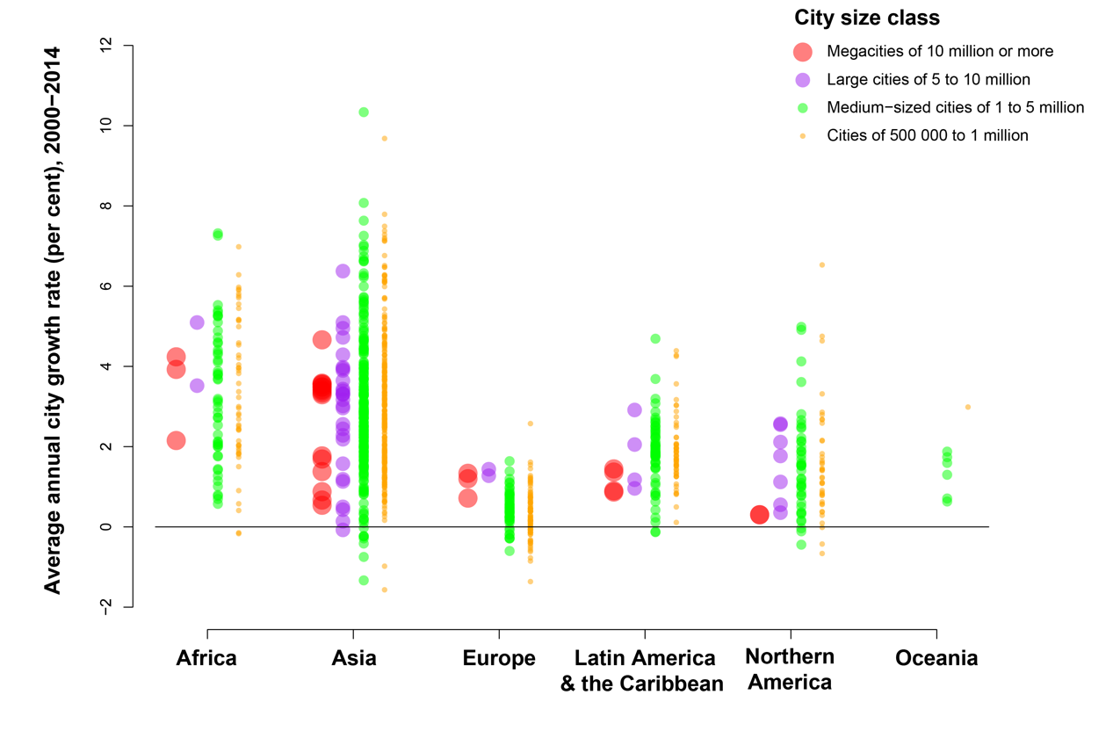
More Cities of All Sizes; Fastest Growth in Africa and Asia
Nearly 90 per cent of the urban population increase will be in Africa and Asia, the fastest urbanizing global regions.

Slide 4
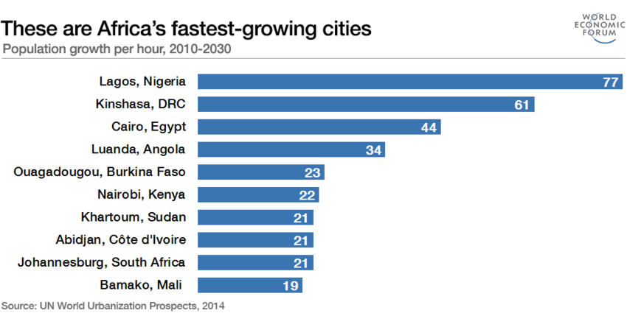
Urban Population Growth in Africa

Slide 5
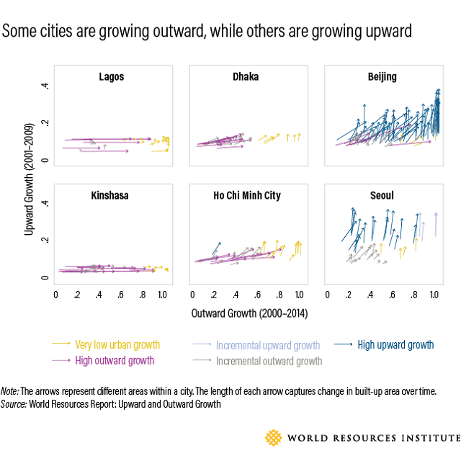
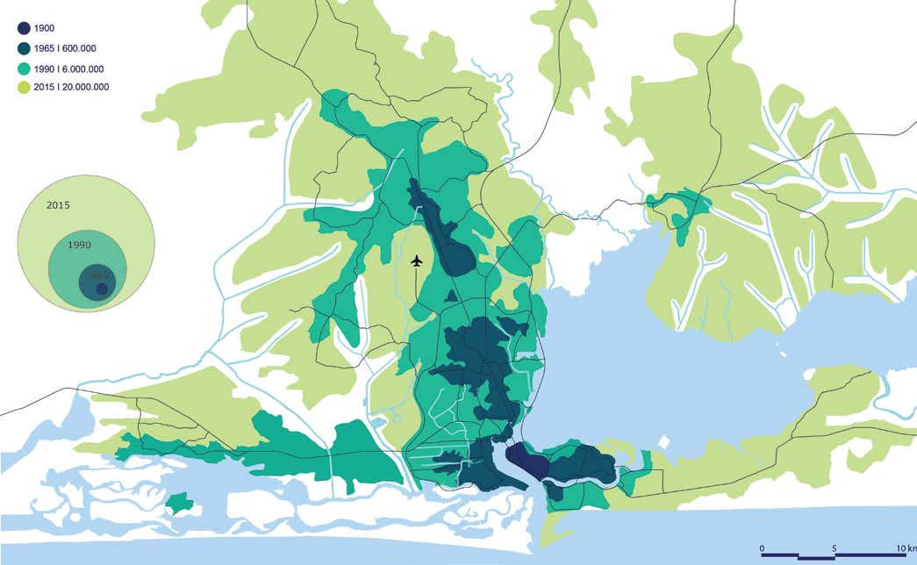
African Cities are Growing Out Rather Than Up
Lagos Growth Map – source http://futurecapetown.com

Slide 6
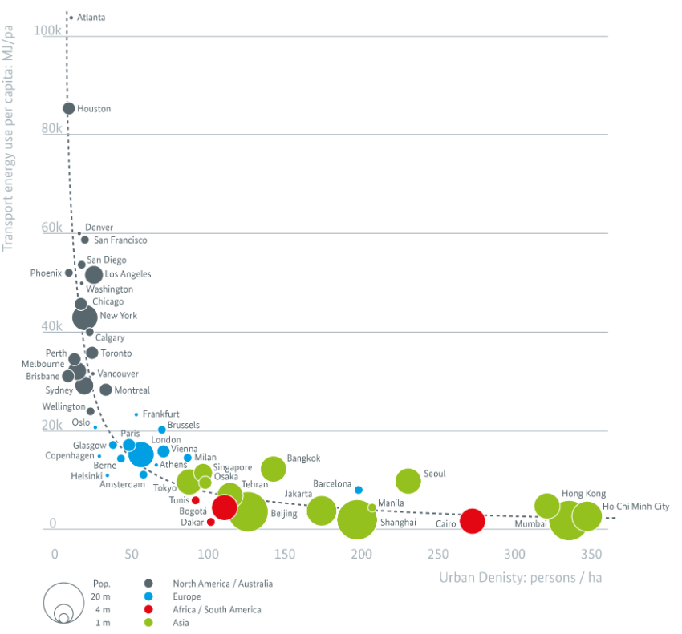
Transport Energy and Population Density
Source: TUMI

Slide 7
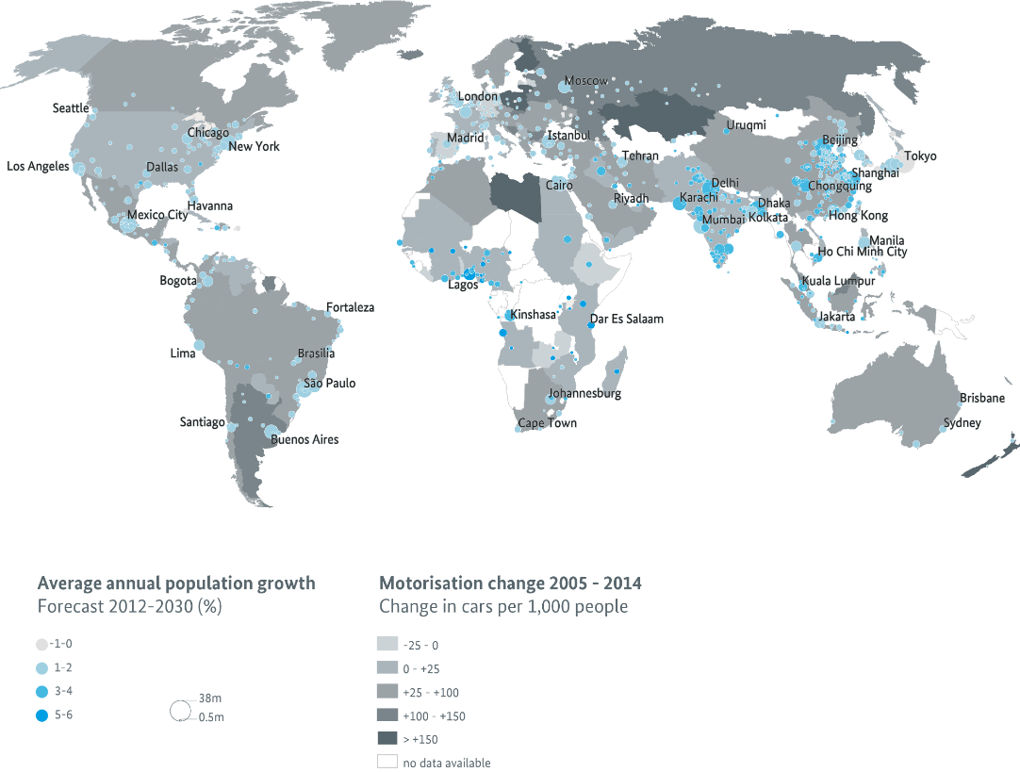
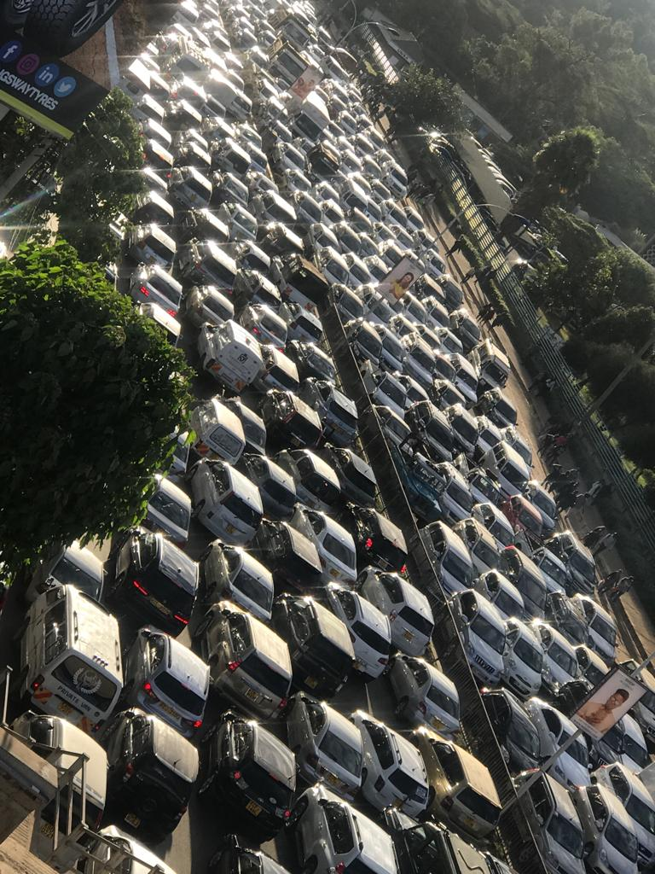
Change in Urban Population and Motorization Rate
Source: TUMI

Slide 8
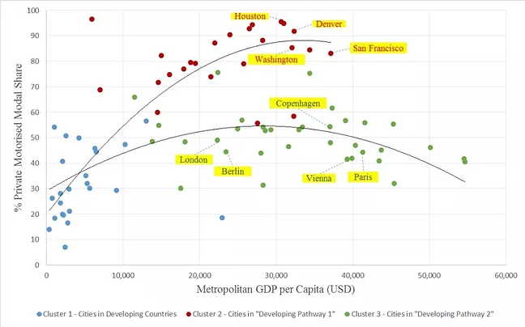
Which pathway to take? Let’s avoid the evolutionary mistakes of other cities… and instead leapfrog to sustainable mobility!
Source: Roger Teoh, Imperial/UCL 2016. UITP data 1995

Slide 9
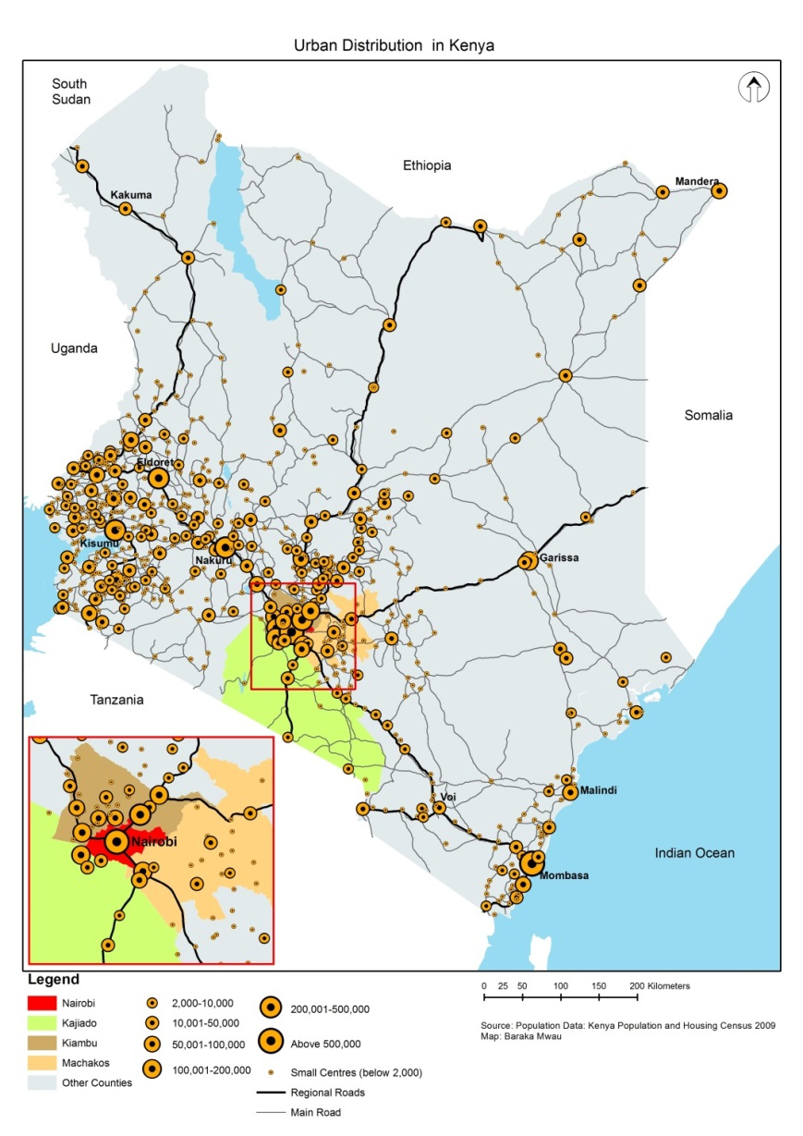
New Spatial Configurations in Africa: City Regions/ Metropolitan
New spatial conﬁgurations: city clusters, large urban agglomerations, urban corridors and city-regions
Rapidly growing Secondary Towns: playing an increasing role for economic power; small towns in vicinity of bigger towns become spatially ”connected”
Challenge: Often unplanned city expansion/ lack of public transport connectivity and affordability

Slide 10
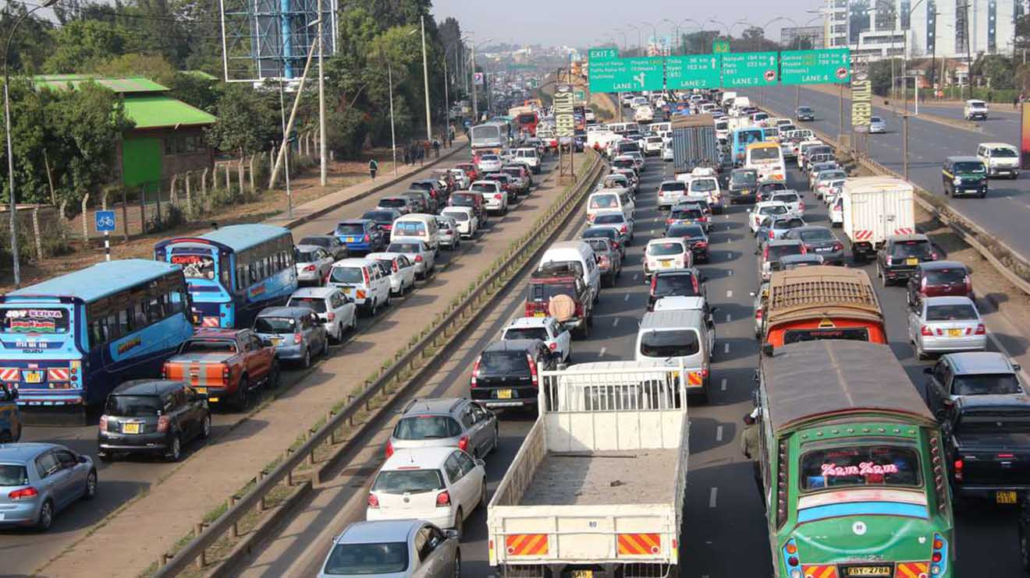
Reality: Car-Based Transit Corridors in many African Cities
Low density, urban sprawl
Car-based transit corridors contributing to congestion, emissions, pollution, accidents
No Integration between mobility systems
Land use systems have not been able to provide access through proximity
Access is mostly dependent on movement

Slide 11
Good Example of Compact Development and Densification
Bring Rapid Transit to People: Dar es Salaam
BRT can act as a backbone around which to transform and redevelop the city to further increase sustainability and functional effectiveness
After BRT phase 1
8% of residents near rapid transit
After BRT phases 1-4
33% of residents near rapid transit

Slide 12
We have to ask ourselves…
How can urban growth be achieved without compromising accessibility and exposing urban residents to negative externalities such as traffic, air pollution, emissions, road accidents, etc.?

Slide 13
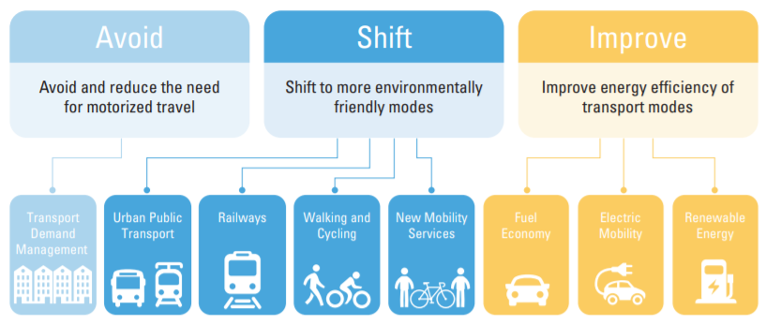
The Avoid-Shift-Improve framework
Source: SLoCaT, 2018

Slide 14

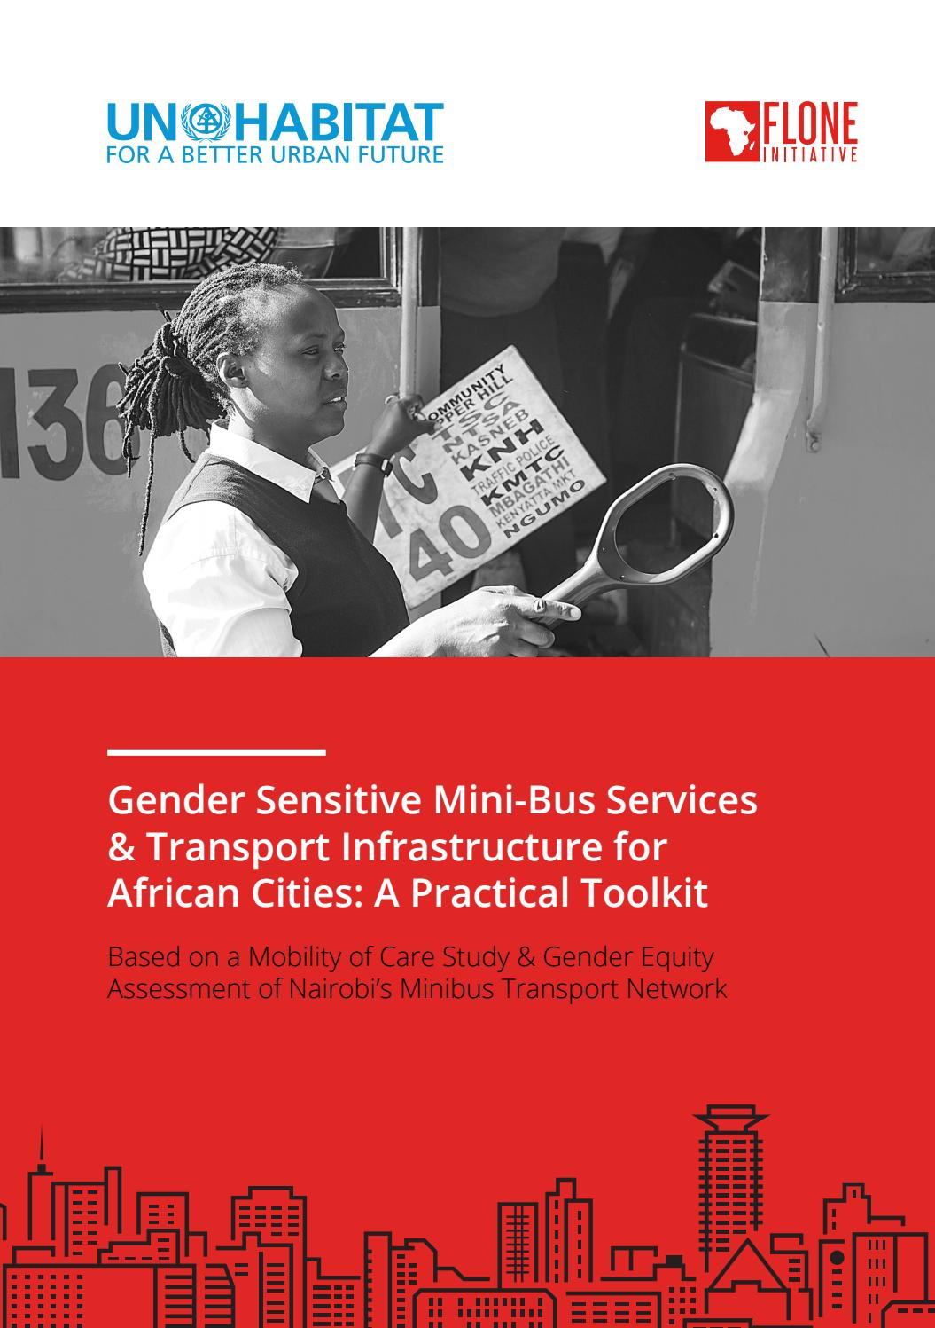
Understanding the need for equitable and inclusive transport
- Urbanisation is bringing more women into the work force. Gender sensitive solutions can accelerate this trend and encourage more inclusive growth.
- Universal access & affordability of transport needs to be ensured, incl. children, elderly, people with disabilities etc.

Slide 15
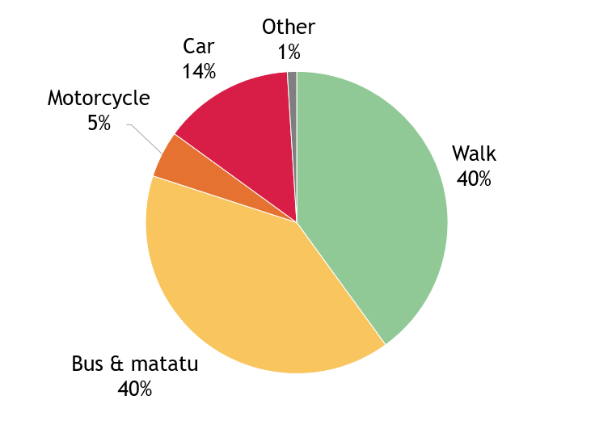
How Nairobi travels…
13%
41%
Source: ITDP based on secondary data in NMT Policy, 2015

Slide 16
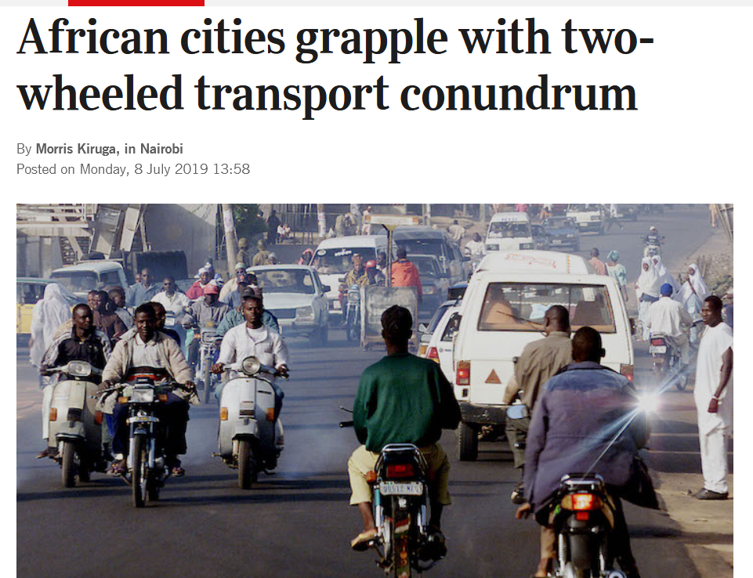
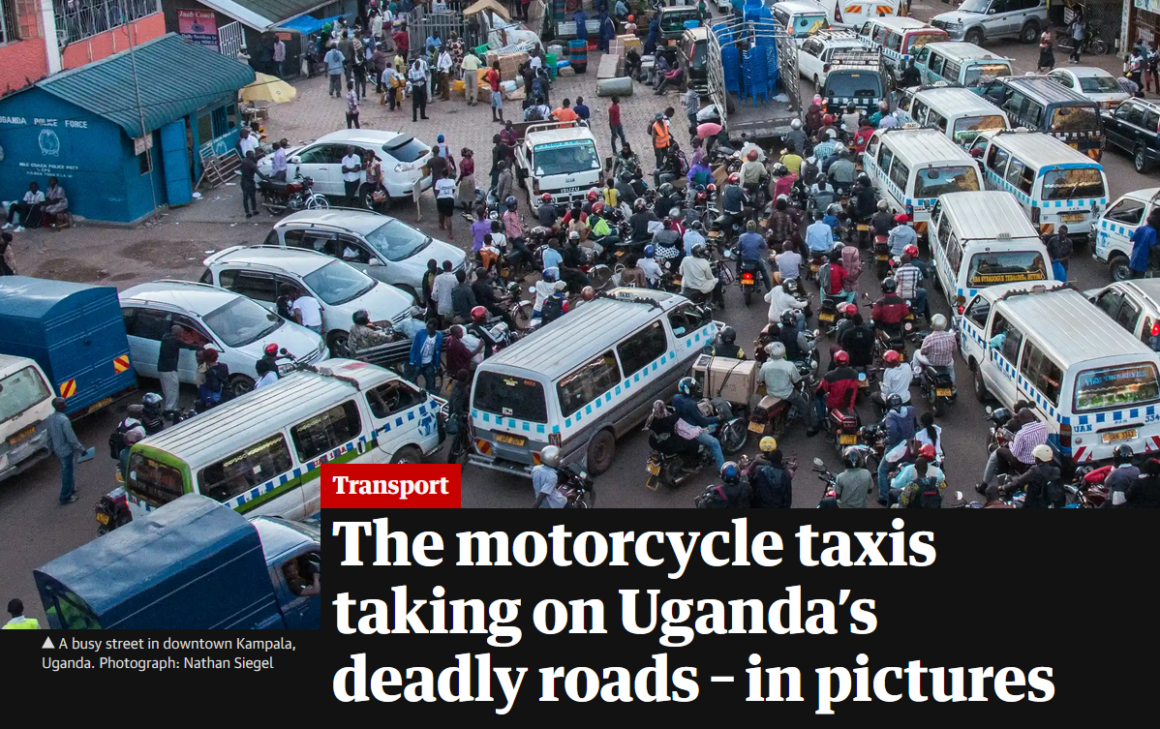
Motorcycles are on the rise…

Slide 17





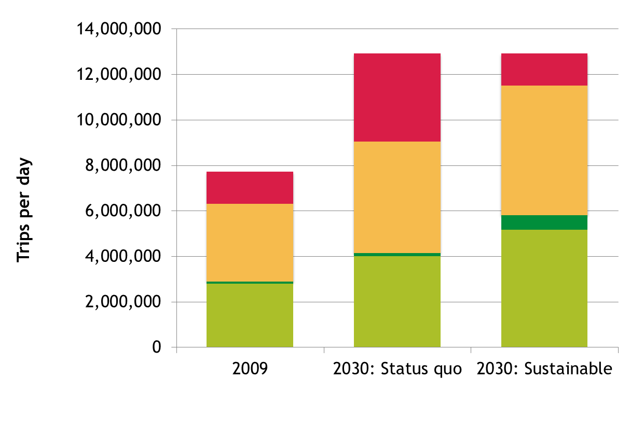
Moving towards the Sustainable Scenario
Better Scenario
Business as Usual
Source: ITDP

Slide 18
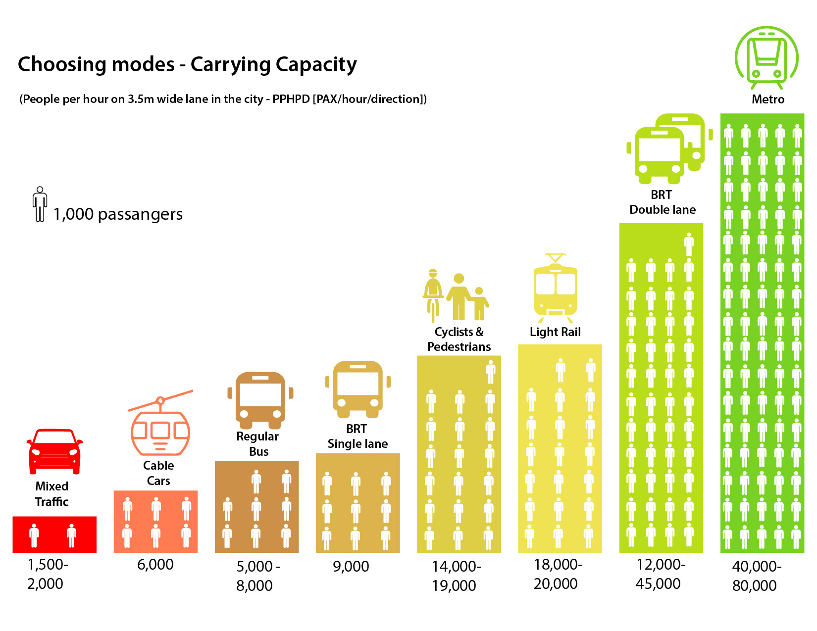
Designing for Efficiency

Slide 19
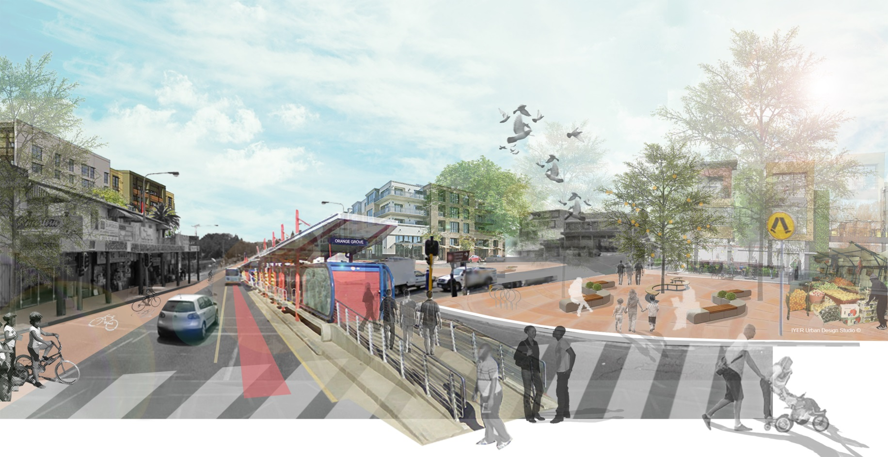
Lessons Learnt and Recommendations
Integrated approach - interventions need to address more than one issue (transit-oriented development)
Link urban growth with land use policies and transport investments to improve access to jobs, schools, recreation and affordable housing around stations
Strong political mandate and strategic vision
Plan for NMT, ensure walkability and attractive public spaces; small block size; fine street grid
Design for a mix of different uses – commercial, retail, office, residential i.e. 15 minutes city/neighbourhood
Institutional arrangement is key - need for interdepartmental collaboration between transport and urban planning authority
Urban mobility plans are about development and urban form and the importance of mobility and connectivity within the urban context
Inclusion, community support and participation at early concept stage

Slide 20
Thank You For Your Attention

