Slide 1
Public Transport Service Planning and Infrastructure Sizing
April 2021

Slide 2
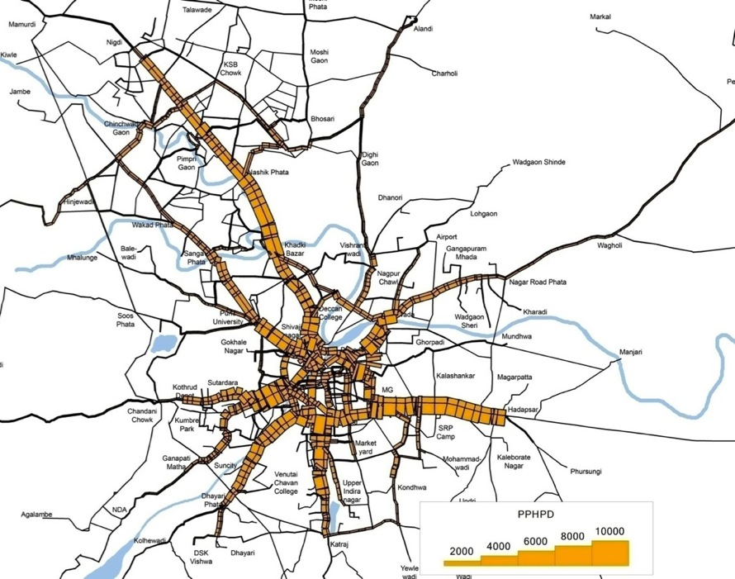
Planning process
Passenger demand assessment
Corridor identification
Service plan
Infrastructure design
Mapping of public transport passenger throughput

Slide 3
What is a service plan?
Route Selection
What combination of routes will be most viable?
Demand Assessment
Fleet Requirement
How many buses are required for each route?
Scheduling
Passenger throughput along each corridor
What headway is required on each route to meet the passenger demand?
Modelling
Calibration of a model representing travel demand patterns
What type of bus is required for each route?
Boarding alighting patterns
Vehicle speeds

Slide 4
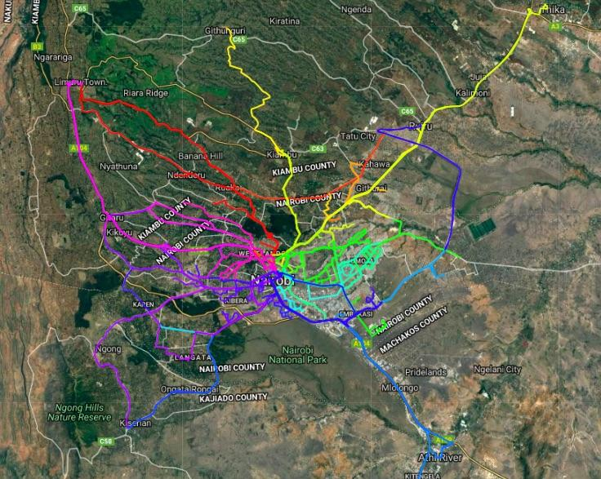
Nairobi BA surveys

Slide 5
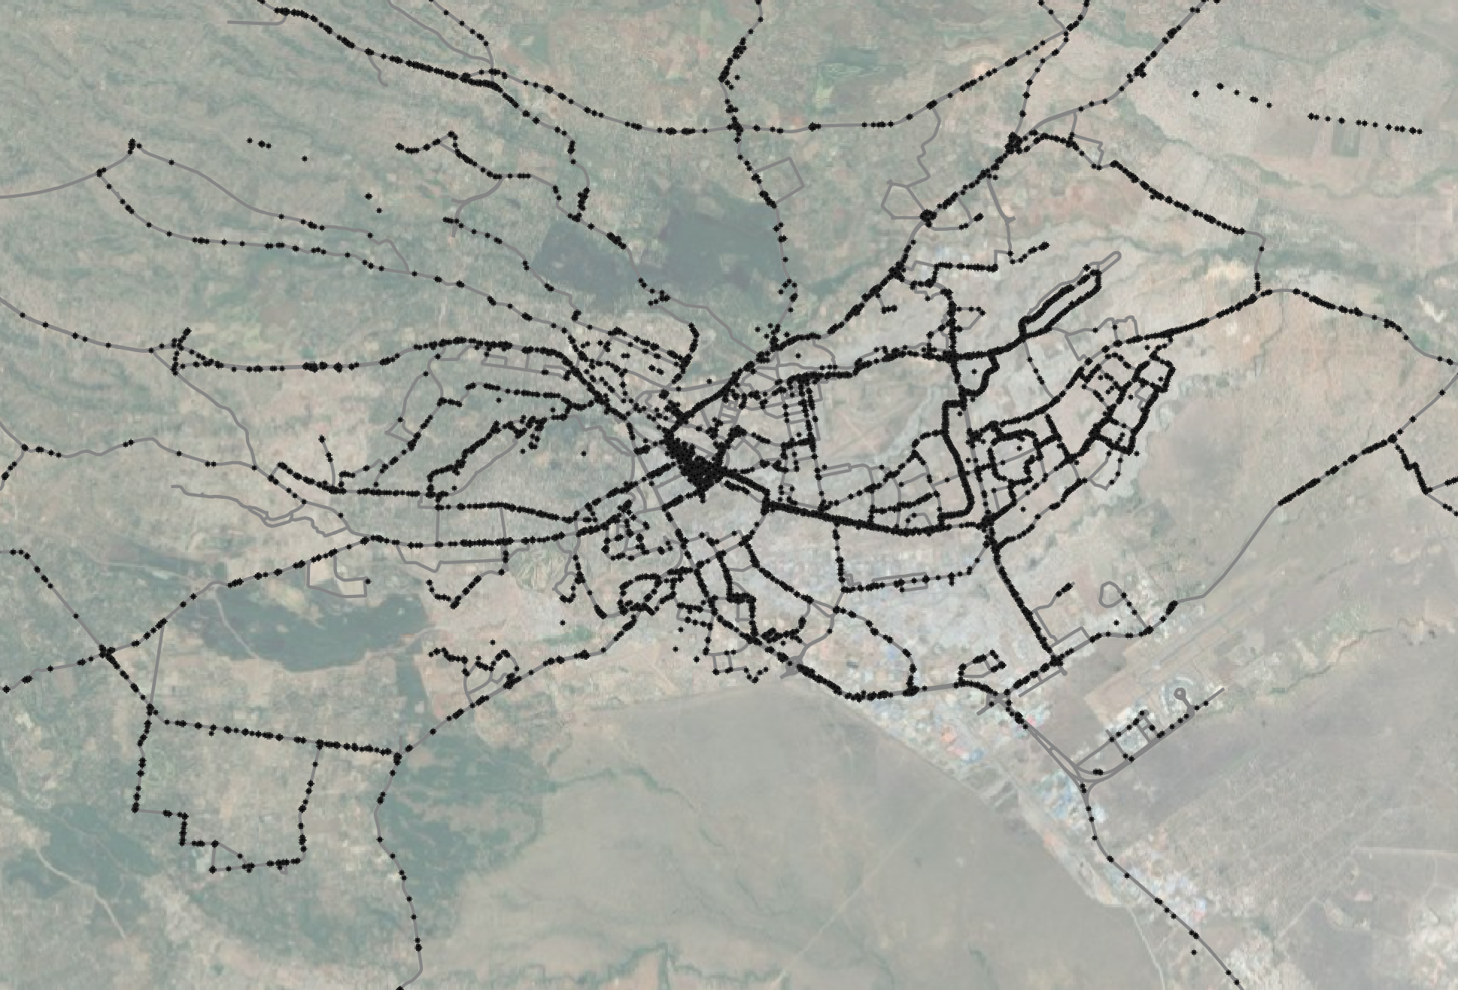
Observed boardings & alightings from 1,170 trips on matatus

Slide 6
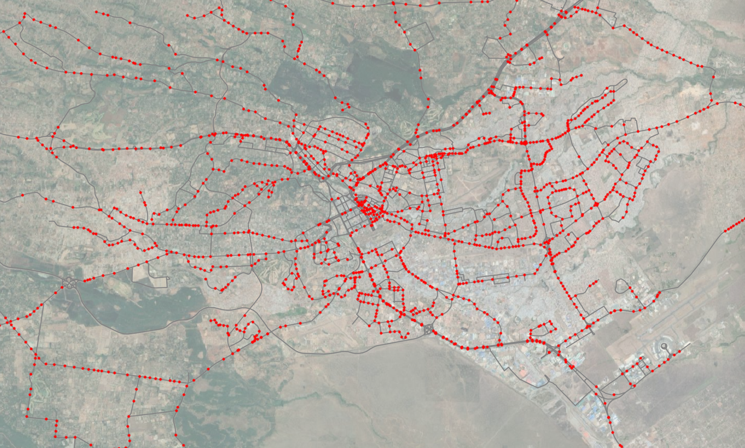
Stop locations in the model

Slide 7
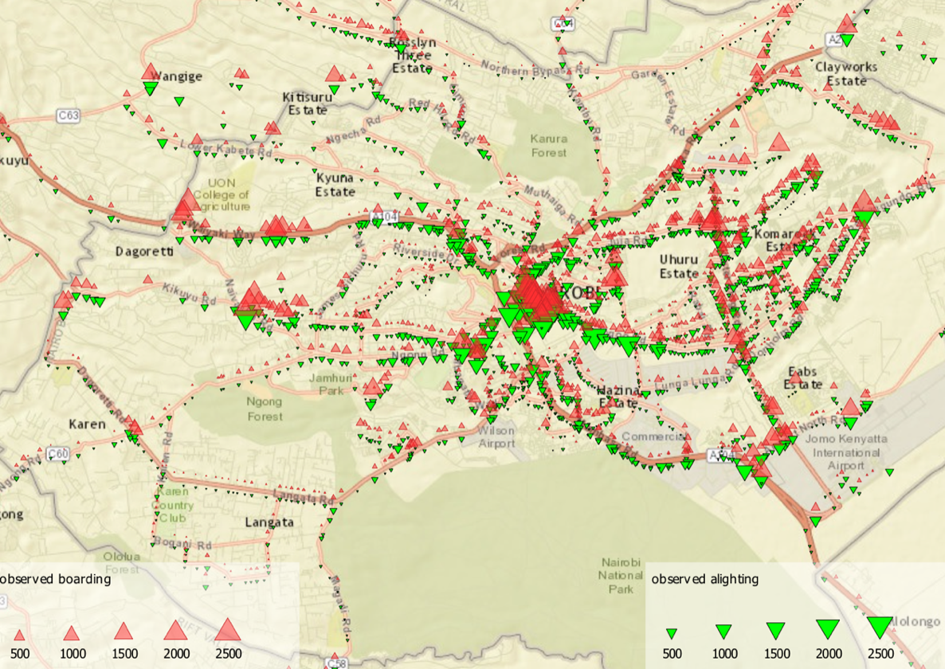
Boarding & alighting patterns

Slide 8
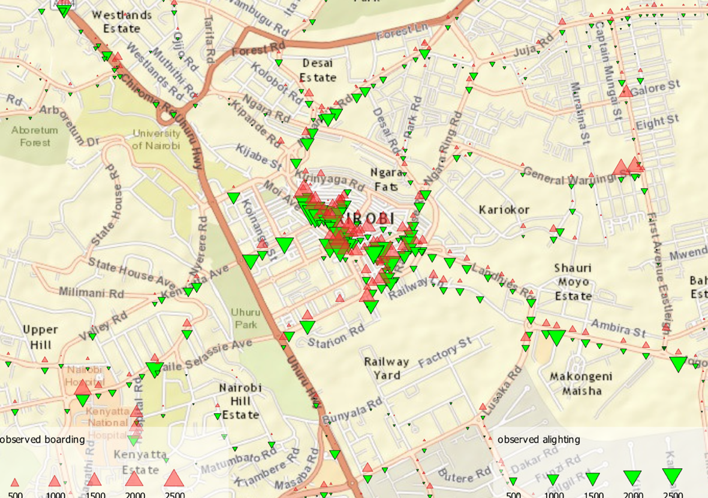
Boarding & alighting patterns: CBD

Slide 9
Average speeds from boarding and alighting surveys

Slide 10
Modelled demand

Slide 11
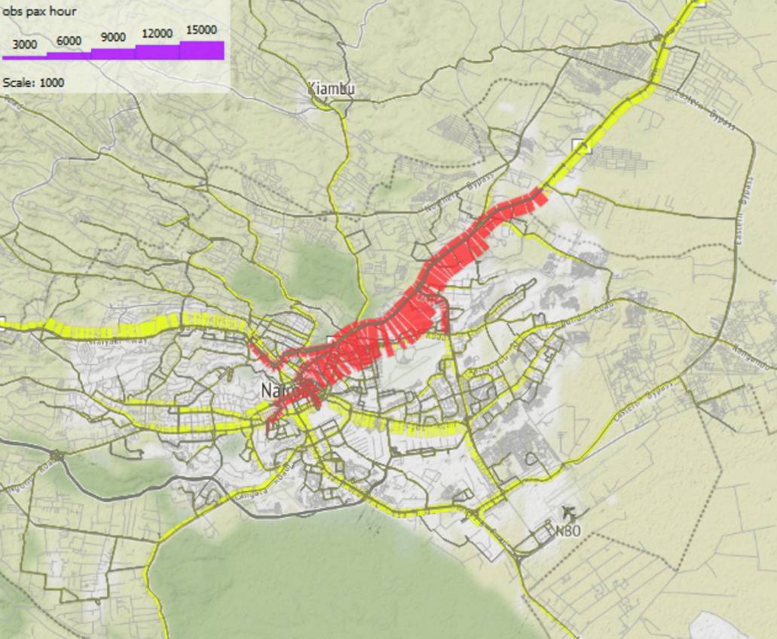
Modelled passenger volumes

Slide 12
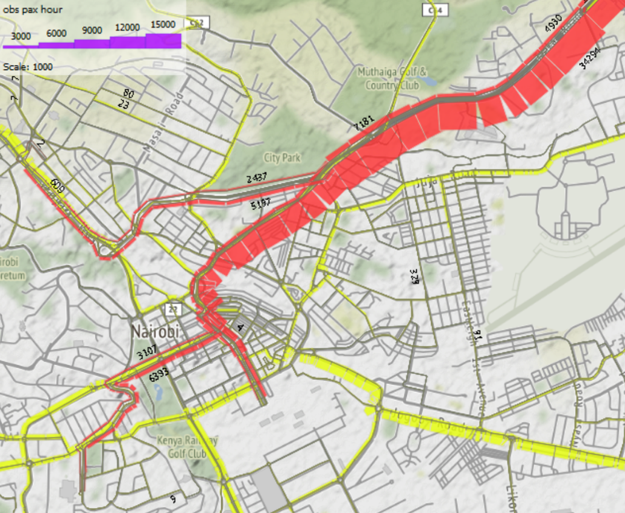
Modelled passenger volumes

Slide 13
Proposed services

Slide 14
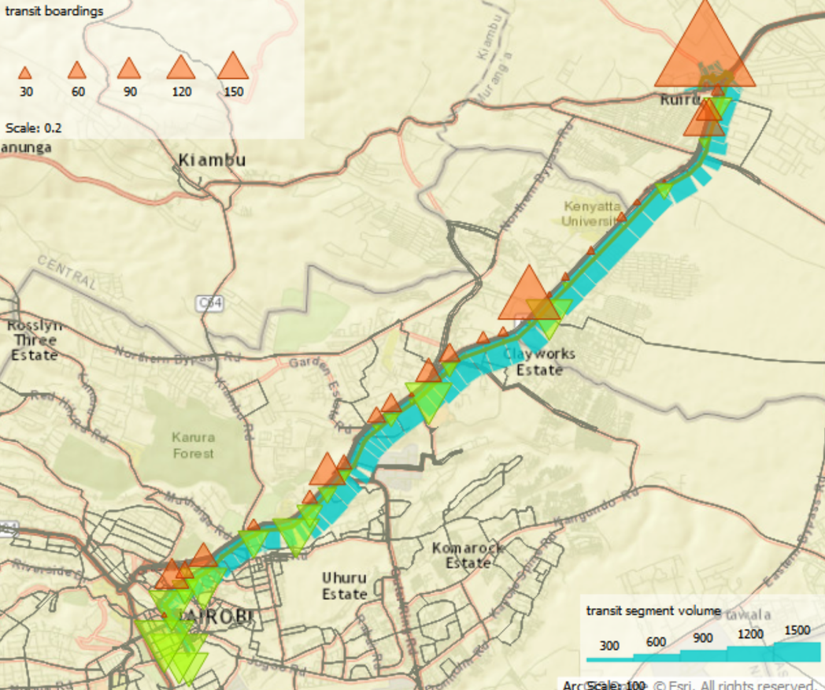
B145
Fleet size | 33
Frequency (buses/hr) | 16

Slide 15
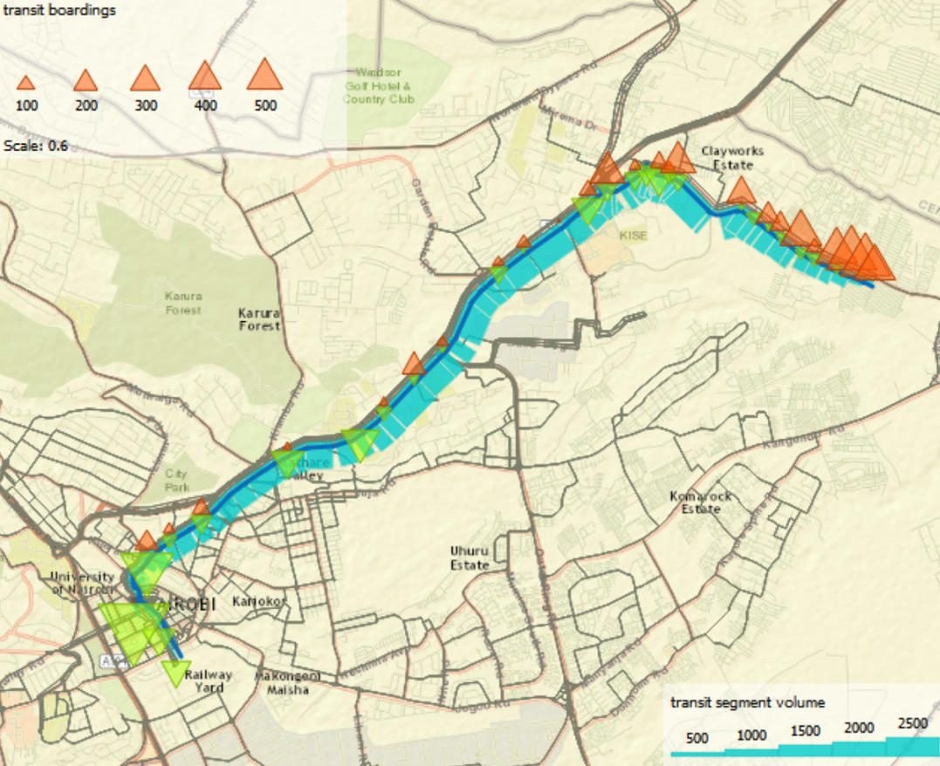
B17B
Fleet size | 64
Frequency (buses/hr) | 32

Slide 16
Service design
Services on multiple BRT corridors
Direct services
Express services that skip some stations
Feeder services

Slide 17
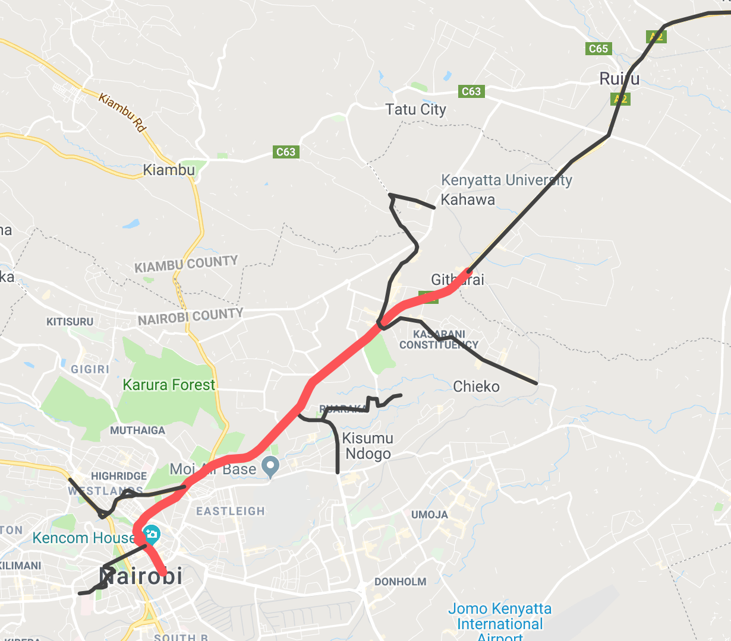
Proposed BRT services
Most existing matatu routes converted to BRT services that use the BRT corridor
16 km dedicated corridor with extensions to major destinations
With direct services, no transfer terminals are required
Ruiru, Juja, Thika
Zimmerman, Kahawa
Githurai
Mwiki
Ruaraka
Westlands
Rounda (Juja Rd)
Upper Hill
Railways

Slide 18
Thika Rd design considerations
Most routes on Thika Rd provide express-style service from residential areas to central Nairobi
Existing routes pick up passengers off the corridor and then join the highway
Due to the existing and planned geometry of interchanges, it is difficult to develop transfer terminals at intersections
E.g.: New ORR interchange lacks provisions for BRT
If passengers who currently enjoy a one-seat journey to the CBD need to transfer from feeders to trunk services, the BRT will be less competitive

Slide 19
BRT services: Summary
12 BRT services
Fleet of 611 articulated buses (incl. 10% reserve)
61,000 peak hour boardings
34,000 pphpd peak volume on Thika Rd

Slide 20
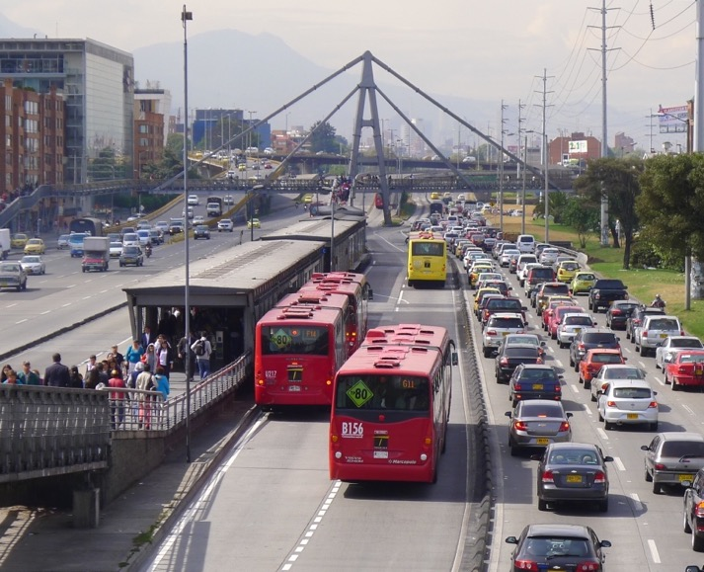
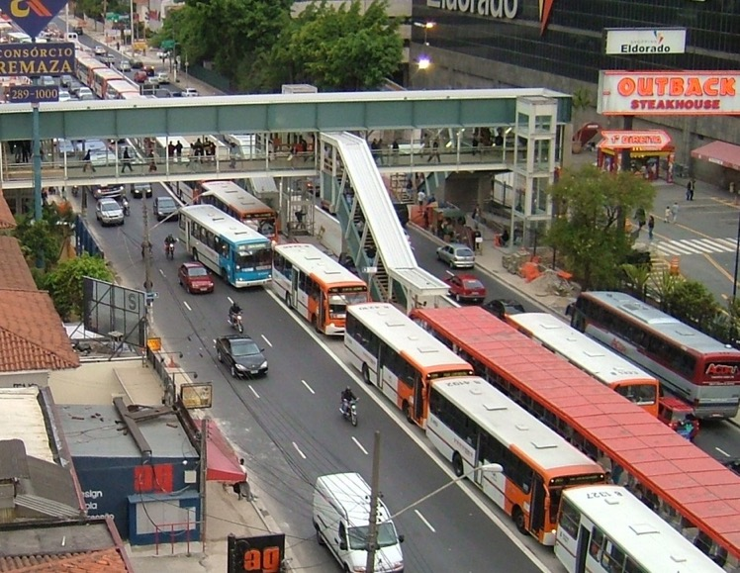
Stations with high demand require passing lanes and independent sub-stops

Slide 21
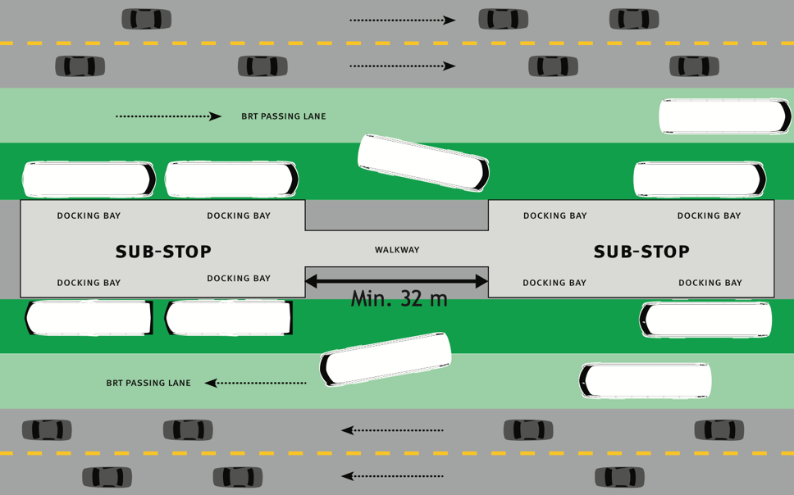
High demand stations
At stations with passing lanes, the distance between two docking bays on stations should be 1.8 times the length of the bus for easy maneuvering.

Slide 22
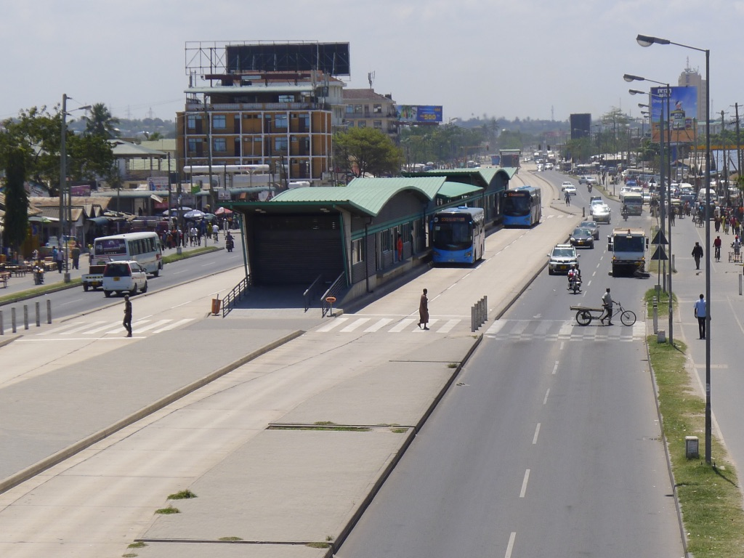
Most stations in Dar es Salaam have two sub-stops

Slide 23
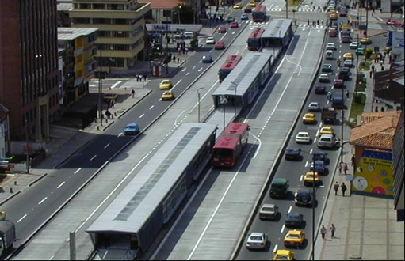
If saturation is over 40%, add new sub-stops

Slide 24
Saturation analysis
 | Boardings |  | Alightings |  | Frequency |  | Saturation |  | Sub-stops
Station | Inbound | Outbound | Inbound | Outbound | Inbound | Outbound | Inbound | Outbound | Inbound | Outbound | Sub-stops: Final
Corridor 1 (city centre)
1 | 0 | 1885 | 4322 | 0 | 68 | 68 | 0.88 | 0.54 | 3.00 | 2.00 | 3
2 | 0 | 0 | 4608 | 0 | 73 | 73 | 0.94 | 0.30 | 3.00 | 1.00 | 3
3 | 0 | 1413 | 3108 | 0 | 66 | 66 | 0.70 | 0.47 | 2.00 | 2.00 | 2
4 | 35 | 743 | 4198 | 279 | 51 | 51 | 0.80 | 0.35 | 2.00 | 1.00 | 2
Corridor 21 (Thika Rd)
1 | 475 | 111 | 6550 | 541 | 46 | 46 | 1.17 | 0.28 | 3.00 | 1.00 | 3
2 | 657 | 15 | 2515 | 322 | 57 | 57 | 0.68 | 0.28 | 2.00 | 1.00 | 2
3 | 1108 | 195 | 2043 | 207 | 55 | 55 | 0.67 | 0.29 | 2.00 | 1.00 | 2
4 | 808 | 278 | 1290 | 565 | 81 | 81 | 0.63 | 0.45 | 2.00 | 2.00 | 2
5 | 687 | 266 | 378 | 214 | 66 | 66 | 0.42 | 0.34 | 2.00 | 1.00 | 2
6 | 828 | 97 | 970 | 263 | 69 | 69 | 0.54 | 0.34 | 2.00 | 1.00 | 2
7 | 2032 | 753 | 781 | 440 | 90 | 90 | 0.77 | 0.54 | 2.00 | 2.00 | 2
8 | 775 | 17 | 561 | 388 | 40 | 40 | 0.35 | 0.22 | 1.00 | 1.00 | 1
9 | 822 | 98 | 362 | 67 | 40 | 40 | 0.33 | 0.19 | 1.00 | 1.00 | 1
10 | 686 | 53 | 362 | 27 | 59 | 59 | 0.39 | 0.26 | 1.00 | 1.00 | 1
11 | 73 | 96 | 88 | 103 | 46 | 46 | 0.22 | 0.22 | 1.00 | 1.00 | 1
12 | 2211 | 271 | 1109 | 741 | 70 | 70 | 0.75 | 0.43 | 2.00 | 2.00 | 2
13 | 213 | 15 | 207 | 40 | 38 | 38 | 0.22 | 0.17 | 1.00 | 1.00 | 1
14 | 99 | 0 | 0 | 0 | 36 | 36 | 0.16 | 0.15 | 1.00 | 1.00 | 1
15 | 59 | 15 | 10 | 0 | 36 | 36 | 0.16 | 0.15 | 1.00 | 1.00 | 1
16 | 3249 | 62 | 28 | 1404 | 69 | 69 | 0.74 | 0.49 | 2.00 | 2.00 | 2

Slide 25
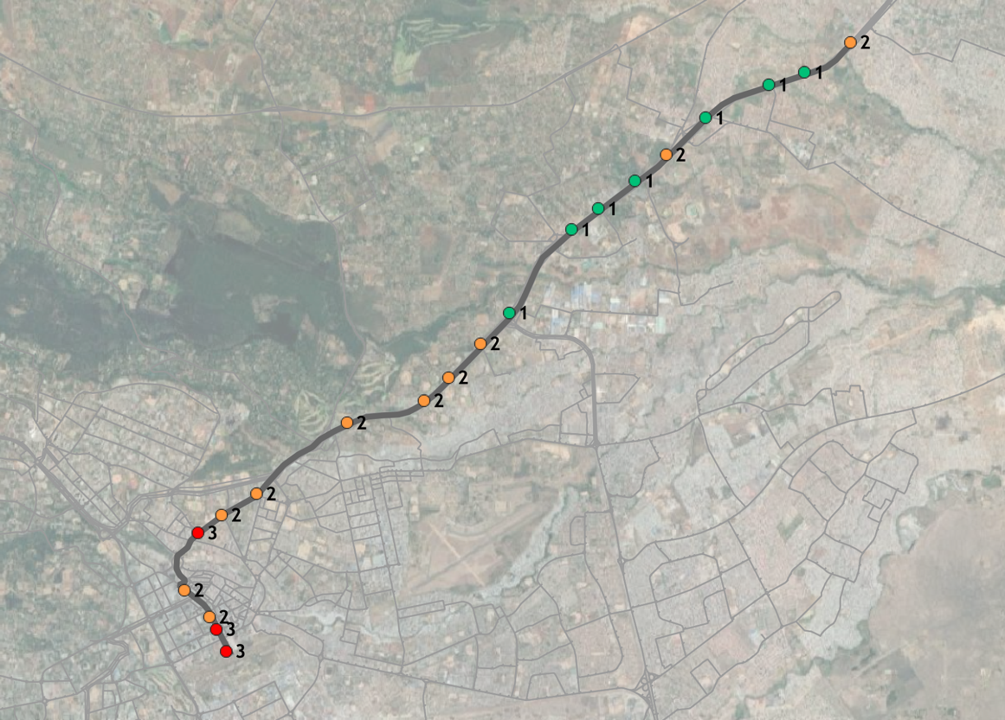
Station sub-stops

Slide 26
Cross section: Thika Rd

Slide 27
Cross section: Moi Ave near Harambee Ave

Slide 28
Typical BRT cross-section: Standard 1

Slide 29
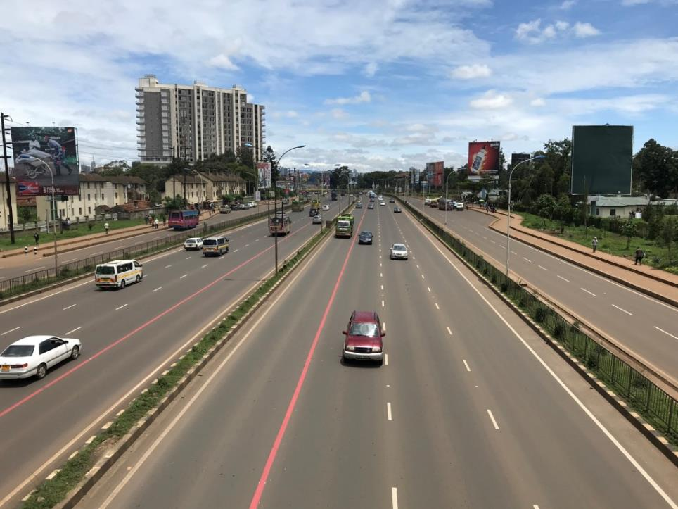
Thika Rd: Existing

Slide 30
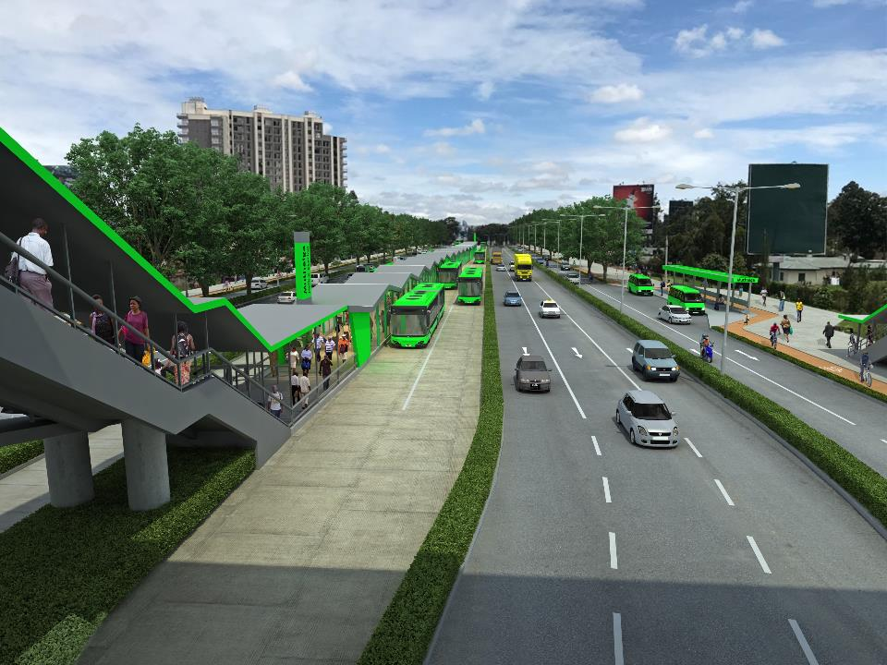
Thika Rd: Proposed

Slide 31
Mombasa Service scenarios

Slide 32
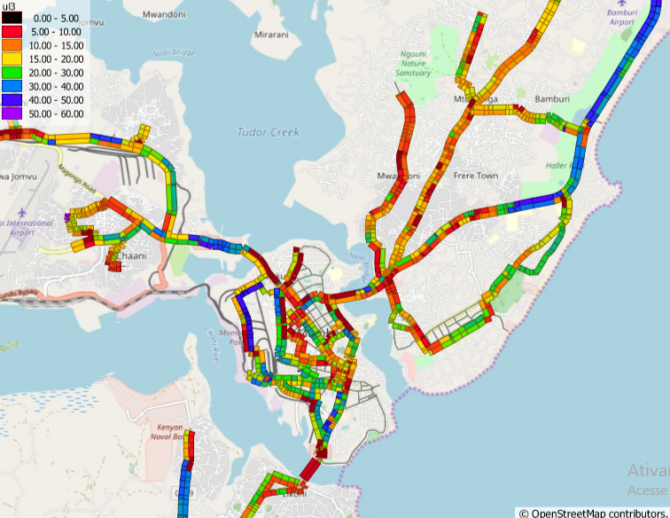
Public transport speeds

Slide 33
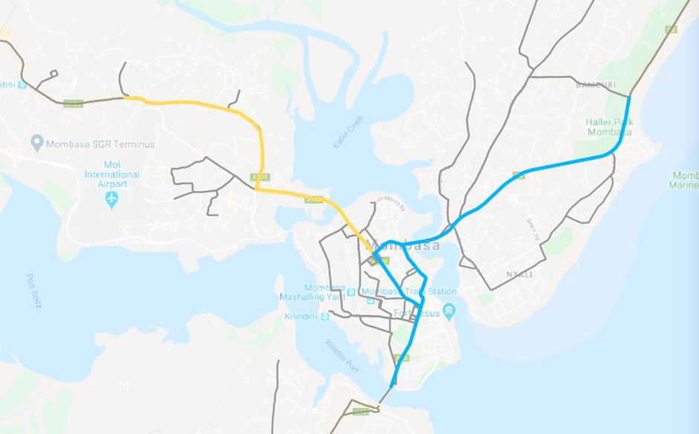
BRT corridor identification
Miritini
Jomvu
Bamburi
Phase 2
Bombolulu
Changamwe
Kongowea
Phase 1
Posta
Ferry

Slide 34
Service scenarios
Scenario 1
Scenario 2
Infrastructure: Phase 1
BRT services: Northern routes
Infrastructure: Phase 1
BRT services: Northern and western routes

Slide 35
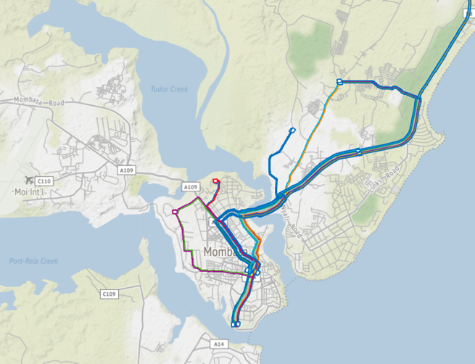
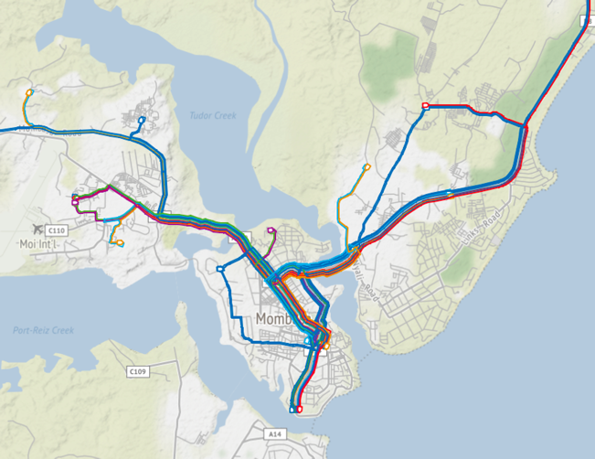
Service scenario results
 | Scenario 1 | Scenario 2
Description | Northern routes | Northern & western routes
BRT services | 9 | 16
Fleet size (12 m; without reserve) | 160 | 232
Daily boardings | 197,000 | 245,000

Slide 36
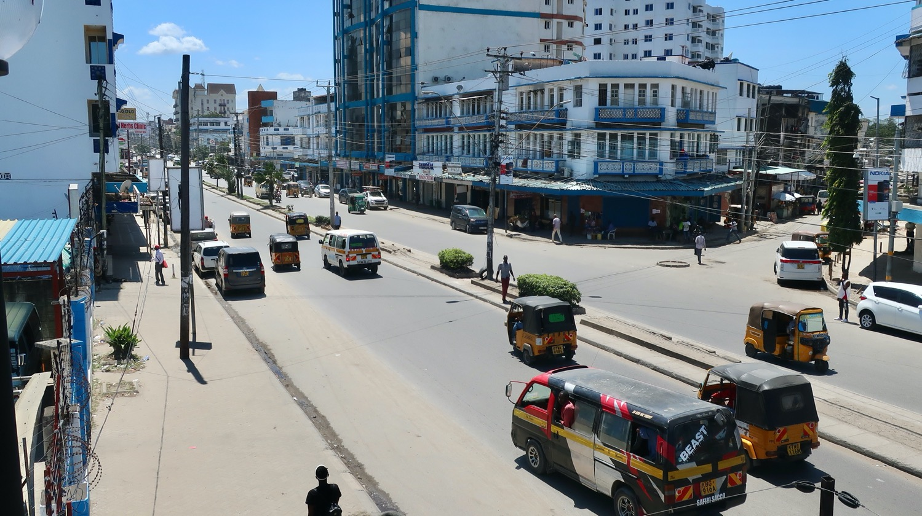
Kanisani - Before

Slide 37
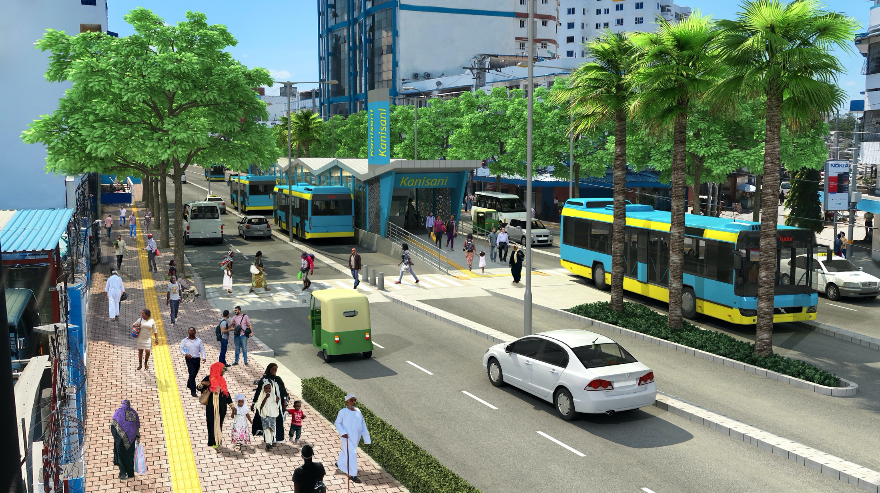
Kanisani - After

Slide 38
Lights - Existing

Slide 39
Lights - Alternate

Slide 40
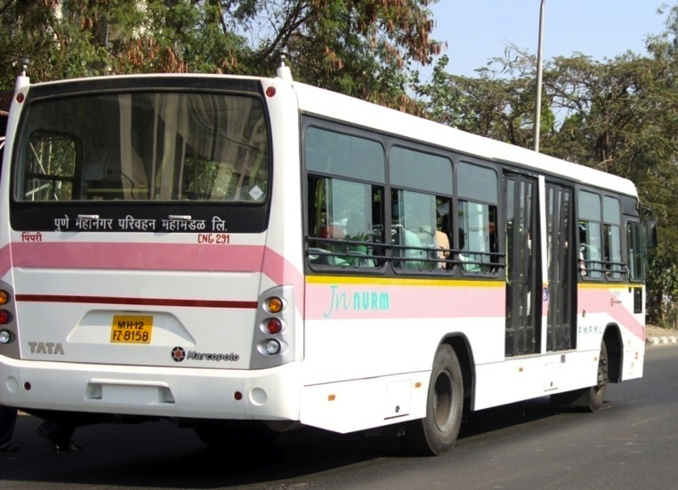
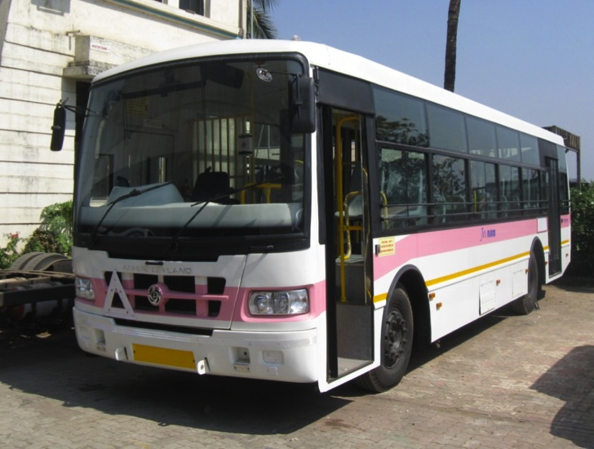
Buses equipped to provide direct services
Right-side level boarding at BRT stations
Left-side stepped boarding off the BRT corridor

Slide 41
BRT line 3

Slide 42
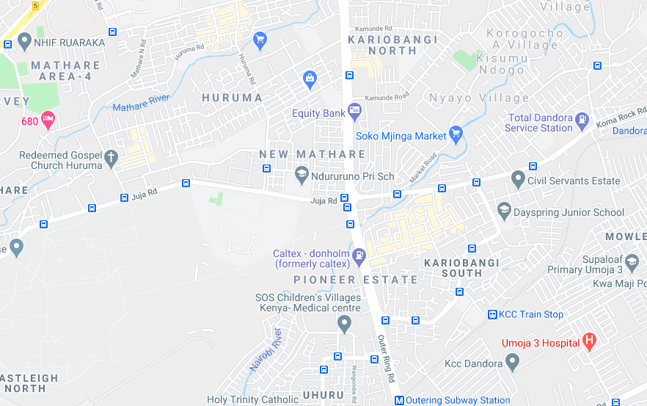
Dandora, Kariobangi, Pioneer & Mathare
1,500
2,600
1,100
3,600
1,100
13,000
2,200
5,200

Slide 43
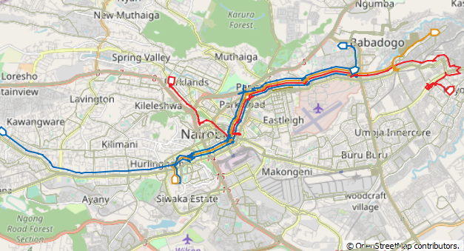
BRT Line 3 route itineraries

Slide 44
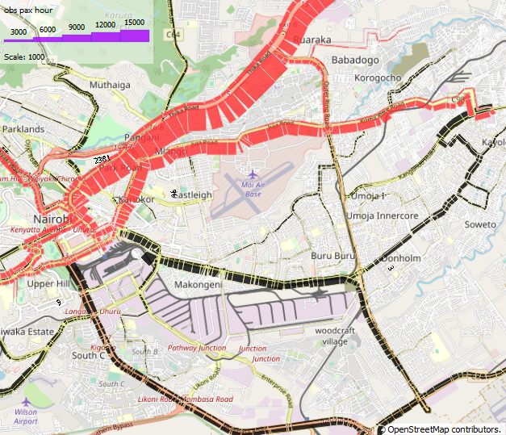
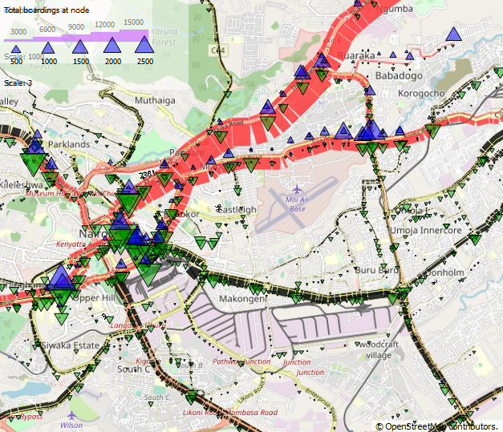
Juja Rd. only
Max load 16,000 pphpd
Thika road 29,000 pphpd

Slide 45
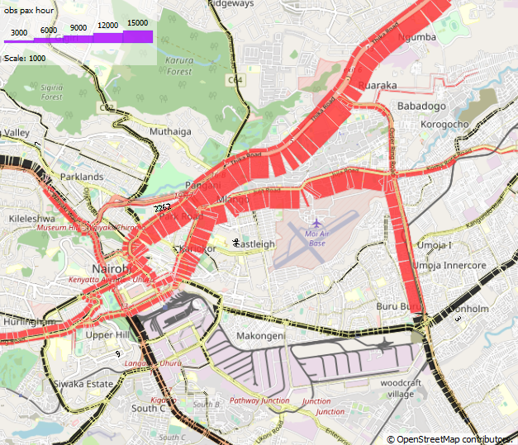
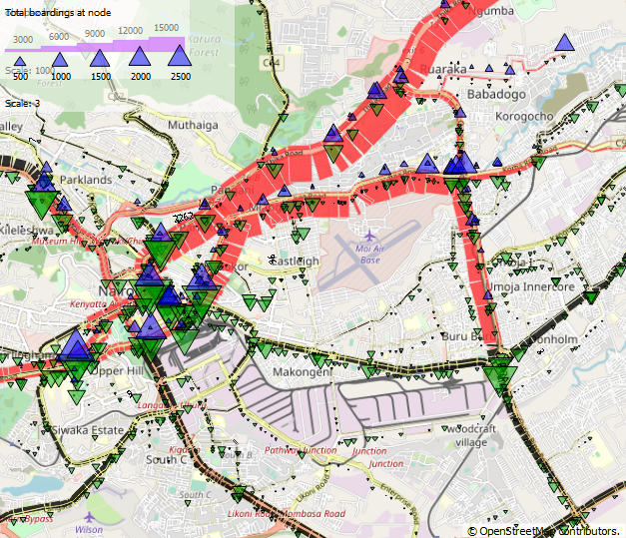
Juja Rd. and Outer Ring Rd.
Max load 23,000 pphpd
Thika road 29,000 pphpd

Slide 46
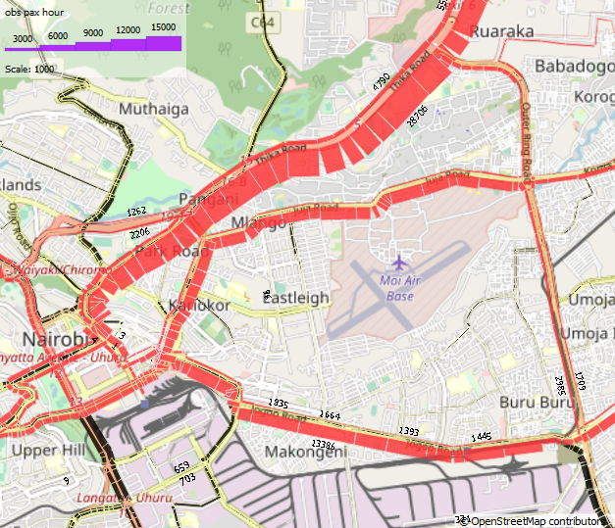
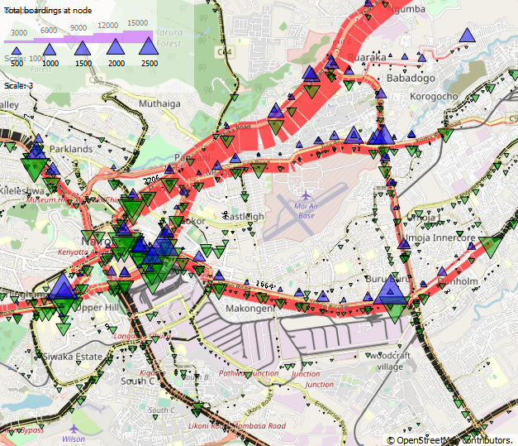
Juja Rd. Outer Ring Rd. and Jogoo Rd
Max load 14,000 pphpd
Thika road 29,000 pphpd

Slide 47
Nairbi CBD matatu scenarios

Slide 48
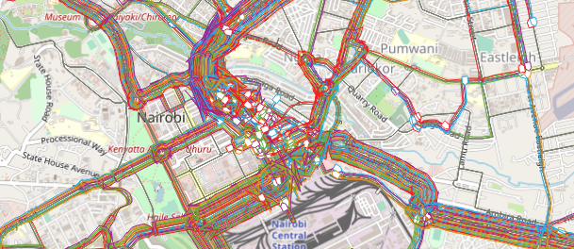
Alternatives to CBD matatu ban
Existing public transport network in Nairobi city centre

Slide 49
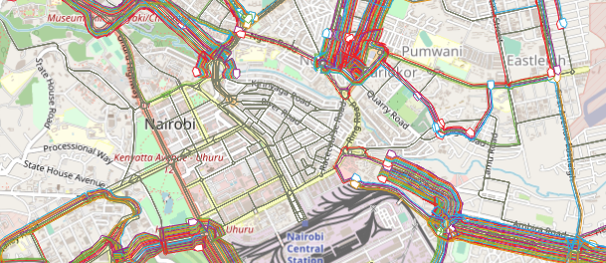
Alternatives to CBD matatu ban
Proposed matatu ban: No public transport service to Nairobi CBD
Average walking time for passengers who transfer in the CBD would increase from 15 to 31 min

Slide 50
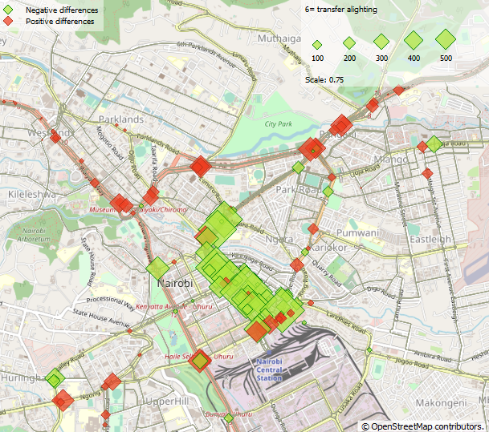
Instead of a ban, introduce cross-town matatu services
Public transport continues to operate in CBD
27 new cross-town routes would carry 43% of demand
156,000 fewer transfers per day compared to matatu ban scenario
Reduction in matatu volumes in CBD due to cross-town services
Change in boarding activity: Green = decrease; red = increase

Slide 51
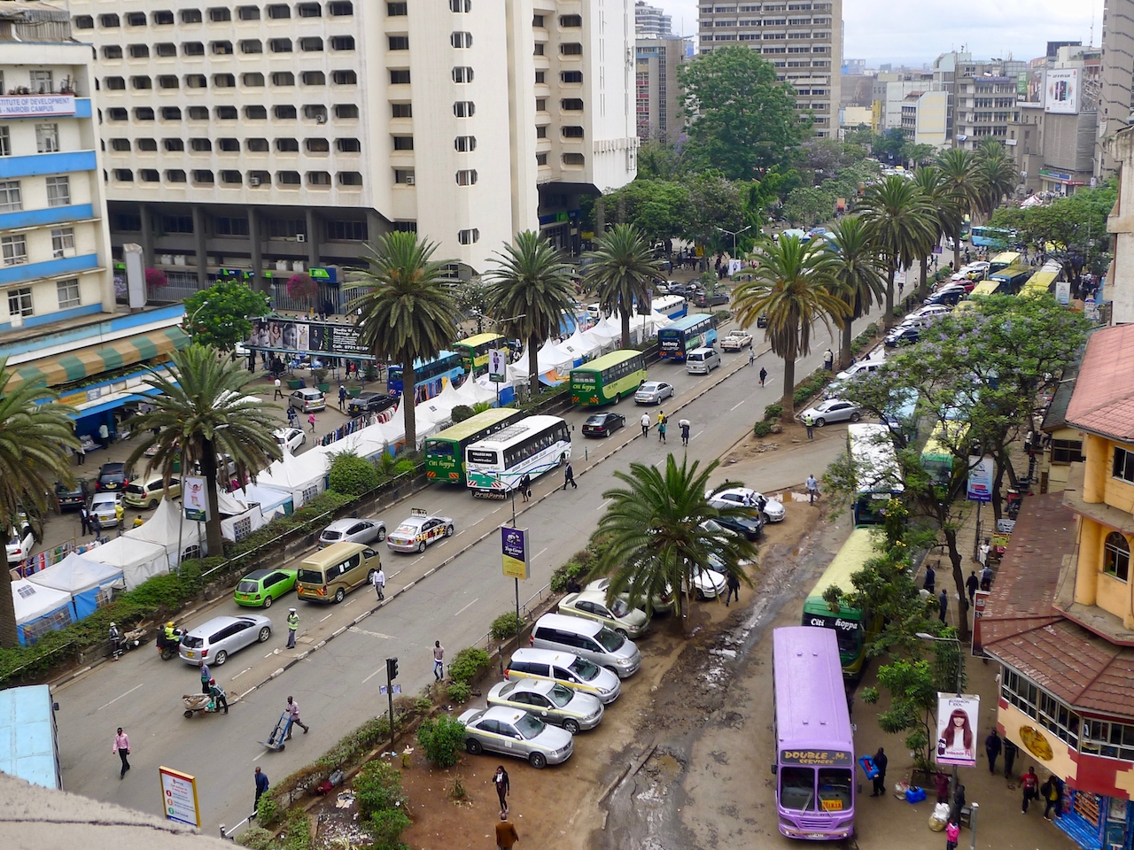
Moi Ave, Nairobi - existing

Slide 52
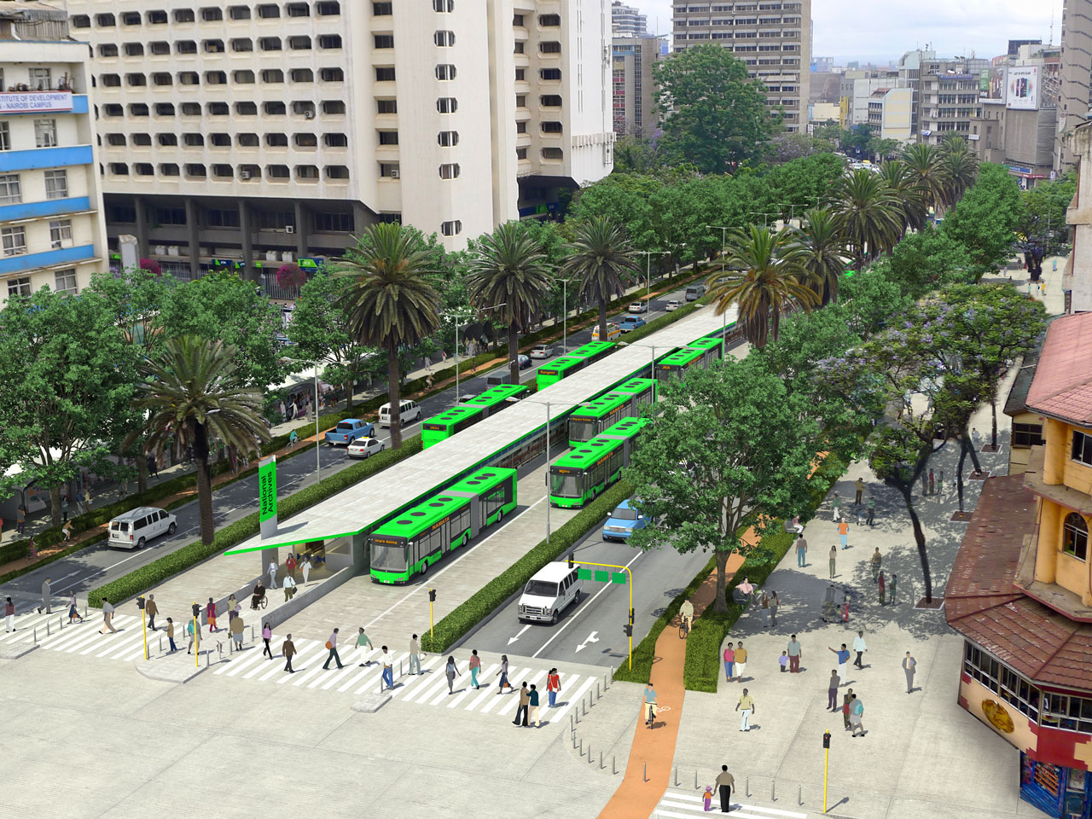
Moi Ave, Nairobi - proposed

Slide 53
Thank you
africa@itdp.org

